Slide 1



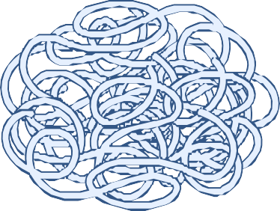


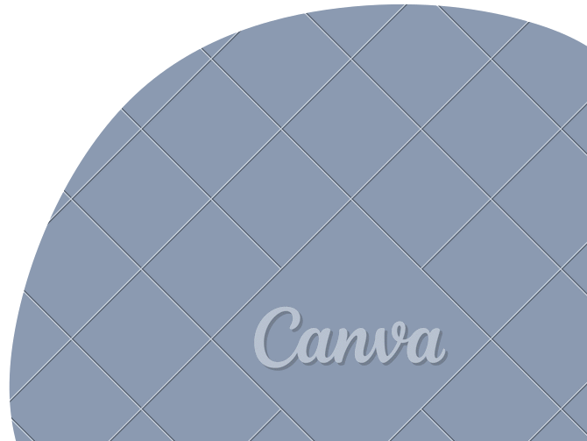





“My Brain is Like Cooked Spaghetti”:
Designing Intelligent Interface with GenAI for Everyday ADHD support in Adults
Moath Erqsous, Victoria Nikolaeva, Liam Roth, Xander Clawson, & Matthew Louis Mauriello
Presented by: Victoria Nikolaeva September 2nd, 2026
MobileHCI 2026

Slide 2


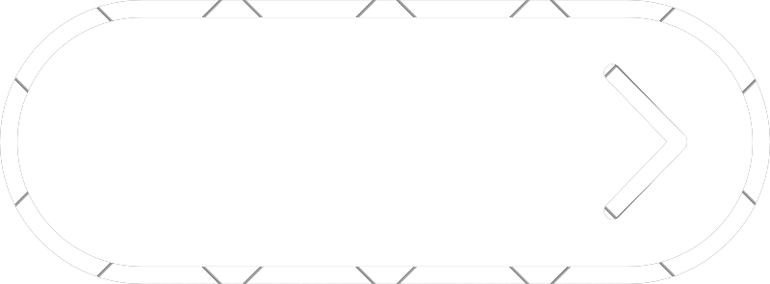
Content
1. Background & Motivation
Research Questions
Methodology
Findings
Discussion
Conclusion
University of Delaware
Sensify Lab
MobileHCI 2026

Slide 3

Why Study ADHD & Mental Health Tech?
Background & Motivation
ADHD affects millions of adults.
Approximately 15 million U.S. adults live with ADHD ADHD commonly co-occurs with anxiety and depression
Barkley’s Adults with ADHD experience difficulties with:
Task initiation
Planning and prioritization Working memory
Time management Sustaining attention
Translating intention into action
Traditional mental health care remains difficult to access & current technologies fall short due to:
Adults with ADHD are rarely involved in designing technologies intended for them.
Focus on Children
Poor Long-Term Engagement
Adults with ADHD struggle with maintaining long-term user engagement
Current technology lacks the ability to personalize the experience to ensure the user needs.
Too Generic
Features Behind Paywall
Many applications current lock meaningful features behind paywalls that are restrictive
Barkley, R. A., & Barkley, R. A. (1998). Attention-deficit hyperactivity disorder: A handbook for diagnosis and treatment(Vol. 2). New York: Guilford press.
Jerica Koh, Germaine YQ Tng, and Andree Hartanto. 2022. Potential and pitfalls of mobile mental health apps in traditional treatment: an umbrella review. Journal of Personalized Medicine 12, 9 (2022), 1376.
University of Delaware

Slide 4



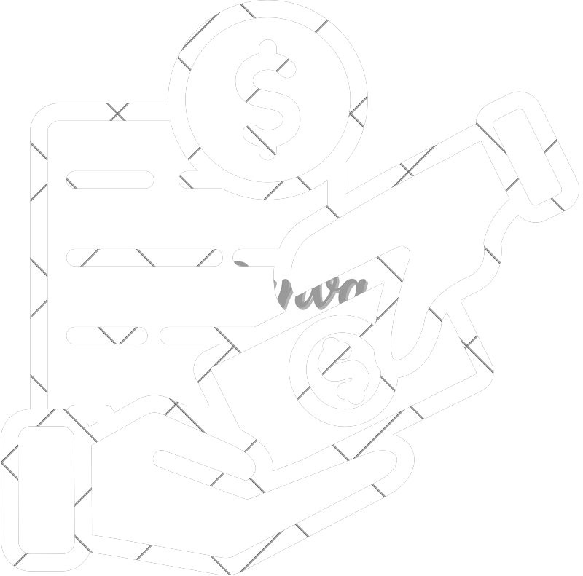
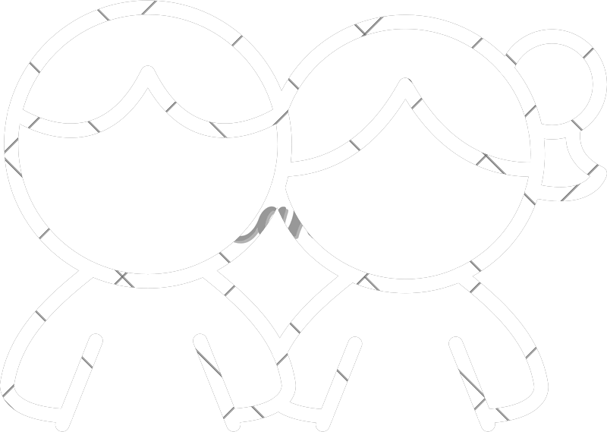
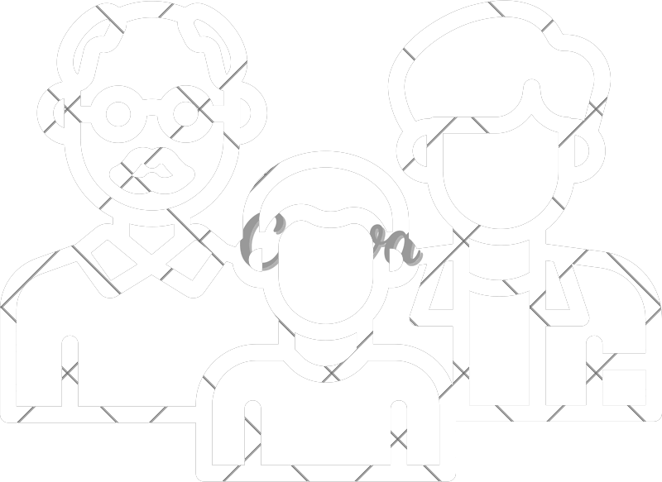
How is Existing Technology Fall Short?
Background & Motivation
Current ADHD technology has important limitations:
Focus on Children
Adults with ADHD are rarely involved in designing technologies intended for them.
Poor Long-Term Engagement
Adults with ADHD struggle with maintaining long-term user engagement
Too Generic
Current technology lacks the ability to personalize the experience to ensure the user needs.
Features Behind Paywall
Many applications current lock meaningful features behind paywalls that are restrictive
University of Delaware

Slide 5

Research Questions
Background & Motivation
RQ1
How do adults with ADHD experience & navigate mental health mobile apps in everyday life?
RQ2
What factors shape trust & sustained engagement in ADHD mobile app
design?
RQ3
How do adults with ADHD percieve GenAI mental health applications?
University of Delaware

Slide 6
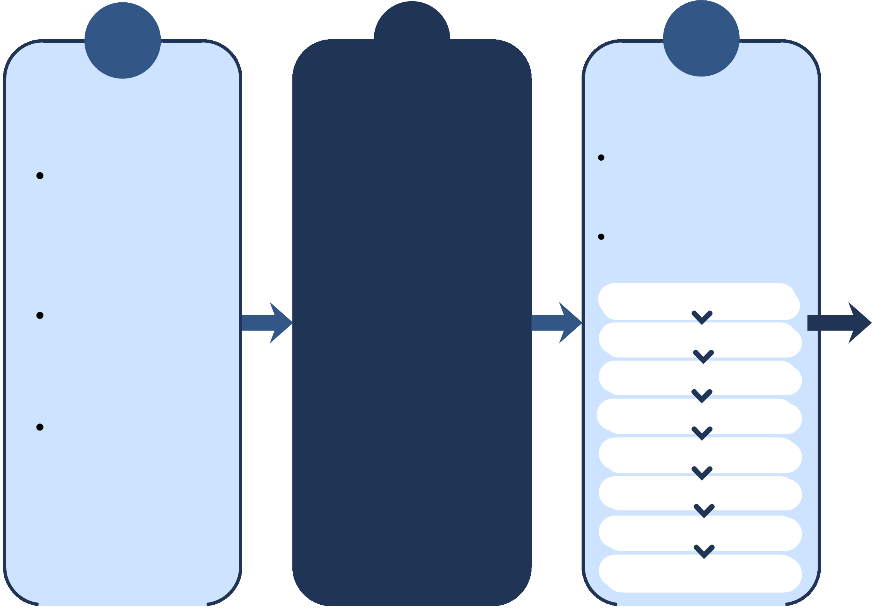
Study Design
Methodology
1
Preparation & Background Review
Review ADHD literature related to excutive function challenges
3
4
Prototype Walkthrough
Participants interact with the prototype
5
Analysis & Design Insight
Thematic analysis of interview and feedbak data
Interviews
Recruit 17 adults diagnosed with ADHD
Conduct semi-structured interviews
Introduction/Consent
Think-aloud and guided walkthrough of key features
Identify five key design priorities
Review exisiting digital interventions and AI tools
App Experience & Interaction
Percieved Effectiveness
Generate design recommendations for the propsesed systems
Identify gaps and information study focus and interview guide
Usability, Trust, & Preferences
Gather feedback on usability, usefulness, and missing features
Challenges & Design Opportunity
Dove Chat Prototype Walkthrough
Prototype Feedback
Conclusion
University of Delaware

Slide 7



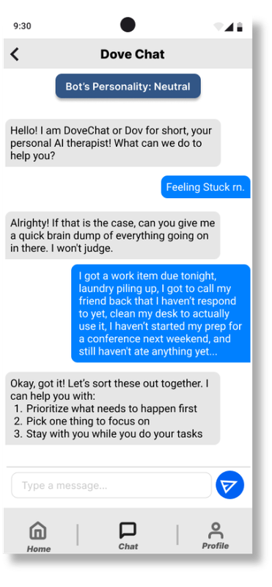
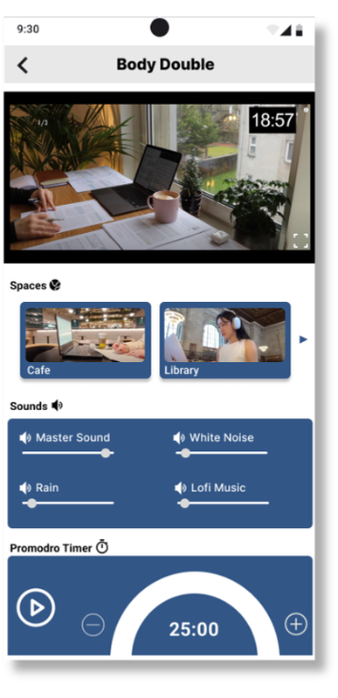
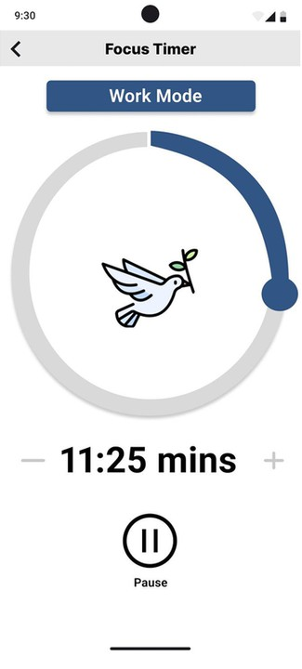
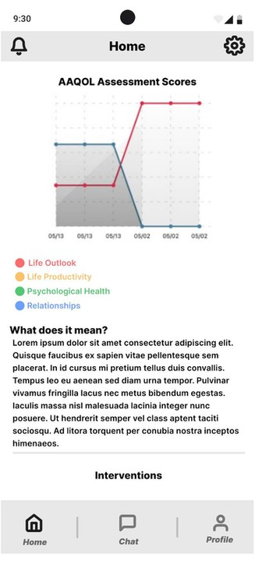

Methodology
Mid-Fidelity Prototype
Option: Body Double
Option: Focus Timer
Assessment (ft. AAQoL)
Prototype AI Chat
University of Delaware

Slide 8
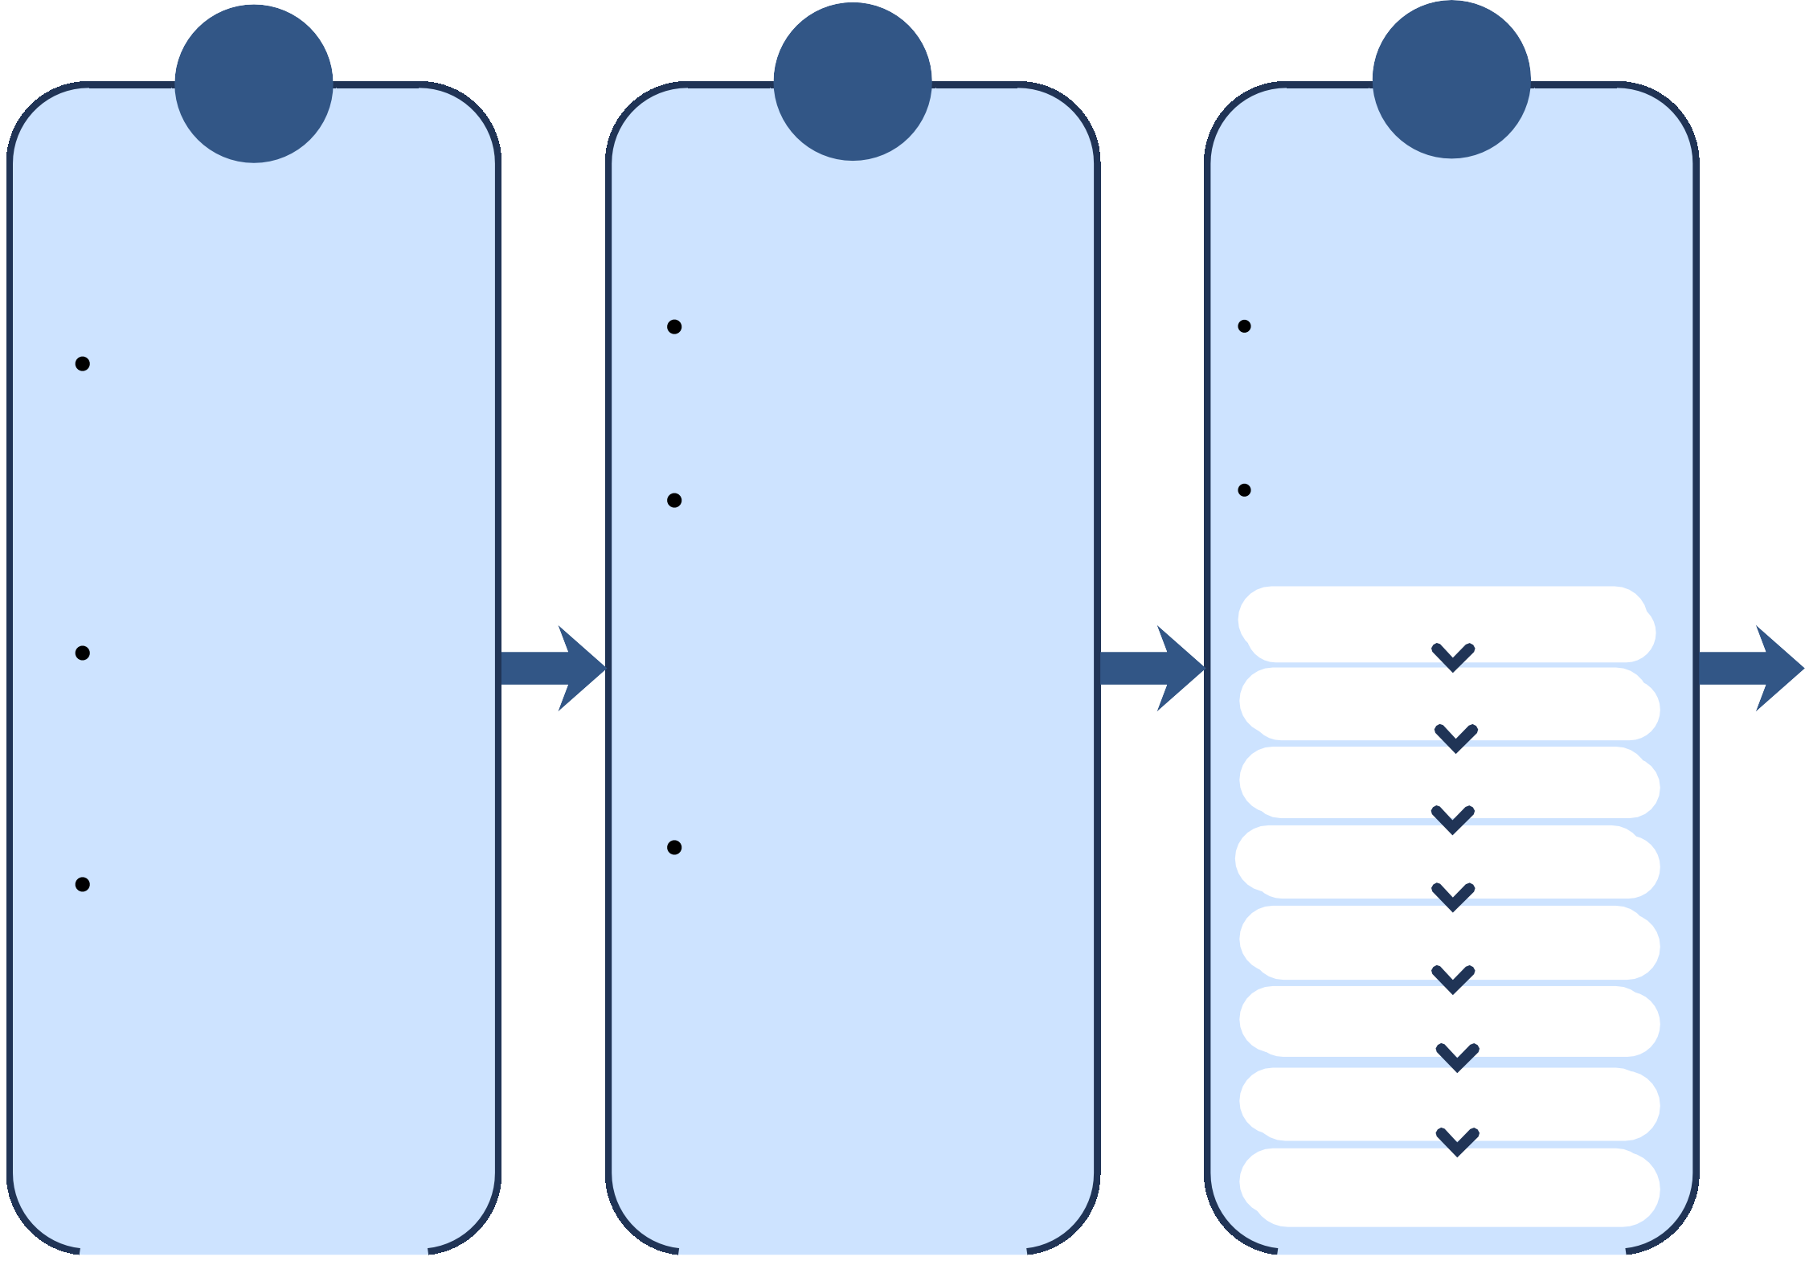
Study Design
Methodology
1
Preparation & Background Review
Review ADHD literature related to excutive function challenges
2
Prototype Design
Design mid-fidelity prototye in Figmia
3
4
Prototype Walkthrough
Participants interact with the prototype
5
Analysis & Design Insight
Thematic analysis of interview and feedbak data
Interviews
Recruit 17 adults diagnosed with ADHD
Core Features: chatbot, body double workspace, focus timer, AAQoL integration
Conduct semi-structured interviews
Introduction/Consent
Think-aloud and guided walkthrough of key features
Identify five key design priorities
Review exisiting digital interventions and AI tools
App Experience & Interaction
Percieved Effectiveness
Generate design recommendations for the propsesed systems
Ensure design reflects findings from literature and exisiting tools
Usability, Trust, & Preferences
Identify gaps and information study focus and interview guide
Gather feedback on usability, usefulness, and missing features
Challenges & Design Opportunity
Dove Chat Prototype Walkthrough
Prototype Feedback
Conclusion
University of Delaware

Slide 9
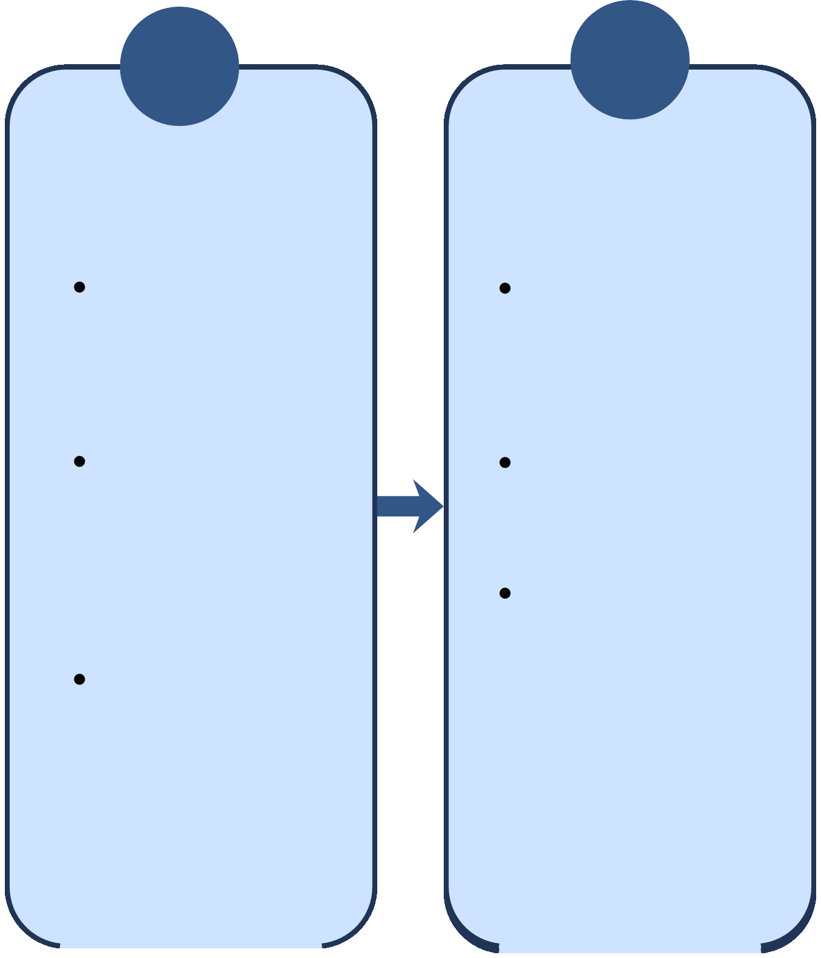
Study Design
Methodology
1
Preparation & Background Review
Review ADHD literature related to excutive function challenges
2
Prototype Design
Design mid-fidelity prototye in Figmia
3
4
Prototype Walkthrough
Participants interact with the prototype
5
Analysis & Design Insight
Thematic analysis of interview and feedbak data
Interviews
Recruit 17 adults diagnosed with ADHD
Core Features: chatbot, body double workspace, focus timer, AAQoL integration
Conduct semi-structured interviews
Introduction/Consent
Think-aloud and guided walkthrough of key features
Identify five key design priorities
Review exisiting digital interventions and AI tools
App Experience & Interaction
Percieved Effectiveness
Generate design recommendations for the propsesed systems
Ensure design reflects findings from literature and exisiting tools
Usability, Trust, & Preferences
Identify gaps and information study focus and interview guide
Gather feedback on usability, usefulness, and missing features
Challenges & Design Opportunity
Dove Chat Prototype Walkthrough
Prototype Feedback
Conclusion
University of Delaware

Slide 10
Study Design
Methodology
1
Preparation & Background Review
Review ADHD literature related to excutive function challenges
2
Prototype Design
Design mid-fidelity prototye in Figmia
3
4
Prototype Walkthrough
Participants interact with the prototype
5
Analysis & Design Insight
Thematic analysis of interview and feedbak data
Interviews
Recruit 17 adults diagnosed with ADHD
Core Features: chatbot, body double workspace, focus timer, AAQoL integration
Conduct semi-structured interviews
Introduction/Consent
Think-aloud and guided walkthrough of key features
Identify five key design priorities
Review exisiting digital interventions and AI tools
App Experience & Interaction
Percieved Effectiveness
Generate design recommendations for the propsesed systems
Ensure design reflects findings from literature and exisiting tools
Usability, Trust, & Preferences
Identify gaps and information study focus and interview guide
Gather feedback on usability, usefulness, and missing features
Challenges & Design Opportunity
Dove Chat Prototype Walkthrough
Prototype Feedback
Conclusion
University of Delaware

Slide 11
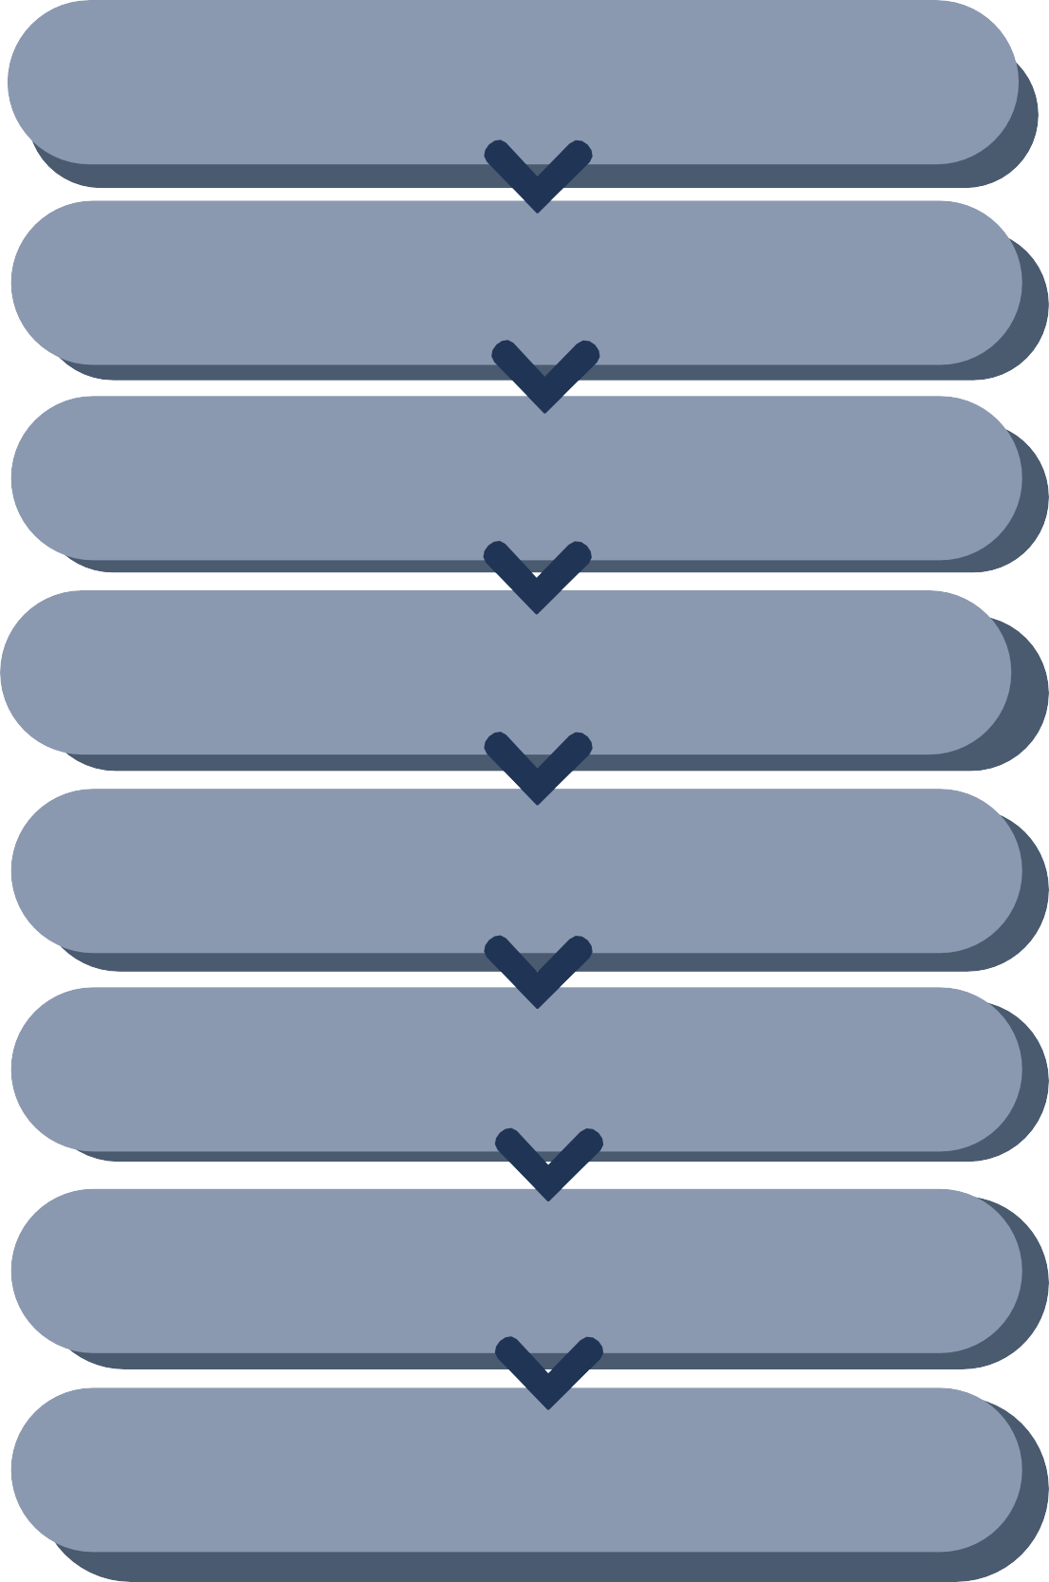
Participants & User Semi Interview Design
Methodology
Introduction/Consent
App Experience & Interaction
Participants
17 adults with ADHD Age 18+
Resided in the United States
Prior experience using mental health apps
Recruitment
ResearchMatch Social media
Interview duration
30–60 minutes
Conducted remotely via Zoom
Percieved Effectiveness
Usability, Trust, & Preferences
Challenges & Design Opportunity
Dove Chat Prototype Walkthrough
Prototype Feedback
Conclusion
User Semi Interview Design
University of Delaware

Slide 12
Methodology
Intervention Foundation from ADHD Literature
Intervention | Targeted Symptoms | Supporting Literature
Chatbot Support | Emotional dysregulation, inattentiveness, task initiation | Chen et al. [1]
Body Double Workspace | Task initiation, sustained attention, isolation, emotional regulation | Eagle et al. [2]
Focus Timer | Procrastination, time mismanagement, inattentiveness | Nakashima et al. [3]
AAQoL Integration | Longitudinal quality-of-life monitoring | Bord et al. [4]
Yirong Chen et al. Soulchat: Improving llms’ empathy, listening, and comfort abilities through fine-tuning with multi-turn empathy conversations.
Tessa Eagle st al. “it was something i naturally found worked and heard about later”: An investigation of body doubling with neurodivergent participants.
Misuzu Nakashima et al. Efficacy of group cognitive behavior therapy targeting time management for adults with attention deficit/hyperactivity disorder in japan
Meryl Brod et al. Validation of the adult attention-deficit/hyperactivity disorder quality-of-life scale (aaqol): a disease-specific quality-of-life measure.
University of Delaware

Slide 13
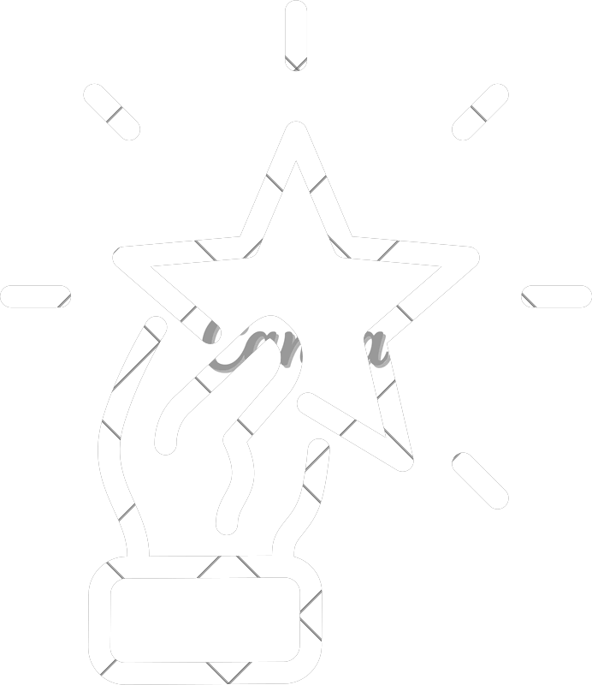
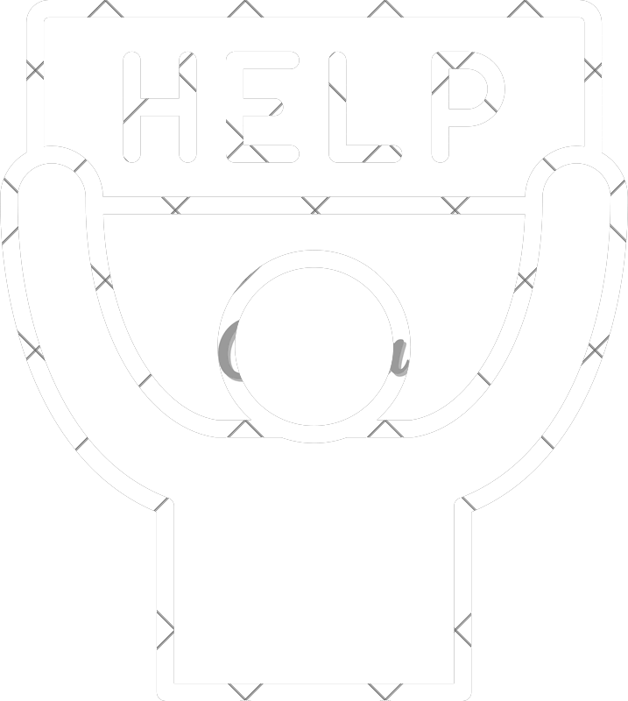

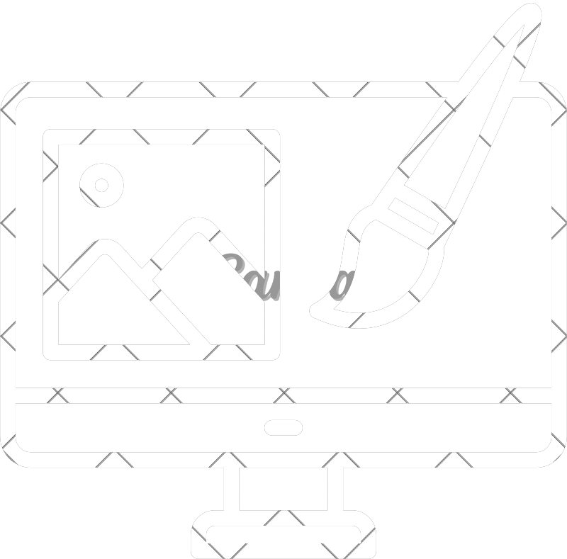

Result Overview
Findings
1
3
5
4
2
Motivations for Using Mental Health Apps
What Makes Apps Feel Helpful
Use of Generative AI
Participants-Identified Design Opportunities
Barriers to Sustained Engagement
University of Delaware

Slide 14






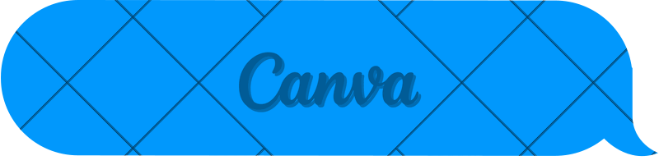
Findings
Motivations for Using Mental Health Apps
Why do Adults with ADHD seek Mental Health Apps?
Diagnosed in Adulthood 31.2%
Common Motivations: Managing ADHD symptoms Improving Organization
Supporting Emotional Well-Being Building Healthier Routines
Diagnosed during Childhood
68.8%
Diagnosis Background
Participants found apps through: Google Search
Social Media Therapists Friends & Family Reddit
University of Delaware

Slide 15
Barriers to Sustained Engagement
Findings
60
Why Do Users Stop Using Mental Health Apps?
Financial barriers (53%)
Subscription costs and locked features discouraged continued use.
53
50
40
Generic experiences (29%)
Apps often failed to address ADHD-specific needs.
30
29
29
Notification fatigue (29%)
Frequent reminders became frustrating.
"Don't tell me what to do, App." (P13)
Loss of interest (24%)
Participants described repetitive experiences that became boring over time.
24
20
10
0
Cost
Generic Design
Boredom
Notiﬁcations
University of Delaware

Slide 16
Participant-Identified Design Opportunities
Findings
What did participants want future apps to include?
Minimal Interfaces
Calendar Integration
Better Design
Organization
Timers
Personalization
Peer Support
Adaptive Reminders
Improvements
Privacy Controls
Progress Indicators
Trust
Motivation
Data Sharing Preferences
Visual Rewards
Saftey Resources
Achievement Feedback
University of Delaware

Slide 17
Use of Generative AI
Findings
88% of participants reported using Generative AI as Everyday ADHD Support
Most Common Uses: Structure their schedules,
Create actionable to-do lists Break deadlines into smaller steps
Externalize planning demands
“ChatGPT really helps me organize my thoughts… My brain is like cooked spaghetti, and ChatGPT helps me put things back in order.” (P6)
Most Common Concerns: Privacy
Trust
Emotional dependence Distraction
“I’ve seen a couple news stories about ChatGPT feeding into people’s delusions… I don’t like the idea of AI.” (P13)
University of Delaware

Slide 18
Prototype Evaluation
Findings
Participants left feedback on the protoype with variety of opinions:
AI Chatbot
Participants appreciated Task organization Prioritization Accountability Simple interface
Body Double
Positive
Accountability Ambient environments White noise
Focus Timer
Helpful for
Structuring work Managing breaks
AAQol Assessment
Mixed opinions
Some valued reflection. Others questioned
Necessity Timing Integration
Participants also requested reminder functionality.
Requested
Greater personalization Human oversight Increased transparency
Concerns
Potential distraction Simulated environments
University of Delaware

Slide 19


Key Findings Summary
Findings
Adults with ADHD frequently rely on technology for everyday support.
Existing mental health apps often fail to address ADHD-specific needs.
Built-in phone tools frequently outperform dedicated ADHD apps.
Generative AI is already being used as an informal productivity and organizational tool
.Future technologies should prioritize: a. Personalization
b. Simplicity c. Trust
d. Integration with everyday workflows
University of Delaware

Slide 20



Discussion Key Insights
Discussion
Adults with ADHD seek technologies designed for their needs.
Four key insights emerged:
1
2
Social media recommendations often misrepresent app usefulness.
Adults with ADHD need tailored, adaptive technologies.
3
4
GenAI currently fills gaps left by existing mental health apps.
Adults already create their own digital support systems.
University of Delaware

Slide 21



Falsification of Social Media Recommendations
Discussion
Participants frequently discovered apps through: Social media
Search engines
However!
Many reported these recommendations failed to meet ADHD-specific needs.
Falsification of Recommendations
A mismatch between how apps are promoted and how useful they are for adults with ADHD
University of Delaware

Slide 22



Adults Need ADHD-Specific Personalization
Discussion
Participants consistently requested: Adaptive reminders Personalized organization Calendar integration
Flexible timers Minimal interfaces
Personalization should adapt rather than simply user preferences.
Attention
Motivation
Emotion
Adaptive AI
University of Delaware

Slide 23
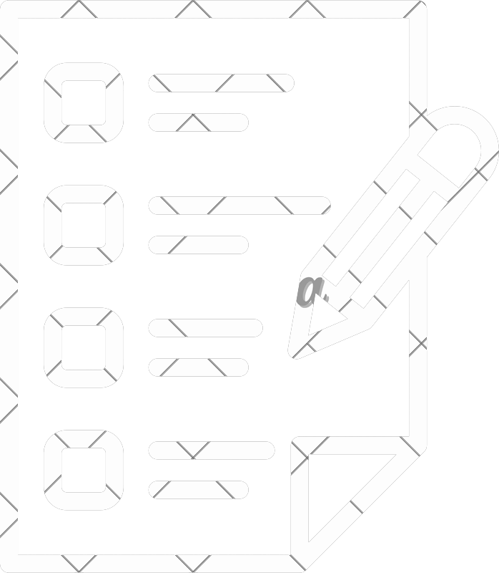
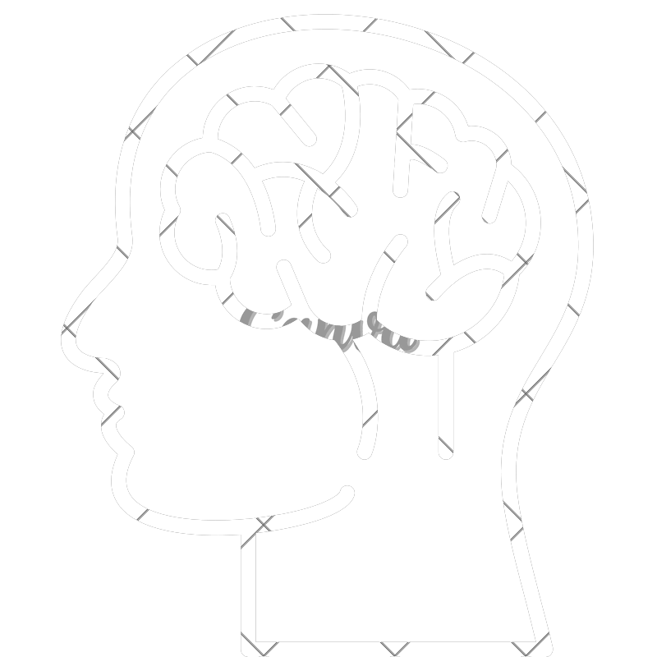

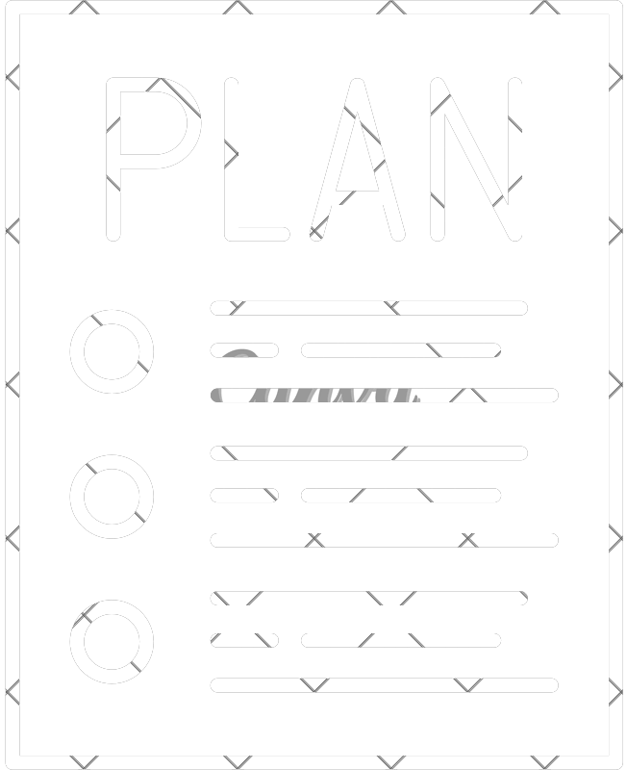
GenAI as a “Stopgap”
Discussion
Participants described ChatGPT as:
Organizational Support
Accountability Partner
Planning Assistant
Brain Dump
GenAI currently fills gaps where existing ADHD technologies fall short
However, the current limitations of GenAI causes skepticism and reveals both potential and the current shortcomings of it.
University of Delaware

Slide 24

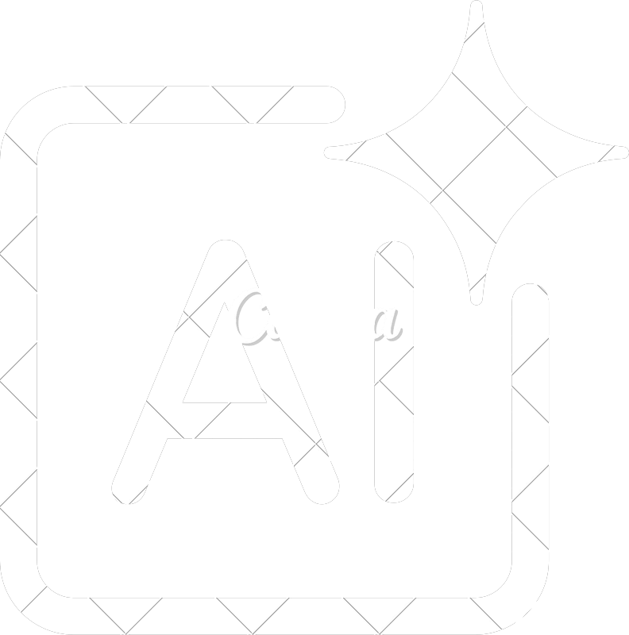
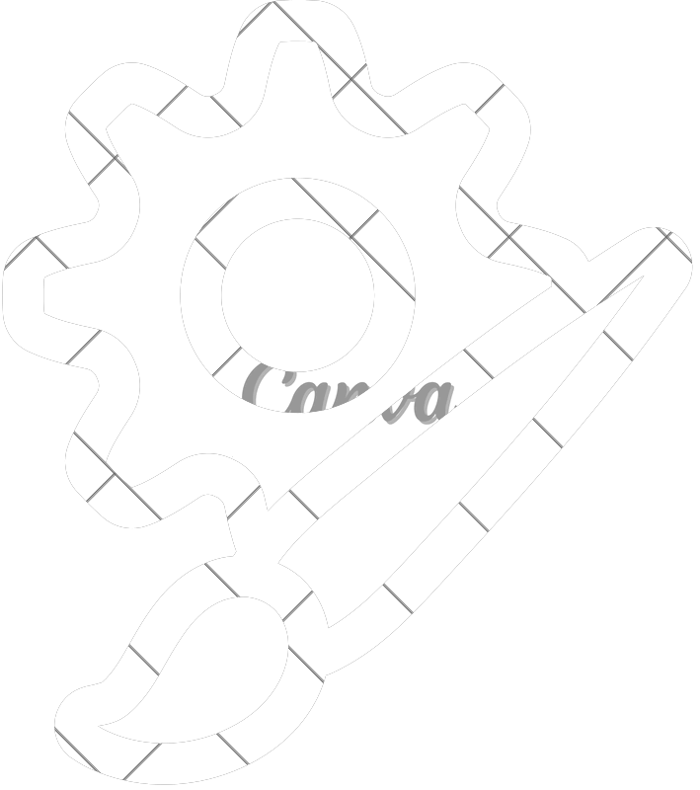



Design Recommendations
Discussion
Five Major Design Priorities:
1
Agentic AI Support
2
Simplicity & Customization
3
Affordable Pricing
4
Transparent Saftey & Crisis Routing
5
Strong Privacy Control
University of Delaware

Slide 25



Limitations & Future Work
Conclusion
Limitations
Several limitations:
Small sample size (17 participants) Self-selection through ResearchMatch and social media Mid-fidelity prototype
Moderated walkthrough rather than real-world deployment Rapidly evolving GenAI landscape
Future Works
Future research include: Larger and more diverse participant groups Longitudinal evaluations Interactive deployments Clinical and community recruitment
Continued evaluation as AI evolves
University of Delaware

Slide 26


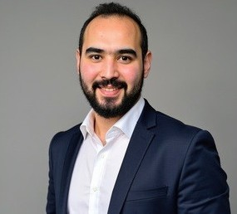
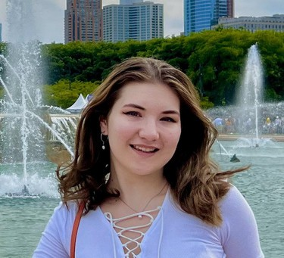



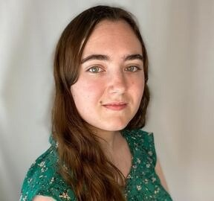
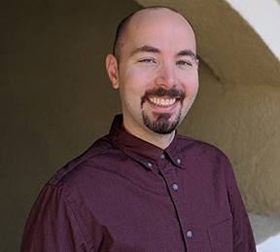

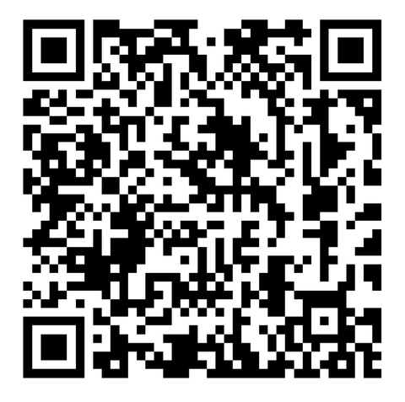



Acknowledgement
Conclusion
Moath Erqsous
Victoria Nikolaeva
Alexander Clawson
Read Full Paper
Meaghan Roth
Matthew Louis Mauriello
Team Members
Enjoyed Your Presenter?
Connect with me on LinkedIn @victoria-nikolaeva04

