Slide 1





When AI Rewrites the News: How Sentiment, Framing, and LLM Disclosure Shape Perceptions
PRERANA KHATIWADA, VARUN PAPPU, BENJAMIN BAGOZZI, & MATTHEW LOUIS MAURIELLO
13, April 2026
Presented by Varun Pappu
University of Delaware
Sensify Lab
Notes:
Good morning everyone!
My name is Varun Pappu, I am an undergraduate student at the University of Delaware and today I’ll be presenting our work titled “When AI Rewrites the News: How Sentiment, Framing, and LLM Disclosure Shape Perceptions”.

Slide 2
Content
1
Background and Motivation
2
Research Goals
3
How We Transformed News Articles
4
Results Overview
5
Insights, Limitations, Future Work
University of Delaware
Sensify Lab
Notes:
I will be following the content outlined here as I go along.

Slide 3
Content
1
Background and Motivation
University of Delaware
Sensify Lab
Notes:
First, let’s get started with Motivation and Background.

Slide 4
Despite the growing adoption of AI-assisted writing, relatively little is known about how algorithmic editorial changes, such as
altering sentiment or reframing arguments affect audience perceptions of fairness, credibility, and trustworthiness
Background and Motivation
Motivation
University of Delaware
Sensify Lab
Notes:
AI-assisted writing is rapidly becoming part of everyday communication, from editing drafts to even reshaping how arguments are presented as a whole. But even as this tool become more common, we still do not fully understand how AI-driven changes in tone or framing affect whether readers see content as fair, credible, or trustworthy.

Slide 5
Prior research shows that media framing and emotional tone influence how audiences interpret political information, shaping perceptions of bias, fairness, and responsibility in news coverage (Entman et al. 1993; Lecheler et al.2013).
Motivation and Background
Background
University of Delaware
Sensify Lab
Notes:
Prior research in political communication and media studies shows that the way news is written, can strongly influence how audiences interpret events.

Slide 6
Studies in political communication demonstrate that sentiment and emotional cues such as anger or negativity can amplify framing effects and influence audience engagement, attitudes, and emotional responses to political content
(Soroka et al.2015; Nelson et al.1997)
Motivation and Background
Background
University of Delaware
Sensify Lab
Notes:
Research has shown that emotionally charged language—such as anger or negativity—can amplify reactions and engagement with political content.

Slide 7
Computational approaches using sentiment analysis and linguistic modeling have been widely used to analyze political discourse, audience reactions, and misinformation, though sentiment alone often fails to capture deeper evaluative meaning or stance
(Khoo et al.2012; Mannan et al.2023).
Motivation and Background
Background
University of Delaware
Sensify Lab
Notes:
At the same time, computational approaches like sentiment analysis have been widely used to analyze political discourse and misinformation, though sentiment alone does not always capture deeper meaning or stance which is especially important for understanding how AI-edited news is perceived.

Slide 8

We aim to investigate how LLM-driven transformations in news—specifically sentiment, framing, and disclosure of LLM modification shape readers’ perceptions of bias, trust, and emotional response.
This involves generating controlled AI-modified news articles, conducting experimental user studies to evaluate audience reactions, and deriving design implications for transparent and trustworthy AI-mediated news systems.
Motivation and Background
What We Did
University of Delaware
Sensify Lab
Notes:
So, to address that gap, we designed a study around controlled LLM-driven transformations of news articles where we varied sentiment, framing, and disclosure of LLM modifications, then measured how those changes influenced readers’ perceptions.
We then used those results to draw design implications for more transparent and trustworthy AI-mediated news systems.

Slide 9
Content
2
Research Goals/Questions
University of Delaware
Sensify Lab
Notes:
Next, I’ll move into the research goals and the main questions guiding this study.

Slide 10

Understand How Sentiment and Framing Shape News Perceptions
Research Goals/Questions
Dataset Curation
LLM-Based Article Transformation
Sentiment & Framing Validation
How do emotional tone (sentiment) and news framing influence readers’ perceptions of bias, trust, and emotional engagement with news?
RQ1
University of Delaware
Sensify Lab
Notes:
Our first research question examines how emotional tone and framing influence readers’ perceptions of bias, trust, and emotional engagement. To study this, we curated a set of news articles and used large language models to generate different versions with varying sentiment and framing, while keeping the underlying facts consistent.

Slide 11
Isolate the Effect of Framing on News Perceptions
Research Goals/Questions
Controlled Experimental Design
Participant Evaluation Surveys
Comparative Analysis of Framing Effects
When sentiment is held
constant, what role does framing play in shaping perceptions of bias,
trust, and balance?
RQ2
University of Delaware
Sensify Lab
Notes:
Our second research question focuses specifically on the role of framing on reader’s perceptions of bias, trust, and balance. And, by comparing responses across conditions, we were able to better isolate the effect of framing on those perceptions.

Slide 12
Examine How LLM Disclosure Shapes Reader Perceptions
Research Goals/Questions
LLM Disclosure Conditions
Perception and Trust Measurement
Statistical and Mixed-Method Analysis
Extending beyond textual features, how does disclosure that an article was modified by an LLM affect reader perceptions of bias, trust, and engagement?
RQ3
University of Delaware
Sensify Lab
Notes:
Our third research question moves beyond textual features to examine how disclosure of LLM modifications affects readers’ perceptions of bias, trust, and engagement
To study this, we introduced disclosure conditions in which participants were informed that the article had been AI-modified, and we then measured how their perceptions of the article changed.

Slide 13

Research Goals/Questions
If framing drives misinterpretation → surface alternative frames or highlight one-sided narratives.
Guiding Questions
Contributions to the Intervention Design
1. What if framing matters more than sentiment?
2.How should interventions adapt when neutral tone still carries bias?
3. When should explanations vs. contrastive perspectives be shown?
If neutral articles still bias readers → provide missing perspectives or contrastive rationale cues.
University of Delaware
Sensify Lab
Notes:
Beyond measuring changes in perception, we also thought about how these findings could inform the design of interventions for news platforms.
For example, if framing shapes how readers interpret an article, platforms could surface alternative perspectives or highlight one-sided narratives.
These guiding questions help connect our results to the design of future AI-assisted news systems that promote transparency and more thoughtful engagement.

Slide 14
Content
3
How We Transformed Articles
University of Delaware
Sensify Lab
Notes:
With the research questions established, I’ll now explain how we generated the article transformations and the general layout of the experiment.

Slide 15
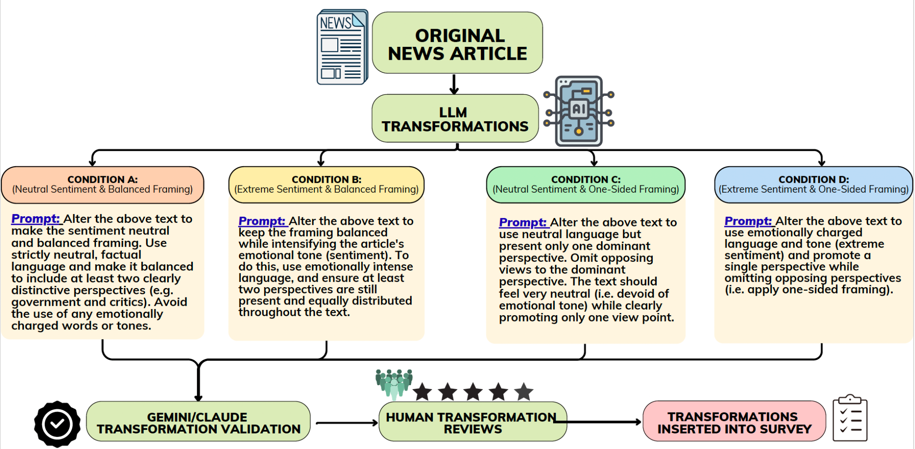
How We Transformed Articles
University of Delaware
Sensify Lab
Notes:
Here is the pipeline we used to transform news articles.
We first selected real news articles from credible sources such as The New York Times, Reuters, and the Associated Press.
CLICK
We then used structured prompts with LLMs, including GPT and Grok, to generate four rewritten versions of each article by manipulating two factors: sentiment, or emotional tone, and narrative framing.
CLICK
To ensure reliability, we validated the generated articles using additional models, including Gemini and Claude, as independent evaluators for cross-validation.

Slide 16
Validation Rubric
How We Transformed Articles
Human Review
Validation
3 Coders: Political Science Experts (Professors & Graduate Students)
Evaluated 3 original + 4 transformed news articles (Best article chosen for experimental use)
Criteria: fluency, faithfulness, tone accuracy, framing clarity, bias, conciseness, overall effectiveness
VADER sentiment analysis
  confirmed tone alignment
Stance entropy
  measured framing diversity (higher = balanced)
Results consistent with human ratings
Human results are included in the full paper—please refer to the full paper for detailed results.
University of Delaware
Sensify Lab
Notes:
To ensure the validity of these transformations, we conducted both human and automated validation.
On the human side, three coders with political science expertise, including professors and graduate students, evaluated the articles based on the criteria shown above.
CLICK
On the automated validation side, we used VADER sentiment analysis to confirm emotional tone alignment and
stance entropy measures to assess framing diversity.
Results were consistent with human ratings, suggesting a robust pipeline for studying additional dimensions. The detailed human study results are reported in the full paper, so I encourage you to refer to that for a more comprehensive analysis

Slide 17
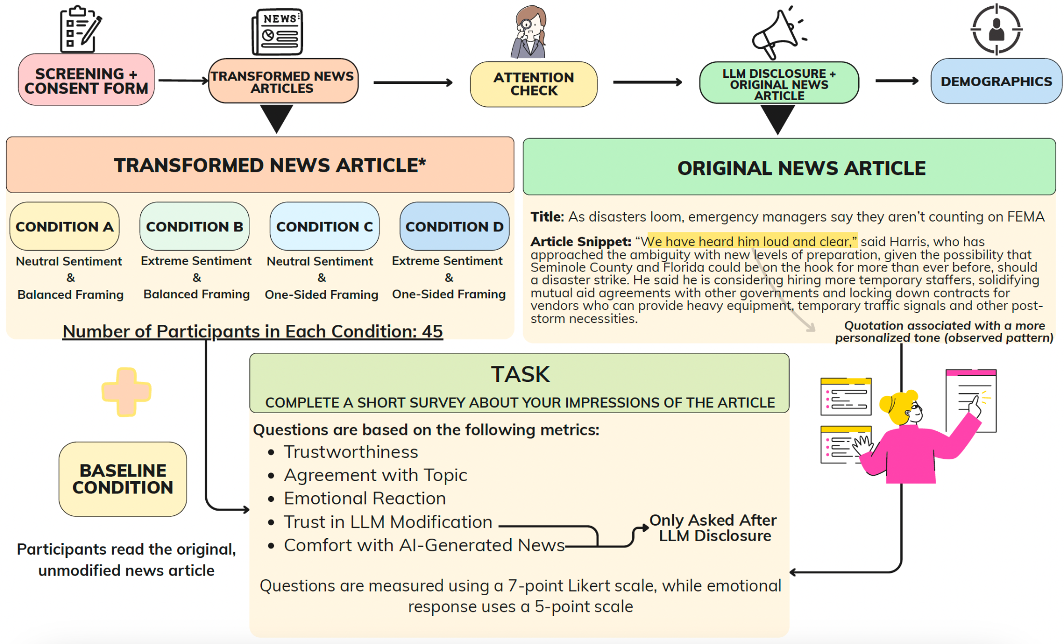
How We Transformed Articles
University of Delaware
Sensify Lab
Notes:
This slide shows our overall survey flow and study design, starting from the article transformation pipeline, through the experimental setup, and finally the survey questions participants answered.

Slide 18
How We Transformed Articles
N = 225 total
Power analysis (G*Power)
Recruitment and Screening
180 in 2×2 design
45 baseline
  original article
(G*Power): f = 0.25, α = .05, power = .80
180 needed (45 per condition)
U.S. MTurk, August 2025
Weekday business-hour batches
Qualifications:
  Age ≥ 18, regular online news reader, English proficiency
University of Delaware
Sensify Lab
Notes:
Our study included 225 participants recruited from Amazon Mechanical Turk in August 2025. The experiment used a 2×2 design, with 180 participants distributed across four conditions, plus an additional baseline group of 45 participants who read the original article.
CLICK
Power analysis using G*Power confirmed that our sample size was sufficient to detect medium effect sizes.
CLICK
Participants were required to be adult English-speaking individuals who regularly read online news.

Slide 19
Content
4
Results Overview
What Actually Happens When AI Rewrites the News?
University of Delaware
Sensify Lab
Notes:
Now I’ll move into the results and what we actually found when AI rewrites the news

Slide 20
Key Findings
Results Overview
Perceptions were surprisingly stable
Disclosure slightly reduced trust
Sentiment & framing had minimal impact before disclosure
Extreme sentiment increased perceived bias
Framing had little effect
Overall, disclosure did not dramatically change perceptions
University of Delaware
Sensify Lab
Notes:
Here are some of our key findings:

Slide 21
Key Findings
Results Overview
Perceptions were surprisingly stable
Disclosure slightly reduced trust
Sentiment & framing had minimal impact before disclosure
Extreme sentiment increased perceived bias
Framing had little effect
Overall, disclosure did not dramatically change perceptions
University of Delaware
Sensify Lab
Notes:
Perceptions were surprisingly stable: AI-modified articles were rated almost the same as the original article on bias, trustworthiness, and balance.

Slide 22
Key Findings
Results Overview
Perceptions were surprisingly stable
Disclosure slightly reduced trust
Sentiment & framing had minimal impact before disclosure
Extreme sentiment increased perceived bias
Framing had little effect
Overall, disclosure did not dramatically change perceptions
University of Delaware
Sensify Lab
Notes:
Sentiment & framing had minimal impact before disclosure, suggesting that readers did not strongly detect subtle tone or framing manipulations

Slide 23
Key Findings
Results Overview
Perceptions were surprisingly stable
Disclosure slightly reduced trust
Sentiment & framing had minimal impact before disclosure
Extreme sentiment increased perceived bias
Framing had little effect
Overall, disclosure did not dramatically change perceptions
University of Delaware
Sensify Lab
Notes:
Overall, disclosure did not dramatically change perceptions which indicates that transparency alone may have limited influence on how readers evaluate news credibility.

Slide 24
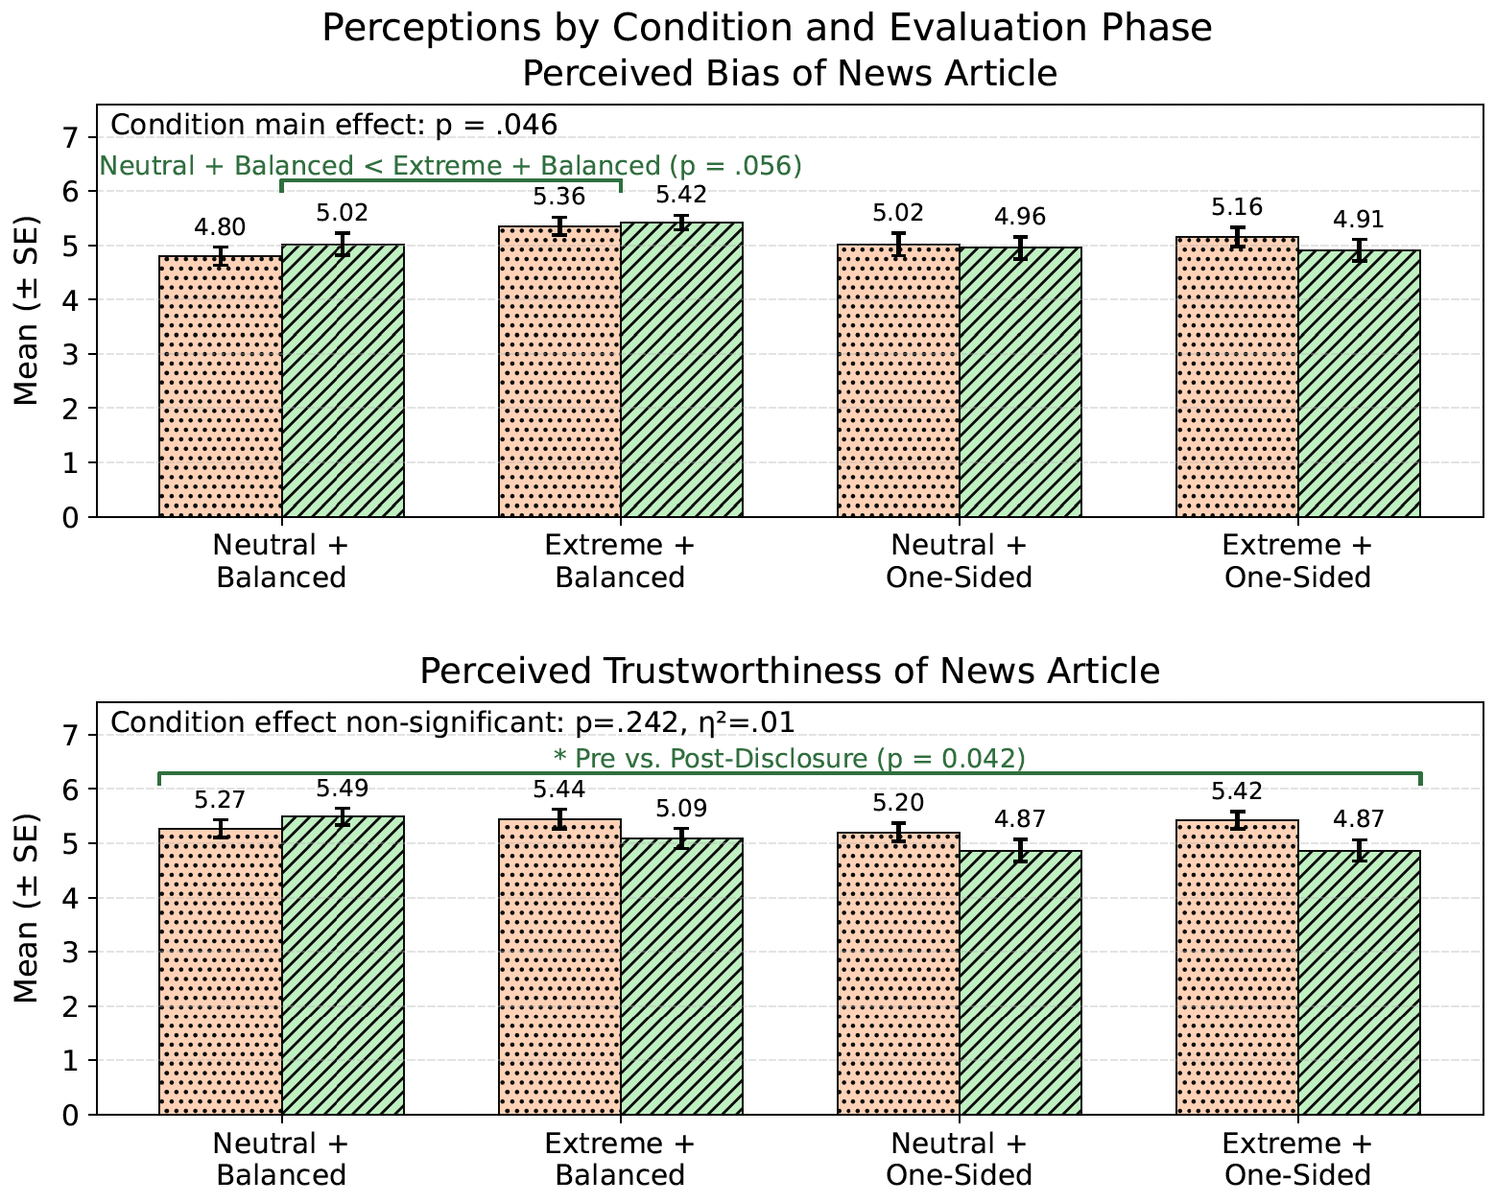
Results Overview
University of Delaware
Sensify Lab
Notes:
To better understand these results, we compared trustworthiness and bias ratings across the four article conditions, both before and after AI disclosure.
Overall, articles with neutral tone and balanced framing showed slightly higher trust ratings, but the differences between article styles were not statistically significant.
However, the disclosure did matter. Trust ratings were slightly higher before participants were told the article was AI-modified, and dropped slightly after disclosure.
For bias perceptions, the main factor was emotional tone. Articles with extreme sentiment were generally perceived as more biased than neutral ones. In contrast, framing, whether balanced or one-sided, had little effect, and AI disclosure did not significantly change bias ratings.

Slide 25
Emotional Reaction Results
Results Overview
Extreme sentiment amplified negative emotions
Disgust (+0.74) and anxiety (+0.69) increased compared to original article, suggesting that emotionally intense language heightens negative feelings
Positive emotions remained stable
Happiness changed little across conditions, indicating that negative emotions were more sensitive to tone changes
AI disclosure did not strongly change emotional reactions
Most emotions remained similar before and after disclosure
Content style mattered more than disclosure
extreme sentiment with balanced framing triggered the strongest negative emotional responses, while extreme one-sided framing reduced positive reactions.
University of Delaware
Sensify Lab
Notes:
While perceptions of bias and trust remained relatively stable, emotional reactions showed clearer differences.
Articles written with extreme sentiment increased negative emotional responses, particularly feelings of disgust and anxiety.

Slide 26
Emotional Reaction Results
Results Overview
Extreme sentiment amplified negative emotions
Disgust (+0.74) and anxiety (+0.69) increased compared to original article, suggesting that emotionally intense language heightens negative feelings
Positive emotions remained stable
Happiness changed little across conditions, indicating that negative emotions were more sensitive to tone changes
AI disclosure did not strongly change emotional reactions
Most emotions remained similar before and after disclosure
Content style mattered more than disclosure
extreme sentiment with balanced framing triggered the strongest negative emotional responses, while extreme one-sided framing reduced positive reactions.
University of Delaware
Sensify Lab
Notes:
On the other side however, positive emotions such as happiness remained relatively stable, indicating that negative emotions were more sensitive to changes in tone.

Slide 27
Emotional Reaction Results
Results Overview
Extreme sentiment amplified negative emotions
Disgust (+0.74) and anxiety (+0.69) increased compared to original article, suggesting that emotionally intense language heightens negative feelings
Positive emotions remained stable
Happiness changed little across conditions, indicating that negative emotions were more sensitive to tone changes
AI disclosure did not strongly change emotional reactions
Most emotions remained similar before and after disclosure
Content style mattered more than disclosure
extreme sentiment with balanced framing triggered the strongest negative emotional responses, while extreme one-sided framing reduced positive reactions.
University of Delaware
Sensify Lab
Notes:
These results suggest that content style and emotional tone influence audience reactions more strongly than disclosure alone.

Slide 28
Perceived Article Modification (Post-Survey)
Results Overview
Participants generally believed AI modifications altered the article
(M = 4.53)
Across all conditions, participants suspected AI edits could influence readers’ opinions
Articles were perceived as moderately partisan overall
(M = 4.73)
Omission of important information was the strongest concern
(M = 4.67)
Subtle modifications sometimes raised more suspicion
University of Delaware
Sensify Lab
Notes:
When asked about AI modifications, participants generally believed that AI editing did change the article in meaningful ways. With ratings above the midpoint (M ≈ 4.53/7), this indicates baseline skepticism toward AI-edited news
CLICK
The participants’ strongest concern with AI editing was the omission of important information, with the next largest concerns being introducing bias (M = 4.61) and changes to the main message (M = 4.60)
CLICK
Across all conditions, participants suspected AI edits could influence readers’ opinions, showcasing a feeling of manipulation and unease about AI edits as a whole
CLICK
There are more observations that have been shown on the slides, and if you would like to hear more about them in more depth please refer to the full paper.

Slide 29
Content
5
Insights, Limitations, Future Work
University of Delaware
Sensify Lab
Notes:
In this final section, I’ll step back from the results and highlight the main insights, the study’s limitations, and where this research could go next.

Slide 30
Design Implications
Key Findings
Contextualized AI Disclosure
Move beyond simple “AI-generated” labels by explaining what was modified and whether human editors verified the content, helping maintain transparency without unnecessarily reducing trust.
Emotion-Aware Highlighting
Use interface cues to highlight emotionally charged or one-sided language, helping readers recognize persuasive tone and engage more critically with the content.
Risk-Aware Moderation
AI systems should detect and soften extreme or inflammatory language while preserving facts, with stronger transparency signals in highly polarized or sensitive topics.
Distortion and Intent Auditing
Provide newsroom tools that flag potential omissions, exaggerations, or agenda-driven language in AI-modified articles, allowing editors to review and maintain credibility before publication.
University of Delaware
Sensify Lab
Notes:
Based on these findings, we propose several design directions for AI-mediated news systems.
First, platforms should move beyond simple “AI-generated” labels and instead provide contextual disclosures, explaining what was modified and whether human editors verified the content.
CLICK
Second, systems could provide emotion-aware highlighting, helping readers recognize emotionally charged or persuasive language.
CLICK
Third, AI tools could incorporate risk-aware moderation, detecting and softening extreme language in highly polarized topics.
CLICK
Finally, newsroom tools could support distortion and intent auditing, helping editors detect omissions, exaggerations, or agenda-driven language before publication.

Slide 31
Limitations
Future Work
Results Overview
Sample bias: MTurk participants were relatively homogeneous, which may limit generalizability to broader populations.
Limited context: The study focused only on sentiment and framing, while real-world news involves other factors like source credibility and media context.
Single article: Using one news article may limit generalization across different topics.
Disclosure scope: Only one form of AI disclosure was tested, leaving other transparency formats unexplored.
Broader datasets: Future work can test multiple news topics and larger datasets to improve generalizability.
Real-world interventions: Future systems could use AI to flag extreme sentiment or one-sided framing and provide multi-perspective summaries to support readers.
University of Delaware
Sensify Lab
Notes:
Like any study, our work also has a few limitations.
First, our participants were recruited from MTurk, which tends to be relatively homogeneous, so the findings may not fully generalize to broader populations.
Second, we focused mainly on sentiment and framing, while real-world news consumption involves additional factors such as source credibility and media context.
Third, the study used only a single news article, so the results may vary across different topics or domains.
Finally, we tested only one form of AI disclosure, and other transparency formats may influence readers’ perceptions differently.
CLICK
Future work can explore broader datasets and multiple news topics to improve generalizability. It can also examine real-world interventions, where AI systems flag extreme sentiment or one-sided framing and provide multi-perspective summaries to better support readers.

Slide 32





Acknowledgements
Team Members:
We thank our volunteer coders from the Department of Political Science and International Relations for their valuable time. We also thank the UD Undergraduate Research Program for supporting Varun Pappu’s participation via the Summer Scholars program.
Let’s Chat
Prerana Khatiwada
preranak@udel.edu
Varun Pappu
varunp@udel.edu
Scan For Full Paper
University of Delaware
Sensify Lab
Notes:
I would like to thank our volunteer coders from the University of Delaware Department of Political Science and International Relations for their support.
I would like also thank the UD Undergraduate Research Program for supporting my participation through the Summer Scholars program.
Thank you for listening and being here today. If you’re interested in learning more, please feel free to read our full paper, and don’t hesitate to reach out if you would like to discuss this work further.

