Slide 1
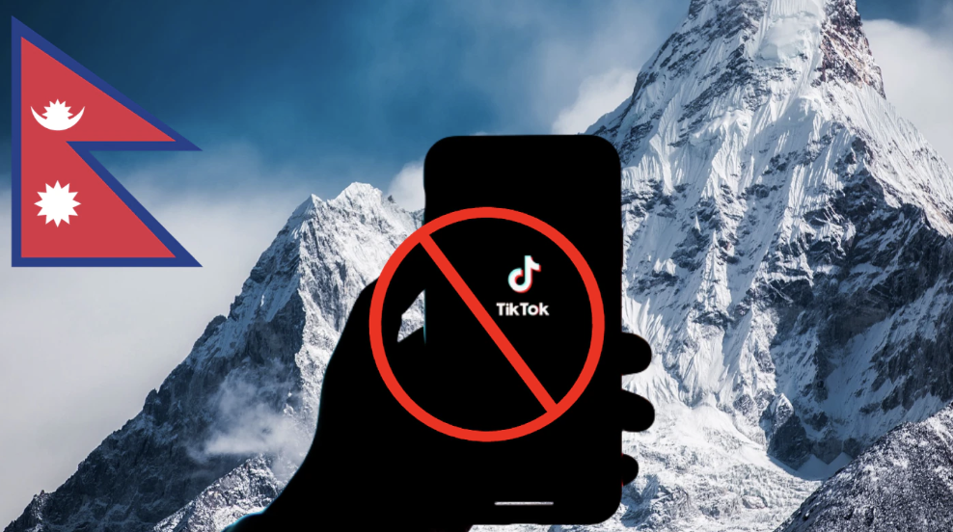
Regulating Social Media: Surveying the Impact of Nepali Government’s TikTok Ban
PRERANA KHATIWADA, ALEJANDRO CIUBA, ADITYA NAYAK, AAKASH GAUTAM, MATTHEW LOUIS MAURIELLO
21, October 2025
Presented by Prerana Khatiwada
University of Delaware
Sensify Lab
CSCW 2025
Notes:
Good morning everyone!
My name is Prerana Khatiwada, I am a phd candidate at the university of Delaware and today I’ll be presenting our work titled “Regulating Social Media: Surveying the Impact of the Nepali Government’s TikTok Ban.

Slide 2
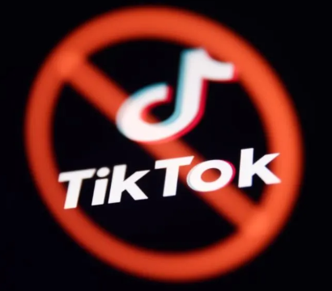
Content
1
Motivation and Background
2
Research Goals
3
Methodology
4
Key Findings
5
Design Implications
6
Contributions
University of Delaware
Sensify Lab
CSCW 2025
Notes:
I will be following the content outlined in the slides as I go along.

Slide 3


Social media platforms like TikTok are not just entertainment tools — they’ve become critical infrastructures for connection, education, and economic opportunity, especially in low-resource and transitional societies like Nepal.
Motivation and Background
Global Platform, Local Impact
University of Delaware
Sensify Lab
CSCW 2025
Notes:
When we talk about social media bans, it’s easy to think they only affect entertainment or screen time. But in reality, platforms like TikTok play a much bigger role — especially in countries like Nepal. They’ve become essential infrastructures for staying connected, learning new things, and even building livelihoods. So, when access is cut off, it’s not just about losing an app — it’s about losing opportunities.”

Slide 4
Yet, most existing research focuses on high-income or geopolitically dominant regions (e.g., U.S., China, India), overlooking how bans or restrictions affect everyday users in smaller nations.
Motivation and Background
Global Platform, Local Impact
University of Delaware
Sensify Lab
CSCW 2025
Notes:
But while we recognize TikTok’s growing importance, much of the existing research focuses on major economies like the U.S., China, or India. That means we know far less about how these same policies — like platform bans — affect smaller or less-represented contexts such as Nepal, where digital access and opportunities are already uneven.”

Slide 5
Nepal: A Transitional and
Underrepresented Context
Motivation and Background
University of Delaware
Sensify Lab
CSCW 2025
Notes:
To understand this gap, we need to look at Nepal — a country still navigating political and economic transition.

Slide 6
Nepal: A Transitional and
Underrepresented Context
Motivation and Background
Political & Economic Transition
Post–civil war instability; 14 prime ministers since 2006
Centralized governance with limited local authority
University of Delaware
Sensify Lab
CSCW 2025
Notes:
Since the end of its civil war in 2006, Nepal has faced ongoing instability and centralized governance, shaping how people experience progress, control, and technology.

Slide 7
Nepal: A Transitional and
Underrepresented Context
Motivation and Background
Political & Economic Transition
Post–civil war instability; 14 prime ministers since 2006
Centralized governance with limited local authority
Low-Resource Infrastructure
Limited technological access, especially in rural and Indigenous areas
26.6% of GDP from remittance (2023)
University of Delaware
Sensify Lab
CSCW 2025
Notes:
Nepal also faces limited infrastructure — with uneven internet access, power outages, and language barriers outside major cities. Yet, with around 26% of its GDP coming from remittances, global connectivity remains vital. Despite these challenges, platforms like Facebook, Instagram, and TikTok are now deeply embedded in daily life.

Slide 8
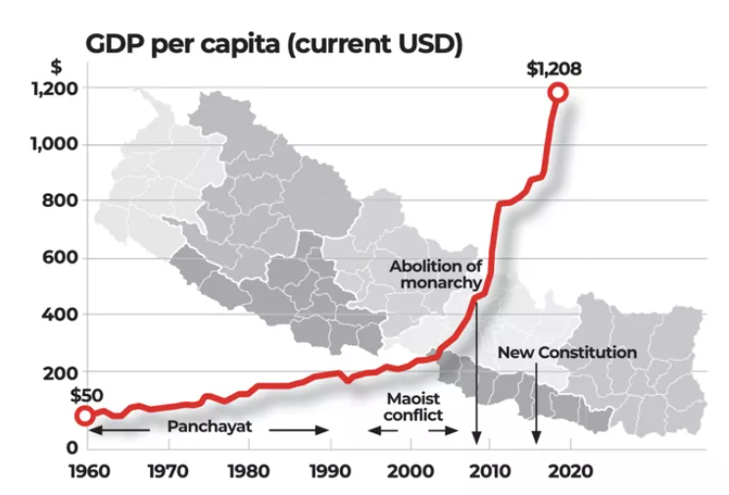
Nepal: A Transitional and
Underrepresented Context
Motivation and Background
Political & Economic Transition
Post–civil war instability; 14 prime ministers since 2006
Centralized governance with limited local authority
University of Delaware
Sensify Lab
CSCW 2025
Notes:
This chart shows Nepal’s GDP per capita over time. Growth was slow for decades due to political instability, but it rose after the new constitution, reflecting economic liberalization and global integration. Still, Nepal remains a low-resource country, shaping how people access and use digital platforms like TikTok.

Slide 9
Nepal: A Transitional and
Underrepresented Context
Motivation and Background
Political & Economic Transition
Post–civil war instability; 14 prime ministers since 2006
Centralized governance with limited local authority
Low-Resource Infrastructure
Limited technological access, especially in rural and Indigenous areas
26.6% of GDP from remittance (2023)
Structural Constraints
No domestic social media alternatives
Limited power to negotiate with global corporations (e.g., ByteDance)
Tension between state control and digital freedom
University of Delaware
Sensify Lab
CSCW 2025
Notes:
Building on that economic context, it’s also important to note that Most tech-related decisions in the country— like the TikTok ban — are made top-down, with little public input. Unlike India or China, Nepal lacks homegrown alternatives or leverage with global tech companies, leaving it caught between state-driven moral agendas and the global systems shaping people’s digital lives. In short, Nepal’s digital transformation is unfolding within ongoing political instability and structural constraints.

Slide 10
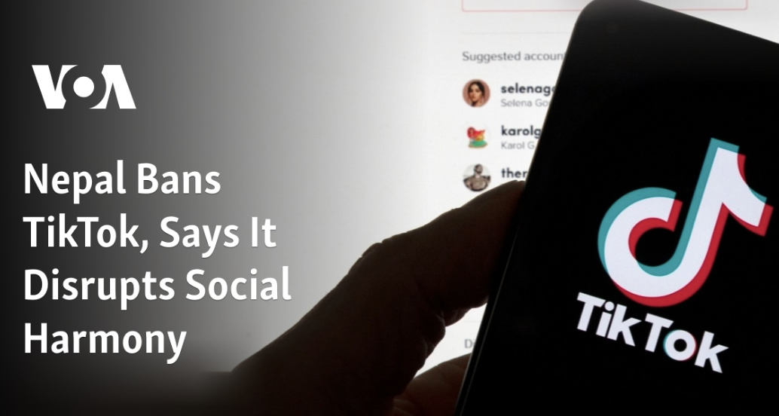
The Nepali government’s TikTok ban in November 2023 — justified under the pretext of maintaining “social harmony” — reflects a growing global tension between state control and digital freedom.
Motivation and Background
Rising Governmental Regulation and Uncertainty
🇳🇵 TikTok Ban Timeline
Banned: Nov 13 2023
Lifted: Aug 23 2024
🗞️ Source: Kathmandu Post (2024), Wikipedia
University of Delaware
Sensify Lab
CSCW 2025
Notes:
In late 2023, Nepal banned TikTok to preserve “social harmony,” but the move exposed tensions between control and digital freedom, hurting small creators and entrepreneurs the most.

Slide 11
However, the ban’s vague reasoning and inconsistent enforcement highlight policy opacity and citizen uncertainty, raising questions about how users interpret and adapt to such top-down decisions.
Motivation and Background
Rising Governmental Regulation and Uncertainty
University of Delaware
Sensify Lab
CSCW 2025
Notes:
What’s striking is how unclear the government’s reasoning was. People weren’t sure if the ban was about morality, misinformation, or control. This confusion forced users to adapt and find workarounds, showing how unclear policies can shape digital behavior as much as the ban itself.

Slide 12
Studying these user behaviors provides new insights into collective governance, policy responsiveness, and cultural negotiation in digital spaces, informing both platform design and equitable regulatory frameworks.
Motivation and Background
Understanding User Adaptation and Collective Agency
University of Delaware
Sensify Lab
CSCW 2025
Notes:
In this study, we focus on.. a low-resource South Asian country which is overlooked in tech governance research. We examine how people experienced and responded to the TikTok ban, offering insight into how smaller societies navigate local regulation versus global platform power. Even after the ban’s lifting, uncertainty remains about users’ trust and return, making Nepal a key case for understanding digital governance in transition.

Slide 13



Understand TikTok’s Role in Everyday Life (Pre-Ban)
Research Goals
How did people in Nepal adopt TikTok before the ban and for what ends?
Examine how Nepali users initially adopted TikTok — the purposes it served in their social, cultural, and economic lives — and what values or community practices the platform enabled.
RQ1
University of Delaware
Sensify Lab
CSCW 2025
Notes:
Click
We begin by asking: How were people in Nepal using TikTok before the ban, and what purposes did it serve in their everyday lives?

Slide 14
Explore Public Perceptions of the Government Ban
Research Goals
How do they perceive the government’s TikTok ban?
Investigate how people interpreted and reacted to the Nepali government’s TikTok ban — including their sense of trust, legitimacy, and fairness regarding state regulation of digital platforms.
RQ2
University of Delaware
Sensify Lab
CSCW 2025
Notes:
• click
Our second question asks: How do people in Nepal perceive the government’s TikTok ban and its broader implications?

Slide 15
Examine User Adaptation and Digital Resilience (Post-Ban)
Research Goals
How did they navigate on social media after the ban?
Analyze how users navigate and re-shaped their online behaviors during and after the ban — whether by shifting to other platforms, finding creative workarounds, or renegotiating their digital identities.
RQ3
University of Delaware
Sensify Lab
CSCW 2025
Notes:
•
Click
Lastly we answer How did they navigate on social media after the ban?

Slide 16
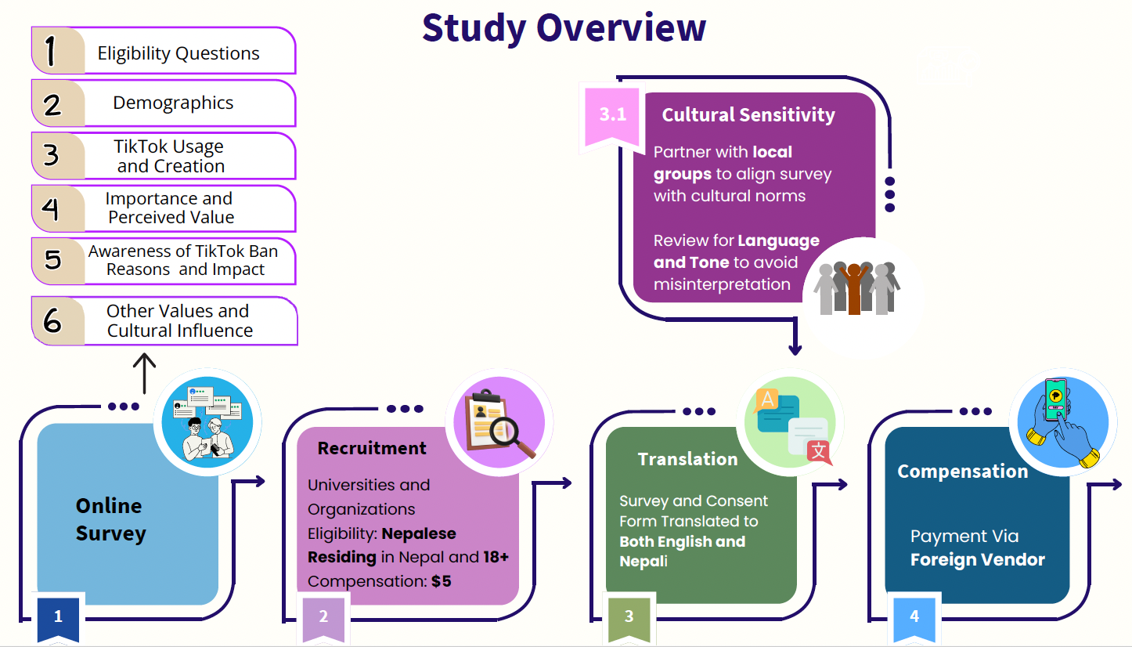
Methodology (N=108)
University of Delaware
Sensify Lab
CSCW 2025
Notes:
Here’s a quick overview of our study design. We ran an online survey with 108 Nepali TikTok users. The survey included questions on demographics, TikTok use, views on the ban, and cultural values.

Slide 17
Methodology
1
2
3
4
5
Study Design & Translation
Cultural Sensitivity and Expert Review
Pilot Testing & Refinement
Recruitment & Data Collection
Data Quality & Analysis
Designed the survey in Qualtrics, informed by digital rights reports and policy documents (Body & Data, Centre for Social Change).
Iteratively translated from English → Nepali, refined by native speakers to ensure accuracy and cultural resonance.
Partnered with Centre for Social Change (Nepal) for a cultural sensitivity analysis to ensure respectful, context-appropriate phrasing.
Revised terms like “small business” and added bilingual question display for clarity.
Conducted a pilot test with Nepali and non-Nepali participants.
Revised confusing or biased questions, simplified language, and refined conditional logic for better flow.
Recruited 108 participants (age ≥18, residing in Nepal) through social media, local colleges, and word-of-mouth.
Implemented attention checks, pilot testing, and conditional logic to improve data reliability.
Performed quantitative (Likert-scale) and qualitative (open-ended thematic) analysis to identify user perceptions and adaptations.
Approved by IRBs at the University of Delaware and University of Pittsburgh.
University of Delaware
Sensify Lab
CSCW 2025
Notes:
Click
We designed the survey in Qualtrics, using insights from digital rights reports and policy documents by Body & Data and the Centre for Social Change.The survey was conducted in both English and Nepali, translated and refined by native speakers for cultural accuracy, with two Nepali researchers on the team.
Click
We partnered with the Centre for Social Change (Nepal) to ensure cultural sensitivity, revising terms like “small business” and adding bilingual questions for clarity.
click
We piloted the survey with Nepali and non-Nepali participants, refining wording, and improving flow through clearer logic.
click
We recruited 108 participants (ages 18+) from Nepal through social media, colleges, and word of mouth. The sample size, set using G*Power, allowed basic correlation analyses. From 251 responses, 108 valid ones were retained after filtering. Participants received $5 compensation via a foreign vendor, appropriate for Nepal’s living costs.
Click
We used attention checks and pilot testing for reliable data, analyzing Likert-scale and open-ended responses to understand user perceptions and adaptations.

Slide 18
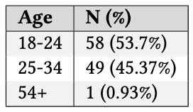
Data Collection
Nov 2023
Aug 2024
Oct 2024
2025
TikTok Ban Announced
Ban Lifted
Survey Data Collection
Analysis and Insights
The Nepali government bans TikTok, citing the need to maintain “social harmony.”
After ~9 months, government lifts the ban following policy reviews and public pressure, restoring access across the country.
Researchers collect data on user experiences, perceptions, and adaptation strategies shortly after the ban is lifted.
insights gained to understand how users adapted, what was lost, and what the case reveals about digital governance in Nepal.
We collected survey data over three weeks during the key period after the TikTok ban was lifted, capturing participants’ immediate reactions, behavior changes and coping strategies
as they re-engaged with the platform
University of Delaware
Sensify Lab
CSCW 2025
Notes:
We collected survey data over three weeks after the TikTok ban was lifted, capturing users’ immediate reactions, behavior changes, and re-engagement strategies.
Click-this is the timeline
Click
Most participants were young adults — about 54% aged 18–24 and 45% aged 25–34, with only one participant over 54. Gender distribution was nearly balanced across the sample.

Slide 19

94%
52%
Key Findings
Behavior During the Ban
Usage Drop: 36% stopped using TikTok after the ban.
Continued Use: 13.88% kept using it despite restrictions.
Women and small creators were disproportionately impacted by the ban, revealing inequities in digital access.
used TikTok daily for entertainment and connection
Return: 23% resumed once the ban was lifted.
Those who kept using Bypassed restrictions using VPNs or DNS changes
as passive viewers rather than creators.
Positives: Entertainment, creativity, business use.
Negatives: Distracting youth, exposing minors, misinformation.
17% reported changing how or why they used TikTok
Post Ban Adaptation
University of Delaware
Sensify Lab
CSCW 2025
Notes:
Click
Our findings show that TikTok wasn’t just a platform for fun — it became part of everyday Nepali life.
Click
Most users watched rather than created content, finding it entertaining but also distracting.
Click
Participants saw TikTok as fun, creative, and useful for business — but also as distracting for youth, risky for minors, and a source of misinformation.
click
with respect to usage, After the ban, about 36% of users stopped using TikTok, while around 14% had already quit earlier. Many left because they felt it was taking too much time, showing repetitive or low-quality content, and not aligning with their personal values.
Once the ban was lifted, about 23% returned, including some who had quit earlier — mainly to reconnect with communities or catch up on trends. Some new users joined out of curiosity or social pressure, while others highlighted TikTok’s importance for maintaining family and diaspora connections — a vital theme in Nepal’s migratory context.”
”Despite the restriction, Around 14% found workarounds using VPNs or DNS changes, mostly urban, educated, higher-income users.
Click
About 17% of users said they changed how or why they use TikTok — shifting toward more intentional use, like following educational content or limiting screen time.
Click
The ban also disproportionately affected women and small creators. Many relied on TikTok for income or visibility, so the restriction revealed deeper inequalities in who has access to digital platforms and opportunities.
Overall participants saw tiktok as a way to connect with communities and promote local culture or small businesses, though these benefits varied in strength.

Slide 20
Content Experiences
Key Findings
Users with favorite content
Users encountering inappropriate content.
38.88%
Top Concerns Reported:
Fake News / Misinformation: 25.09%
Hate Speech & Sexual Exploitation: 15.55% each
Content Against Nepali Societal Values: 11.66%
Informed, inspired, entertained, personal relevance, cultural ties
(e.g., PCOS-friendly food, travel videos, AI interpretations of Hindu deities).
31.72%
Content That Resonates
1
2
Why Users Save Content
Content Engagement & Concerns
University of Delaware
Sensify Lab
CSCW 2025
Notes:
Overall many users enjoy TikTok.
Click Click
About 32% of users had favorite TikTok content, while 39% came across inappropriate posts. However, only a few reported them, likely due to low trust in moderation or fear of consequences.
Click
Participants often saved TikToks that informed, inspired, or entertained them — content that felt personally or culturally meaningful. Examples included health tips like PCOS-friendly foods, travel videos, and AI art of Hindu deities. These examples show how TikTok served not just as entertainment, but as a space where global and local identities intersected.”
Click
At the same time, participants were highly aware of TikTok’s risks. about 25% cited misinformation, followed by hate speech and exploitation, and around 12% also pointed to content they felt clashed with Nepali cultural values — showing how social media use is closely shaped by local norms and moral boundaries.

Slide 21
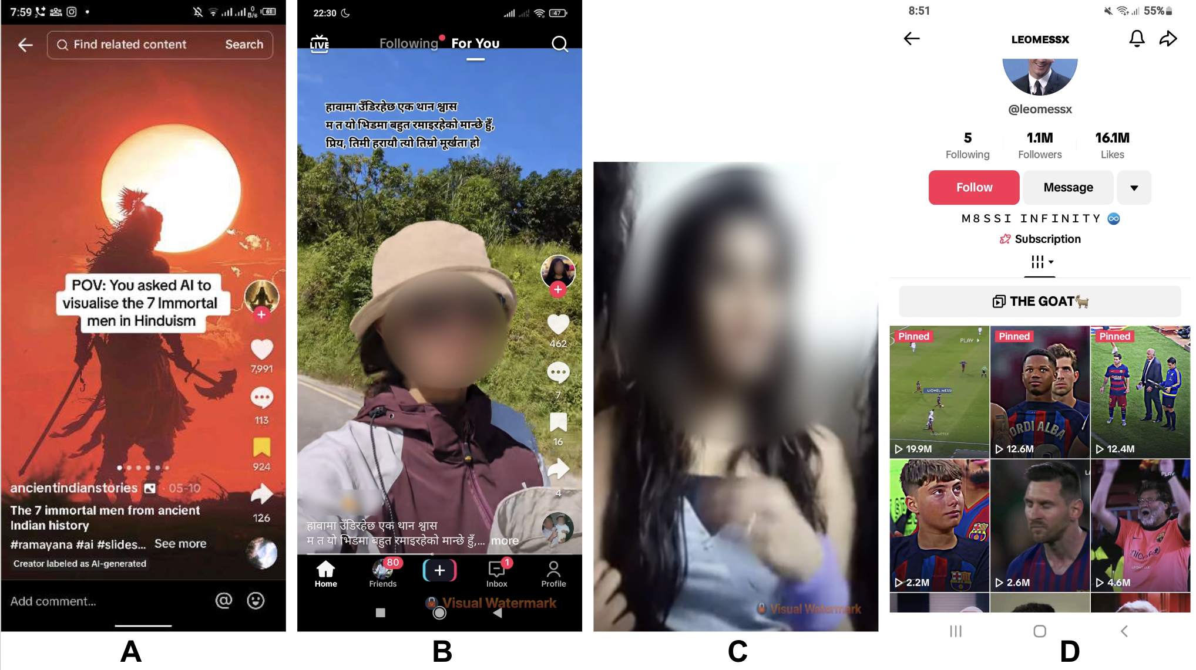
University of Delaware
Sensify Lab
CSCW 2025
Notes:
These were some of the videos participants had saved on their phones before the ban. When asked what kind of content they chose to keep, many shared examples like AI-generated images of Hindu deities, motivational quotes, health tips, and even fake celebrity accounts — showing the mix of creativity, culture, and misinformation that shaped their TikTok experience.

Slide 22
Results | Motivations and Actions Surrounding the Ban
Key Findings
“I wasn’t creating anything—just endlessly consuming content. I found myself glued to the screen and putting off my responsibilities. At first, it was entertaining, but eventually, I felt drained and realized the videos offered little value.”
Stopping TikTok Usage Pre-Ban
University of Delaware
Sensify Lab
CSCW 2025
Notes:
When analyzing open-ended responses, one participant shared this reflection about their TikTok use before the ban.

Slide 23
Results | Motivations and Actions Surrounding the Ban
Key Findings
“TikTok was a very welcoming app for women creators in the sense that there were a lot of women creators in the appp [app], which I think has been reduced when transitioning from TikTok. The transition has cut a lot of small creators like small business owners, less digital-savvy users, and women as well.”
A Step Back for Small Creators
University of Delaware
Sensify Lab
CSCW 2025
Notes:
One participant highlighted how TikTok had been a supportive space for women and small creators.

Slide 24
Results | Motivations and Actions Surrounding the Ban
Key Findings
“. . . After the ban, I switched to Instagram for my fix of reels, but I missed the fun and creativity of TikTok. So, I found a way around the ban and continued to enjoy, even if I don’t spend as much time there anymore.”
Circumventing the Ban
University of Delaware
Sensify Lab
CSCW 2025
Notes:
participants also described finding ways to bypass restrictions.

Slide 25
Results | Motivations and Actions Surrounding the Ban
Key Findings
“I started using Tik Tok after the government lifted the ban, and my reasons were influenced by a mix of curiosity, social pressure, and a desire to connect with a wider cultural moment. When the platform became accessible again, I couldn’t help but feel intrigued by all the
buzz surrounding it. Throughout the ban, I had heard about Tik Tok rise in popularity. Friends and social media platforms often discussed the trends, viral challenges, and creative
content that Tik Tok was known for, which made me wonder what I had been missing. As soon as the app was available to me again, I decided to dive in and explore it firsthand.”
Resuming Engagement Post-Ban
University of Delaware
Sensify Lab
CSCW 2025
Notes:
This reflection captures how curiosity and social influence drove many users back to TikTok once the ban was lifted.

Slide 26
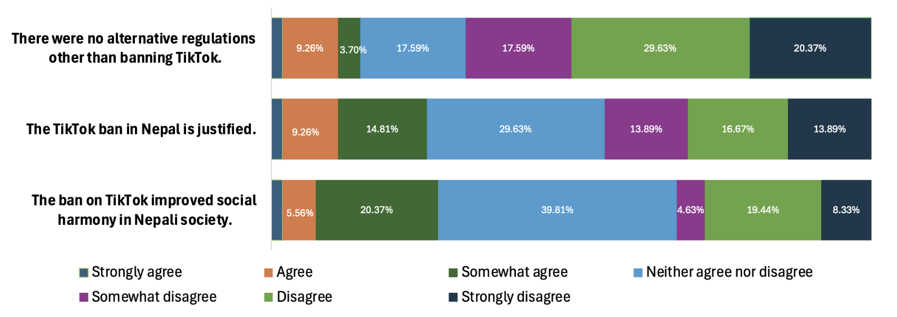
Public perceptions of Nepal’s TikTok ban: Motives, impacts and regulatory alternatives
Key Findings
Overall, participants expressed skepticism about the ban.
63.89% felt it violated freedom of expression, while many questioned whether banning was the only solution. Around 30% disagreed with the ban’s justification.
Only a small 1.85% believed that the ban improved social harmony, felt it was justified, or viewed banning as the only solution.
University of Delaware
Sensify Lab
CSCW 2025
Notes:
Click
Overall, most participants were skeptical of the ban — 64% saw it as a violation of free expression,
about a third disagreed with the government’s reasoning, and less than 2% felt it improved social harmony, viewing it as overly restrictive.

Slide 27

Key Findings
Needs and motivations
Users seek short-video platforms like Instagram and Facebook Reels that mirror TikTok’s features.
They value content variety (31.86%), privacy (30.88%), and ease of use (18.14%).
TikTok’s simple tools, quick editing, and community features fostered creativity and small business growth across age groups.
Instagram (81% pre-ban / 86% post-ban)
Facebook (76% pre-ban / 58% post-ban)
YouTube (frequently mentioned for education and news)
Nepali TikTok Users Transitioning to Alternative Platforms
What is Lost In Transition?
Users felt that other platforms lacked TikTok’s creativity, collaboration, and viral algorithm.
Some found other apps “less chaotic and calm” but missed TikTok’s sense of community and reach.
Alternative Platforms
Instagram
Facebook
Youtube
University of Delaware
Sensify Lab
CSCW 2025
Notes:
Click
Users turned to Instagram and Facebook Reels for similar short videos, valuing content variety (32%), privacy (31%), and ease of use (18%). TikTok’s simple tools and community features had encouraged creativity and small business growth.
Click
Users found other apps calmer but less creative and engaging, missing TikTok’s community and viral reach.
Click
Before and after the ban, Instagram remained the most used platform, rising from 81% to 86%.

Slide 28
Results | Alternative Platform Usage, Before and After Ban
Key Findings
In Nepal, mostly, people used TikTok to grow their businesses. Even where my dad used to work [at a cloth shop], they used TikTok to promote and advertise their product. They were generating good source of income. People used to visit the store by watching videos and ads in TikTok. But, after that ban it impacted their business a lot. People were learning to do E-commerce. E-commerce is still growing in Nepal…”
Losing a Digital MarketPlace
University of Delaware
Sensify Lab
CSCW 2025
Notes:
Many participants emphasized TikTok’s role in supporting small businesses and local commerce.

Slide 29
Results | Alternative Platform Usage, Before and After Ban
Key Findings
Alternatives to it really are just not as great in my opinion. Sure, they might have all the
functions of TikTok, like video sharing, but its algorithm is special and really works so
well for the user’s wants. TikTok really focuses on short, fun videos and has a great sense
of community that really inspires creativity not found in most alternatives.”
Why TikTok Feels Irreplaceable
University of Delaware
Sensify Lab
CSCW 2025
Notes:
Participants talked about how no other platform matched TikTok’s unique algorithm and community. They felt its personalized feed and creative environment made it more engaging than any alternative.

Slide 30
Design Implications
Embed Participatory & Transparent Oversight
Move from Reactive Bans → Collective Governance
Build Structural Safeguards for Digital Rights
Strengthen Community-Driven Digital Literacy
🏛️ 🤝
👥 🔍
Design socio-technical systems that empower local communities to participate in rule-making and moderation rather than enforcing top-down restrictions.
Support plurality and dialogue instead of blanket censorship.
Establish hybrid governance councils (users + civil society + technical experts) to mediate among platforms, the state, and citizens.
Enable public moderation dashboards and algorithm audit tools for transparency and accountability.
🛡️ ⚖️
💡 📚
Prioritize data transparency, appeals processes, and algorithmic accountability over punitive or opaque regulatory control.
Align design practices with global human-rights frameworks to ensure equitable governance.
Integrate localized, multilingual, and culturally relevant literacy initiatives that help users understand moderation, privacy, and algorithmic influence.
Treat education as an ongoing, co-designed component of governance not an afterthought.
University of Delaware
Sensify Lab
CSCW 2025
Notes:
Through our findings, we argue that platform bans like Nepal’s TikTok restriction reveal deeper issues of power, governance, and infrastructural precarity.
If a global platform like TikTok can be so easily restricted, it raises important questions about what this means for other technologies that mediate communication, identity, and visibility—especially in low-resource or transitional societies.
Countries like Nepal often have limited negotiating power with global corporations and few alternatives for locally governed platforms.
This imbalance highlights the need for new governance models that move beyond reactive, top-down bans and toward collective, community-driven frameworks.
Click
That’s where our design implications come in.
First, we call for a shift from Reactive Bans to Collective Governance — designing socio-technical systems that give local communities a real voice in defining norms and moderation policies, emphasizing dialogue instead of blanket censorship.
Click
Second, we advocate for Participatory and Transparent Oversight, through local governance boards that bring together users, civil society, and technical experts — supported by tools like public moderation dashboards and algorithmic audits to ensure accountability.
Click
Third, we emphasize Building Structural Safeguards for Digital Rights, such as data transparency mandates, fair appeals processes, and algorithmic accountability aligned with global human rights frameworks.
Click
Finally, we highlight the need to Strengthen Community-Driven Digital Literacy — making education a central part of governance.
This means developing localized, multilingual, and culturally relevant literacy programs that help users understand moderation, privacy, and algorithmic influence.
Altogether, these implications urge us to rethink how regulation, design, and community participation intersect — pushing toward a more inclusive, accountable, and context-aware framework for governing digital platforms in places like Nepal and beyond.

Slide 31
Our work contributes to diversifying design research beyond Western contexts by centering voices often excluded from global platform studies, while highlighting power dynamics in how communities with limited control over technological infrastructures navigate and govern social media systems.
Contributions
1
2
3
Policy & Design Guidance
Offer actionable recommendations for policymakers and social media platforms to support user needs in collectivist and low-resource contexts through better governance, moderation, and digital literacy initiatives.
Empirical Insights
Provide real-world evidence on how people adapt to and continue using digital platforms following a government-imposed ban.
Community Dynamics
Highlight how online communities reorganize, shift behaviors, and form alternative spaces for connection and expression.
University of Delaware
Sensify Lab
CSCW 2025
Notes:
Our work adds to the growing call for diversifying design research beyond the West, particularly in centering the voices of those not historically considered primary users of social media platforms like TikTok. We ask: What types of political actions are possible within a technological system, and to what extent should these actions be clearly defined/made visible? Similarly
If a platform as influential as TikTok can be restricted, what does this signify for other technologies that similarly shape communication?
Click
We provide empirical insights into how people adapt to and use a system following a ban.
CLick
We highlight the community behaviors and shifts
in interactions that develop when people engage with online platforms (e.g., the emergence of alternative platforms);
Click
We offer actionable guidance for policymakers and social media platforms to better understand user behavior and community needs, particularly in collectivist cultures and resilient communities, through improved governance, moderation, media access policies, and digital literacy efforts.
A collectivistic perspective highlights the significance of group affiliations, where individuals feel a sense of obligation and interdependence with one another. In this context, identity is shaped by group memberships and relationships, making it essential to understand individuals through their connections within social units

Slide 32



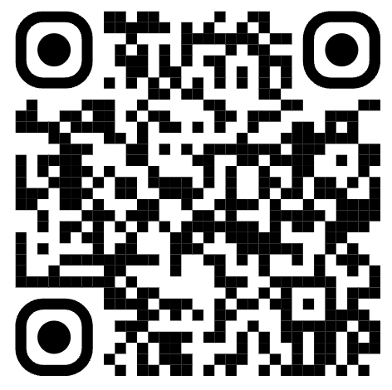





Full paper → Scan here
Prerana Khatiwada
Alejandro Ciuba
Aditya Nayak
Let’s Talk
Prerana Khatiwada
preranak@udel.edu
Matthew Louis Mauriello
Aakash Gautam
This work was carried out in collaboration with students and faculty from the University of Pittsburgh, whose insights and partnership greatly enriched the project.
Notes:
Thank you!

