Slide 1


"I spent 14 hours debugging just one assignment": Toward Computer-Mediated Personal Informatics for Computer Science Student Mental Health
Aishwarya Chandrasekaran
London Bielicke
Diya Shah
Harisha Janakiraman
Matthew Louis Mauriello
Notes:
Hello EVERYONE, I AM AISHWARYA, from University of Delaware Sensify Lab AND I AM here TO PRESENT OUR WORK on computer mediated personal informatics for CS stzudent mental health
ON BEHALF OF MY CO AUTHORS London Diya Harisha and my advisor Dr. Matt Mauriello

Slide 2

INTRODUCTION
Anxiety and Depression symptoms are 2x as high in Computer Science (CS) students compared to other undergraduate students and 5-10x higher than in the general population (Passos et al., SIGCSE 2020)
There has been a rapid proliferation of mental health tools ranging from mobile sensing and digital phenotyping to the integration of Cognitive Behavioral Therapy (CBT) techniques and storytelling.
Notes:
Rising MENTAL HEALTH issues IS A GROWING concern IN HIGHER EDUCATION.
U.S. engineering students ARE 10 times more likely to exhibit a high risk of serious mental health disorders compared to the general U.S. adult population
SPECIFICALLY, IN CS students, ANXIETY AND DEPRESSION symptoms are twice higher than OTHER UNDERGRADS AND 5-10X HIGHER THAN GENERAL POPULATION,
In response to the growing mental health needs of various populations, including students, there has been a rapid proliferation of digital mental health ranging from mobile sensing digital phenotyping to CBT Storytelling

Slide 3
INTRODUCTION
The real world adoption rate of digital mental health among students is low. For college students, the key factor contributing to this gap has been suggested as the mismatch between tool design and their everyday experiences (Lattie et al., CHI 2020)
The specific reasons why CS students experience elevated mental health issues are unknown
Ji et al., (SIGCSE 2024) explored this direction, but the results are constrained only to students with pre-existing mental health conditions
Notes:
However, the real world adoption rate of these tools is low. For students, research suggests that the primary contributing factor is mismatch in how these tools are designed and their everyday experiences
Despite the CS education community recognizing the importance of protecting student psychological well-being as recently as 2020, the reasons why they face elevated mental health challenges are unexplored
Ji et al explored this direction but the results are confined to students with pre existing mental health conditions

Slide 4
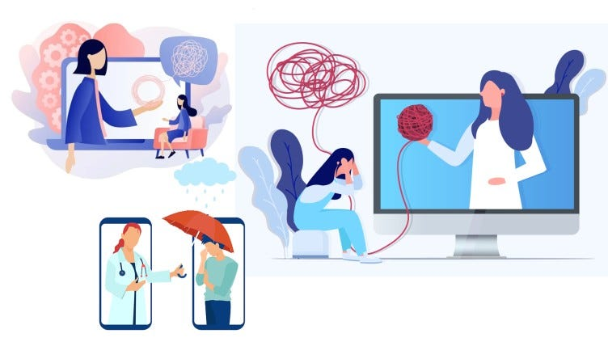
RESEARCH QUESTION
What are the reasons for elevated mental health issues in CS students and
how can technology address the same?
Notes:
To bridge this gap, by keeping student autonomy and self-determination at the heart of our approaches, our research aims to answer the central question
“ ”

Slide 5

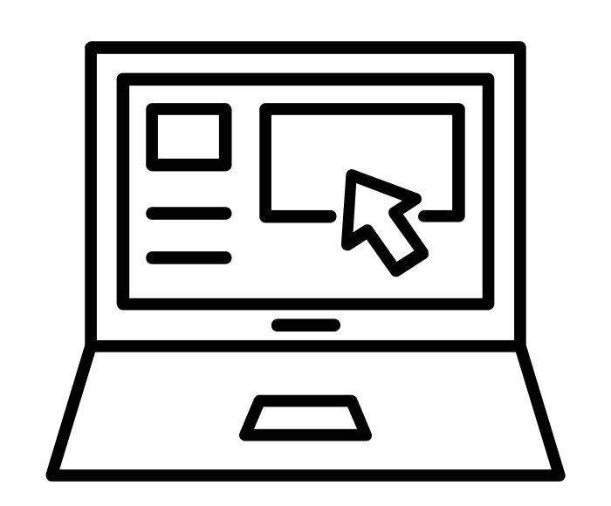
OVERVIEW
Needfinding
Tool Design and Acceptability
Needfinding interviews with 20 university CS students to understand reasons for elevated mental health challenges and preferences for technological support
Developed a tool based on student preferences and conducted field deployment to understand it’s acceptability among CS students
Notes:
To answer this RQ we conducted a mixed method study in the form of
semi structured needfinding interviews
Based on the challenges and preferences we gathered in the interview study,
we developed a tool called emotionstream and launched a one week in the wild deployment to understand the acceptability among cs students

Slide 6

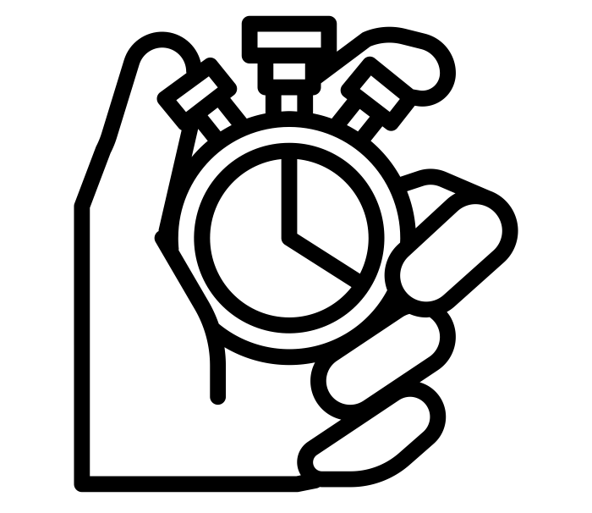


NEEDFINDING: METHOD
METHOD: SEMI-STRUCTURED INTERVIEWS
Recruited participants at an R1 US university and conducted interviews from December 2022 to March 2023
60 minute semi-structured interviews (M=48)
20 Participants
12 Undergraduate, 8 Graduate
14 Domestic, 6 International
4 First-gen, 16 Non-first-gen
Thematic Analysis
using inductive and deductive coding
Notes:
In needfinding study, we conducted semi structured interviews between December 2022 and March 2023 by recruiting university cs students in the US
Interviews lasted for 60 minutes
we recruited 20 participants and
We conducted thematic analysis of the interviews using inductive and deductive coding

Slide 7
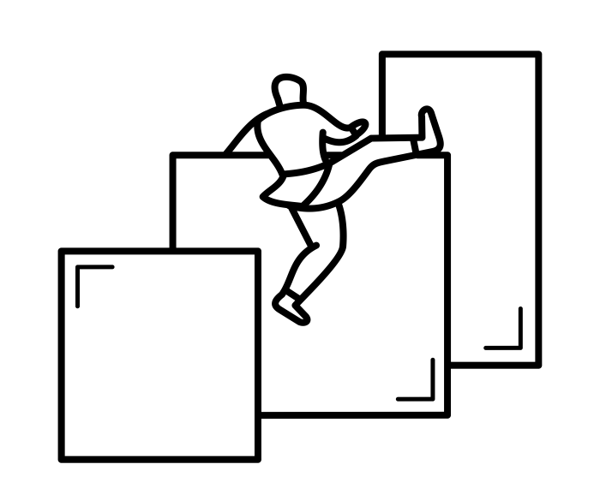
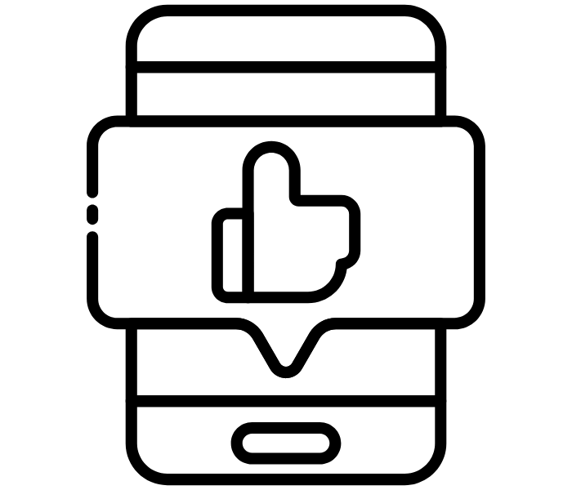
NEEDFINDING: RESULTS
Integrate computer-based mental health tools into academic environments (G1)
Continuously track emotional states (G2)
Track stress levels and associated contexts (G3)
A Visual dashboard summarizing emotional responses along with context data (G4)
Maintain data locality and privacy (G5)
Programming and Debugging
Imposter Syndrome
Lack of Awareness of Mental States
Challenges
Contributing to elevated mental health issues in CS students
Preferences
Toward computer-mediated Personal Informatics tool
Notes:
here is an overview of our results
For challenges, we found three key themes
For preferences, we first specifically enquired regarding their willingness to adopt a computer mediated tool
and then regarding specific feature preferences where participants expressed the following features

Slide 8
NEEDFINDING: RESULTS
Challenges: Difficulty during programming (debugging)
“I’ve literally sat at my computer and cried. I remember I was taking [a Data Structures class] [...] I was like, I can’t do this. I did that for 15 minutes. And then settled down. [...] There’s been times where I’m on a [time] crunch. So, I’m frantically going through things. I’m just reading and typing and I’m like what isn’t working? I’m reading [my code] a million times because I have to get it in in a few hours. And then you’re happy when it finally works, and you’re really excited. So I’ve just been through every emotion while doing that.”
-P08
Notes:
The first theme is around challenges with programming
Coding and debugging are integral components of the CS curriculum.
Our participants all acknowledged attraction to the field due to their problem-solving inclination. Despite this, they (20/20) expressed debugging to be extremely stressful and frustrating.
Participants described a range of intense emotions during the process, including anger, frustration, restlessness, sadness, and panic.
They often felt as though their efforts were in vain, leading to a sense of desperation and a desire to give up (9/20).

Slide 9
NEEDFINDING: RESULTS
Challenges: Lack of self-awareness of mental states
“Sometimes I think I don’t understand that I’m stressed. For example, last semester, I had an Android project to do. I finished most of the coding part. But at that time, I didn’t realize that I was not taking breaks as much because I love coding [...] But when it was exam time, it was so difficult for me because, for example, I was seeing ‘not’ instead of ‘hot’ but I didn’t understand that maybe I was stressed.”
-P03
Notes:
Even though participants chose CS due to their love for problem solving and coding,
they reported that prolonged efforts to fix their code led to a lack of self-awareness of their stress and emotions,
resulting in a cycle of sleep deprivation and burnout.
In the absence of formal stress-monitoring practices,
participants had to rely on their own judgment to identify moments of heightened stress
Notably, P3 mentioned requiring intervention from their professor to take a break and in their own words

Slide 10
NEEDFINDING: RESULTS
Technological Support Preferences: Real-time mental state monitoring
“I think one of the big things is, if I would notice that I’m at a volatile state where it’s not too good, it might be an indication that it is time to take a five minute break, [...] because I feel with programming, you can get stuck in this idea that you have to get it done all in one go. And that’s usually just not the case.”
-P18
Notes:
When asked about their willingness to adopt a
computer-based PI tool, most participants indicated that they were
open to using such a tool to support mental well-being and expressed preference for two types of monitoring
Emotions
And stress
The goal of the monitoring being to
1) Promote awareness of their feelings during computer-based academic tasks and 2) Enable them to self-manage (e.g., taking breaks when feeling consistently frustrated).

Slide 11
NEEDFINDING: RESULTS
Technological Support Preferences: Contextual monitoring
Activity-level data
Peripheral data
Other - Time of day
“So I would say, this was something that came to my mind based on the way you were typing the keys sometimes. Because I would tap them hard or tap them fast if I’m stressed or doing some programming tasks, and I’m not able to achieve that task, or maybe bang that space bar, identify those patterns, if possible.”
-P12
Notes:
In addition to monitoring their emotional states and stress, they expressed a willingness to monitor the contexts in which their emotional states and stress levels deviated from what was normal to them. They identified the key contextual factors associated with their stress levels and emotional states to be: 1) Activity-level data, 2) Peripheral data such as keystroke and mouse metrics, and 3) Other contextual factors such as time of day

Slide 12
NEEDFINDING: RESULTS
Technological Support Preferences: Visualization dashboard
“Maybe some kind of symbol representing how you’re feeling, like a little smiley face or a frowny face or, you know, stressed out a face or something that would maybe alert you if you were getting too stressed out or something and say, go take a 10-minute break… I think something like that would be would be very beneficial.”
-P01
Notes:
When asked how they would like to make sense of the data collected from these logging components discussed, participants (15/20) came up with various ideas, which had to mostly do with a summary of how they felt during the task and for how long.

Slide 13
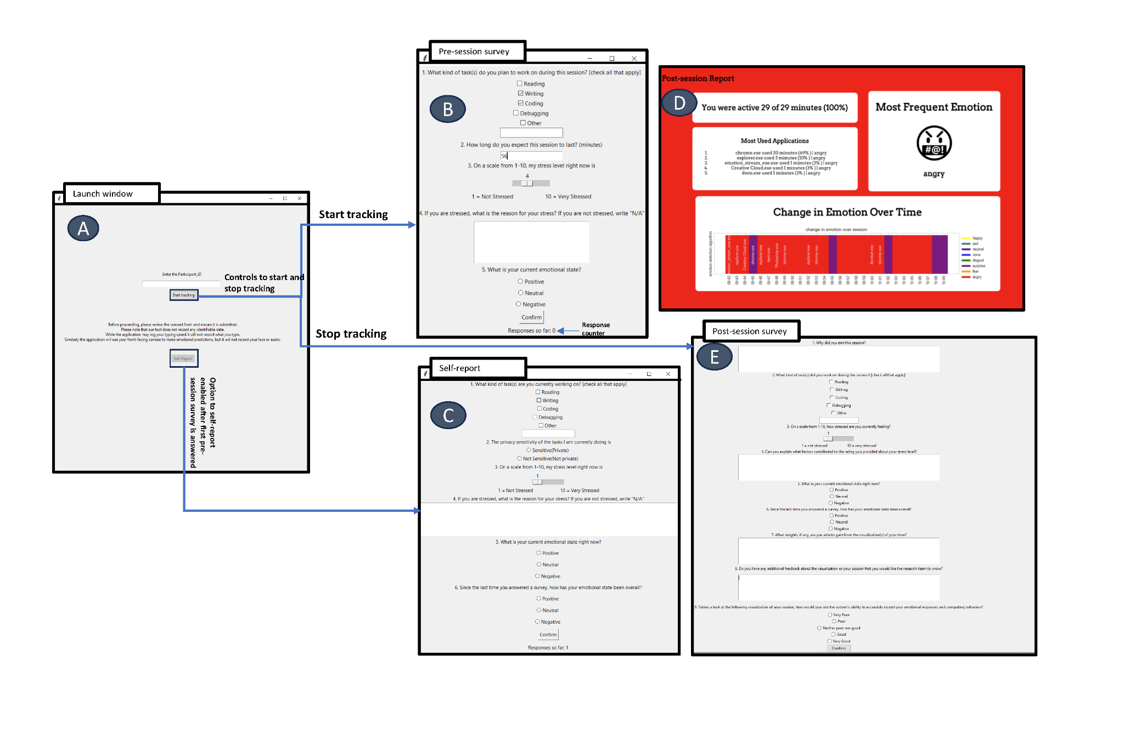
EMOTIONSTREAM
Automated Emotion Recognition (AER) using two state of the art Computer Vision models (RMN and DeepFace)
Context Logging
  Key Logger
  Mouse Logger
  Application Logger
Experience Sampling Surveys
To collect stress, ground truth emotion, and associated context such as task
Personal Informatics Dashboard
Figure 1. Interface Design of EmotionStream. (A) The Consent and Initialization View, (B) Pre-Session View, (C) Contextual Self-Reflection View, (E) Post-Session Insight View, along with visualization dashboard (D)
Notes:
Based on the preferences gathered in the needfinding study we distilled specific design goals and developed emotionstream
It consists of 3 main components
Passive logging of emotions for which we used two state of the art Computer vision models
and context logging where we tracked peripheral data such as keystroke and mouse and the applications
The app also launched Esm surveys periodically to collect stress and stressor related data and
At the end of each session, participants were shown a front end visualization dashboard summarizing key insights from their session aligned with both situational (what activity were they doing) and when which is the temporal context

Slide 14
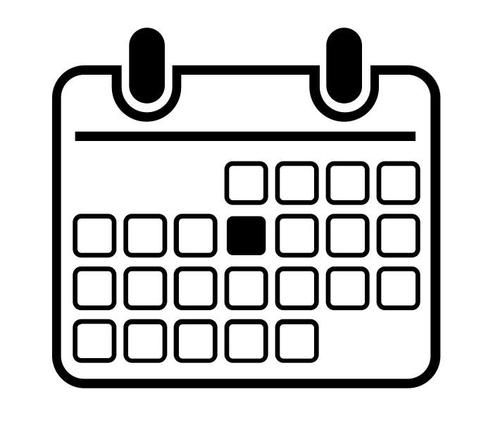
EMOTIONSTREAM: METHOD
METHOD: EMOTIONSTREAM TOOL EVALUATION
One week in-the-wild naturalistic study during out-of-classroom academic activities
12 Participants Recruited
10 from the needfinding interview study
Acceptability metrics and post-hoc analysis to understand the reliability of AER and role of context in stress prediction
Notes:
to understand the acceptability of EmotionStream among university CS students, We evaluated EmotionStream in a one-week field deployment with 12 participants
And report on acceptability metrics and a post hoc analysis to validate the underlying AER models we used and the role of context in stress prediction

Slide 15
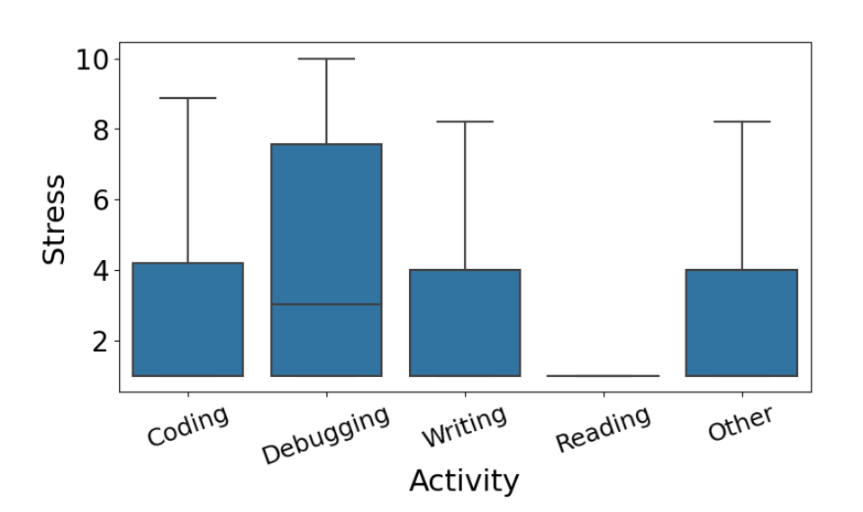
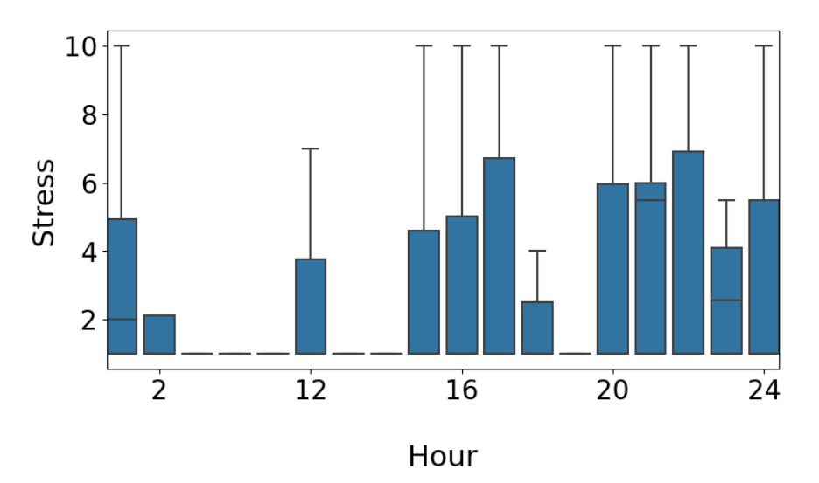
EVALUATION: SELF REPORTS
Certain activities, such as debugging, have more than 25% of the ESM responses with stress values above 7.5 and the maximum stress value reported is 10.
Coding, on the other hand, was associated with more than 25% of its ESM responses above 4
Participants also reported being more stressed during later hours of the day
Figure 2: (Top) Activity wise stress data
(Bottom) Hour wise stress data
Notes:
Corroborating our needfinding interview study, we found that debugging was the most stressful activity and participants reported stress values higher than 7.5 in atleast 25 percent of their ESM responses
Participants also reported higher stress during later hours of the day

Slide 16
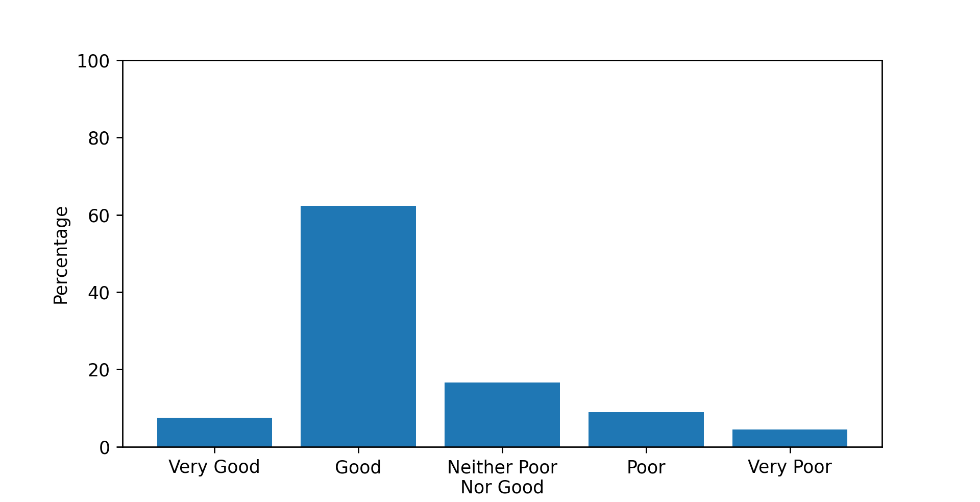
EVALUATION: ACCEPTABILITY
Tool Rating:
“I think the main reason for the reduction in my stress was because often I was asked about the nature of how I was feeling and why. Grappling with that question led to progress towards a better emotional state.”
- (P18)
Figure 3. System Ratings
Notes:
In our post-session surveys, we collected system ratings from participants
The scores indicate that participants were very satisfied with the app as EmotionStream received a rating of "Good" and "Very Good" from 60% and 10% of the survey responses, respectively
Open ended feedback explains their sentiments using the tool for example P18

Slide 17
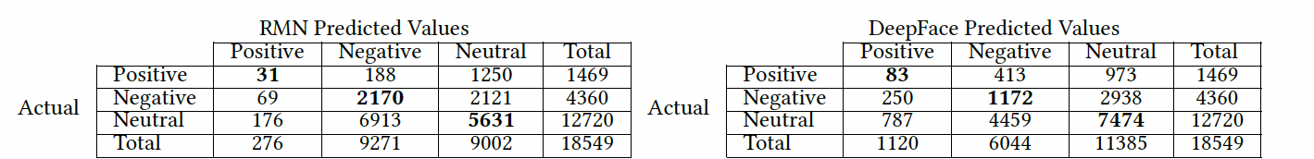
EVALUATION: ACCURACY OF AER
RMN model’s accuracy for classifying Positive, Negative, and Neutral affect is 42%, with precision at 0.49, recall at 0.42, and F1-Score at 0.43
DeepFace model’s overall accuracy for classifying Positive, Negative, and Neutral affect is 47%, with precision at 0.50, recall at 0.47, and F1-score at 0.48
Notes:
Automated Emotion Recognition is increasingly used in various applications such as hiring services, mental health, and even track employees
Therefore in our post hoc analysis to evaluate the reliability of AER in stress prediction, we compared the two AER model predictions with self-reported affect and
The 6 emotion classes outputed by the model were further classified into affect positive negative and neutral
found that accuracies of both models we used was less than 50%
When we performed a chi square statistical test to compare both signals, they were significantly different

Slide 18
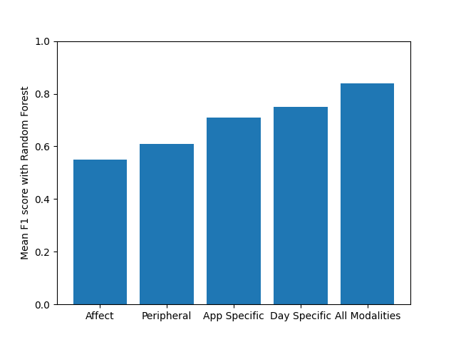
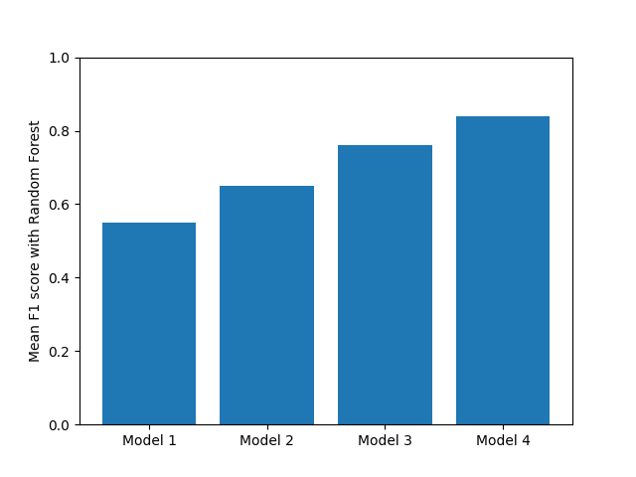
EVALUATION:
STRESS PREDICTION
F1 scores from each modality were 0.55 from self-reported affect, followed by peripherals (0.61), app-specific data (0.71), and day-specific data (0.75). The best F1 score was 0.84 when all the modalities were used to predict stress.
Model 1, comprising only self-reported affect, yielded an F1-Score of 0.55. Model 2, an incremental addition to Model 1 with peripheral data, yielded an F1 score of 0.65. Model 3, an incremental addition to Model 2 with app-related features, yielded an F1 score of 0.76. Model 4, an incremental addition to Model 3 with day-specific features, yielded an F1 score of 0.84.
Notes:
As a next step we conducted different analyses to predict stress from emotion and contextual cues
First, Stress prediction from individual modalities
Second, Forward stepwise feature selection
For all the analysis, we trained independent Random Forest classifiers for each user and reported the average F1 scores across individuals.
F1 score was highest when all modalities were combined and the highest F1 score was when we augmented feature set from just emotional states to include all contextual factors (activity, peripheral and time)

Slide 19
CONTRIBUTIONS
Qualitative insights regarding the unique challenges of CS students, specifically due to academic tasks and their preferences for technological support.
A computer-mediated, algorithm-assisted PI tool EmotionStream- that provides both contextual and emotional insights based on individual behaviors.
An evaluation of the reliability of AER models and the role of context in stress prediction: we demonstrate that emotions, when augmented with contextual cues, shows promise for stress prediction using existing AER tools.
Notes:
In summary, the contributions of our work are

Slide 20



"I spent 14 hours debugging just one assignment": Toward Computer-Mediated Personal Informatics for Computer Science Student Mental Health
Aishwarya Chandrasekaran (aishc@udel.edu)
London Bielicke
Diya Shah
Harisha Janakiraman
Matthew Louis Mauriello
Notes:
Add QR code
Thank you,
London was able to contribute to our research through the CRA Wp’s DREU program
If you are interested to learn more, please read our paper and contact me with any questions

