Slide 1
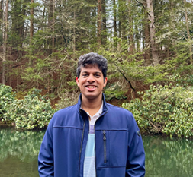
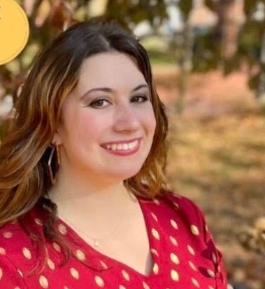

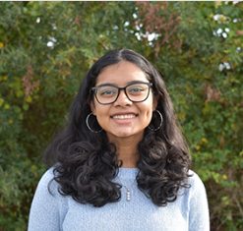


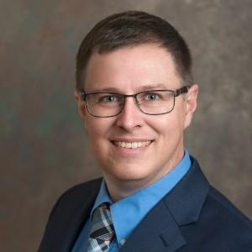
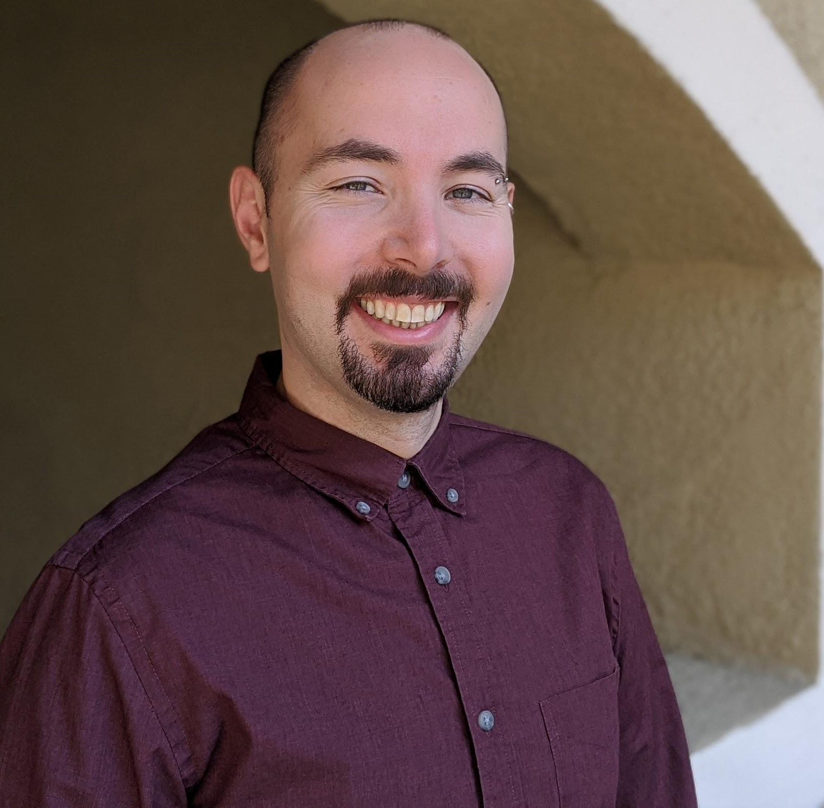

uCue: An Interactive Musical Interface to Enhance Formative Listening Experiences for Children with ASD
Abhishek Karwankar
Elise Ruggiero
Zoe Lipkin
Malika Iyer
Simon Brugel
Prerana Khatiwada
Dr. Daniel Stevens
Dr. Matthew Mauriello

Slide 2
Autism Spectrum Disorder
Introduction Research Gap Research Questions uCue Results Future Work
Introduction
Autism Spectrum Disorder, or ASD, is a condition that affects how a person communicates, interacts with others, and behaves. People with ASD may have trouble with social skills, may not speak or use gestures like others, and often repeat actions or routines.
The Centers for Disease Control (CDC) declared that in the United States, 1 in 54 children have Autism. ASD is a lifelong condition and is normally diagnosed at age 2 or 3; however, signs of Autism can be detected as early as 18 months.
Children with autism often experience sound sensitivity, making them prone to sensory overload in noisy or unpredictable environments.

Slide 3
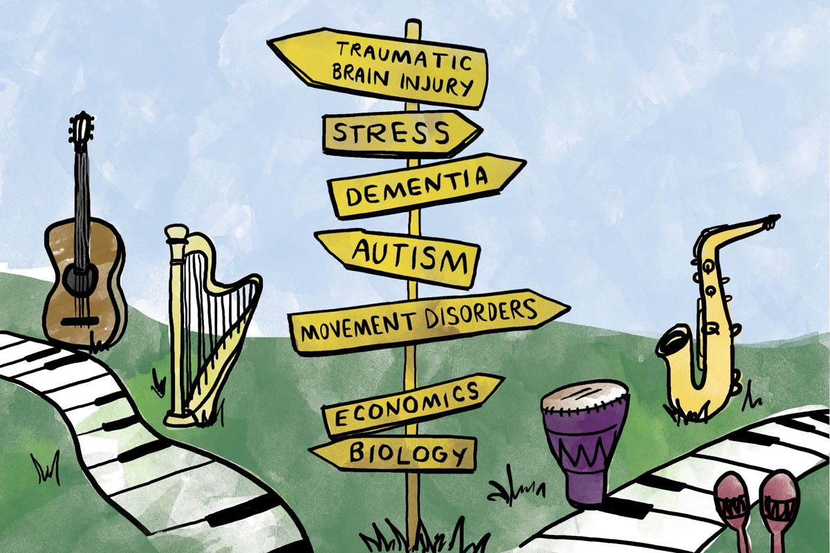
Music Therapy and ASD
Introduction Research Gap Research Questions uCue Results Future Work
Introduction
Evidence-based approach that uses music within a therapeutic relationship to address a patient's physical, emotional, cognitive, and social needs
An intervention in pediatric health care to alleviate symptoms and improve quality of life. (Mayer-Benarous et.al.,Front. Psychiatry, April 2021 )
Aiding communication and emotional regulation in children with ASD. (Thompson et.al., Child Care Health Dev. Nov 2014)
Can improve peer interactions and provide insights into their behavioral and emotional states. (Cibrian et. al.Pervasive Health,May 2018)
Image from Northwestern University’s website: “The Power and Science of Music Therapy”

Slide 4
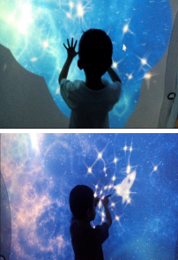
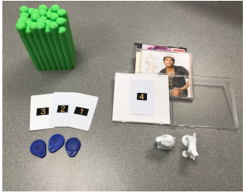
Tangible Interfaces for Music Therapy
Introduction Research Gap Research Questions uCue Results Future Work
Introduction
An interactive fabric surface that plays sound while touching a fabric to promotes self-regulation and motor control
A Do-It-Yourself (DIY) prototyping platform that allows users to create audio triggers out of existing or fabricated objects
BendableSound (Cibrian et. al. 2016)
SenseBox (Hamidi et. al. 2016)
Notes:
A multisensory approach, like tangible musical interfaces, engages multiple senses to support focus, emotional regulation, and learning in children with autism by aligning with their diverse sensory processing needs.

Slide 5



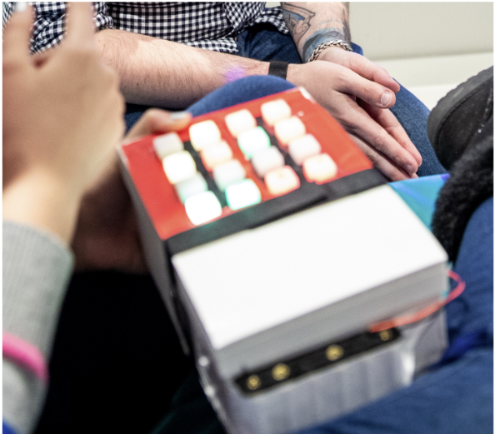

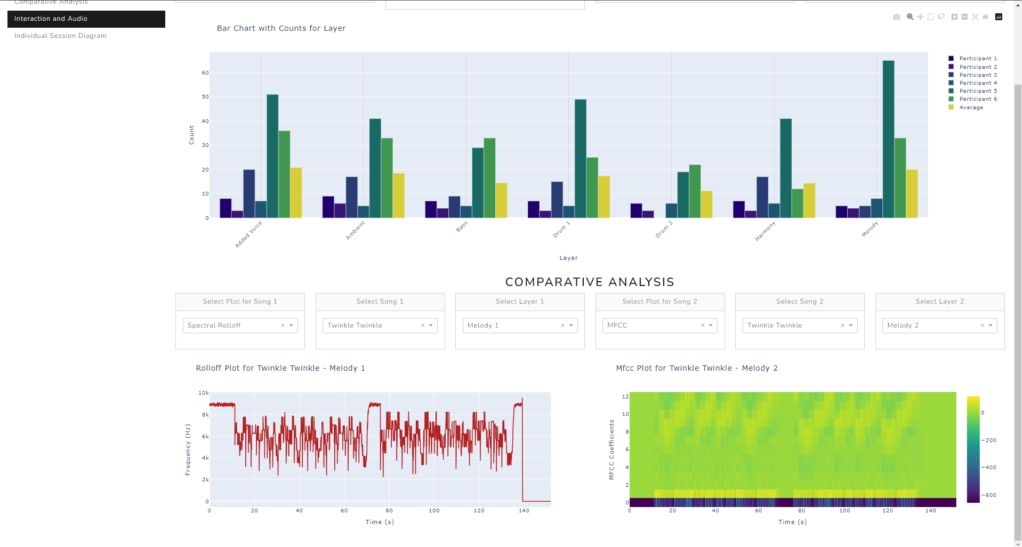



Research Gap
Introduction Research Gap Research Questions uCue Results Future Work
Introduction
Introduction Research Gap
Existing Research
Proposed Research
Traditional Music Therapy Framework
Proposed uCue Musical Framework
No Music Personalization options
No Logs available for improvising music therapy
Music Personalization based on needs
Analyzing the Logs to improvise the therapy sessions
No Logging
No Customization
Notes:
Sound personalization is important because it tailors auditory experiences to individual sensitivities and preferences, reducing distress and enhancing engagement for children with autism.

Slide 6
Research Questions
Introduction Research Gap Research Questions
Introduction Research Gap Research Questions uCue Results Future Work
Does interacting with a tangible interface help children with ASD actively identify and express their musical preferences?
Can engaging with a tangible interface to create music facilitate emotional expression and enhance these children's enjoyment of music?
How might children with ASD benefit from having greater autonomy over their listener experience?
What if children with ASD were able to personalize their own music to enhance their listening experience?

Slide 7
What is uCue?
Introduction Research Gap Research Questions uCue
uCue
Introduction Research Gap Research Questions uCue Results Future Work
A musical interface designed to enhance musical engagement
Incorporates modular arrangements of children's songs set at an accessible tempo and allows users to modify musical layers as needed
Collects data on listener interactions, including layer combination and timing, which can inform composers in creating more engaging music for this population.
uCue was created with a vision of “You create, you enjoy”

Slide 8
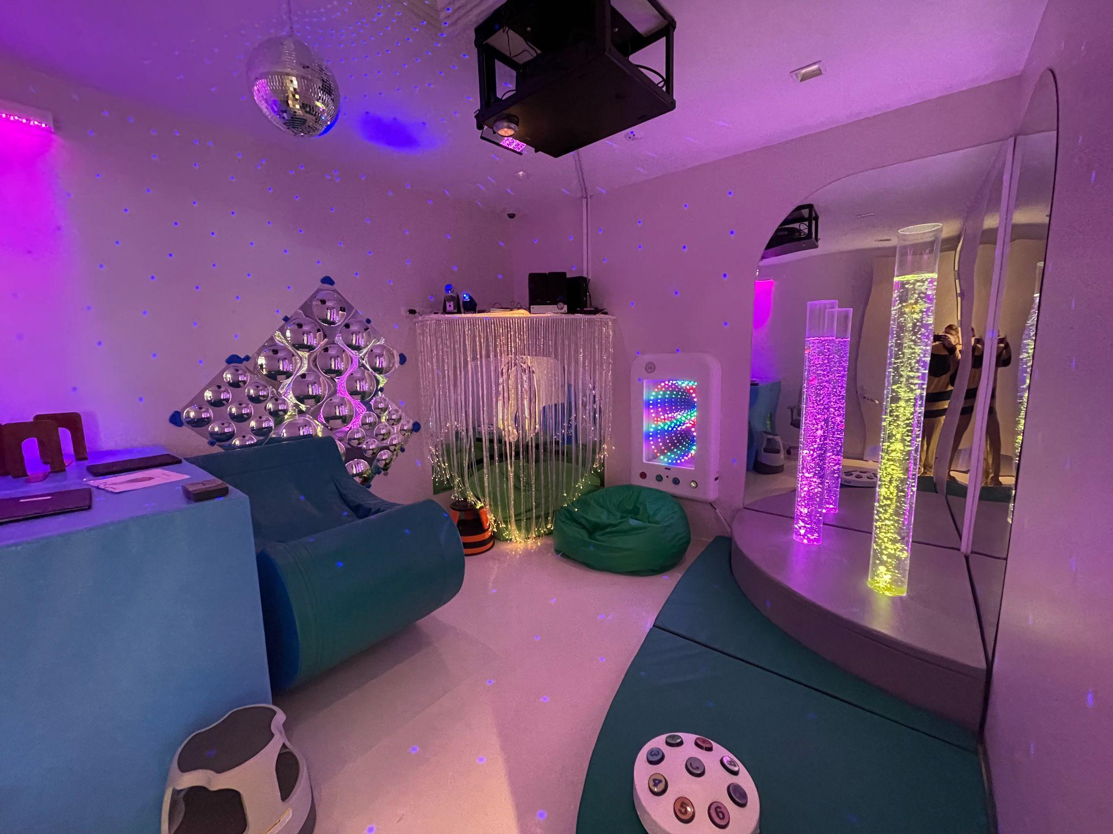
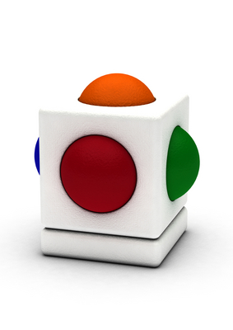
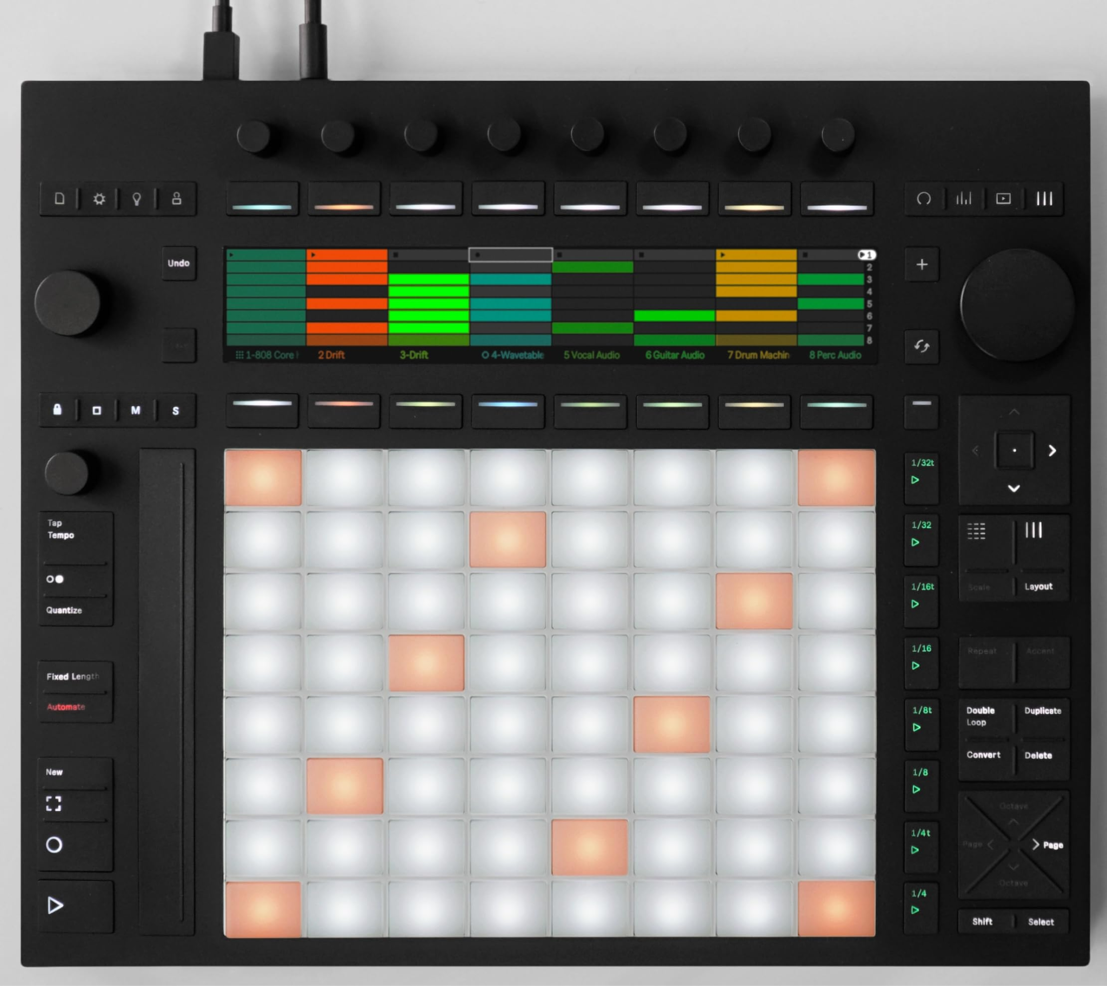
uCue: A Tangible Musical Interface
Introduction Research Gap Research Questions uCue
uCue
Introduction Research Gap Research Questions uCue Results Future Work
Ableton Push
Skoog
Sensory Room
Notes:
the room allows for both stimulation and relaxation, catering to different sensory needs.

Slide 9
Design
Introduction Research Gap Research Questions uCue
uCue
Introduction Research Gap Research Questions uCue Results Future Work
The design process included collaboration with experts from Autism Delaware and the Rt. 9 Library & Innovation Center, alongside educators, family members, and researchers with personal ASD experience.
Their input shaped sensory-friendly design choices like soft buttons, gentle lighting, and intuitive interactions to reduce sensory overload.
Although children with ASD were not directly involved in early design, trusted advisors informed design, study protocol, and communication strategies.

Slide 10
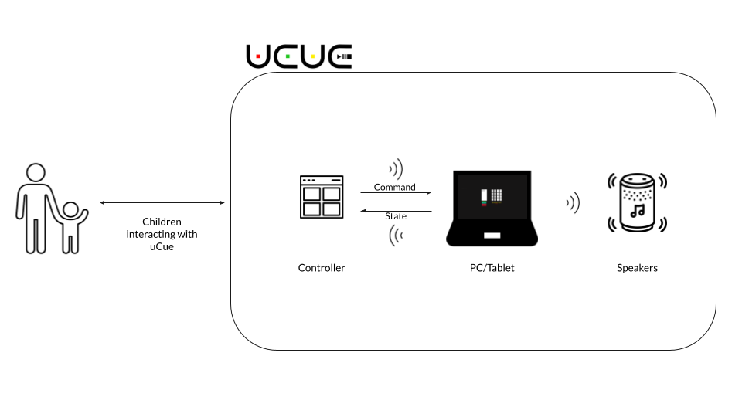
System Diagram
Introduction Research Gap Research Questions uCue
uCue
Introduction Research Gap Research Questions uCue Results Future Work

Slide 11
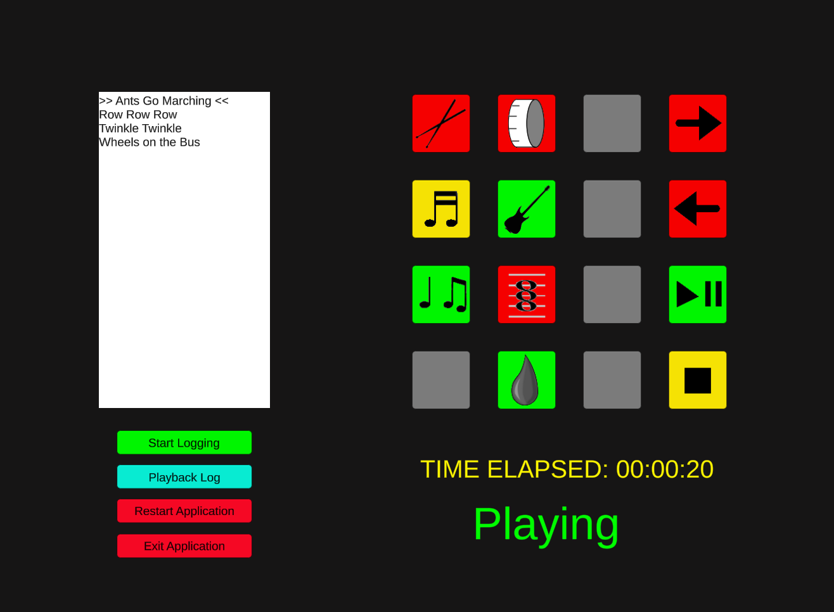
Software Interface
Introduction Research Gap Research Questions uCue
uCue
Introduction Research Gap Research Questions uCue Results Future Work

Slide 12
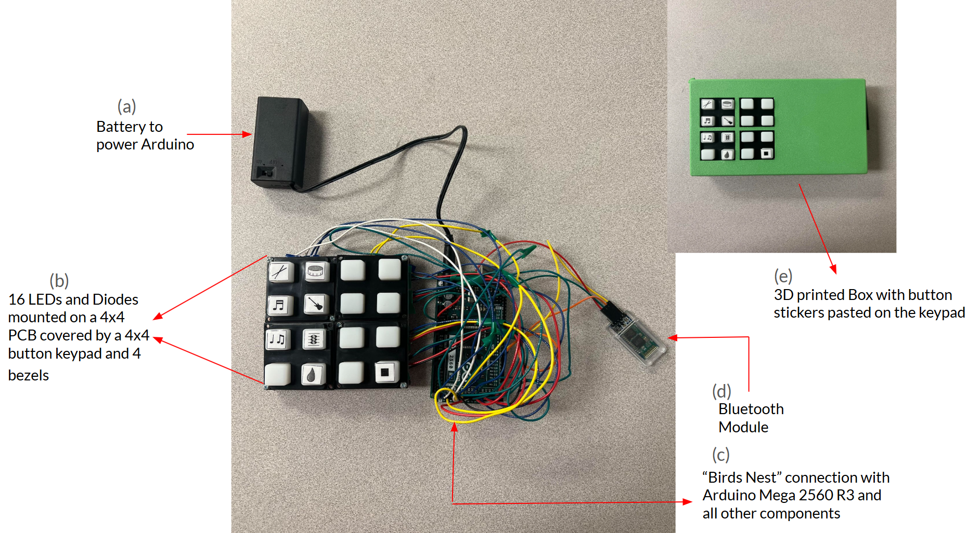
Hardware Architecture
Introduction Research Gap Research Questions uCue
uCue
Introduction Research Gap Research Questions uCue Results Future Work

Slide 13
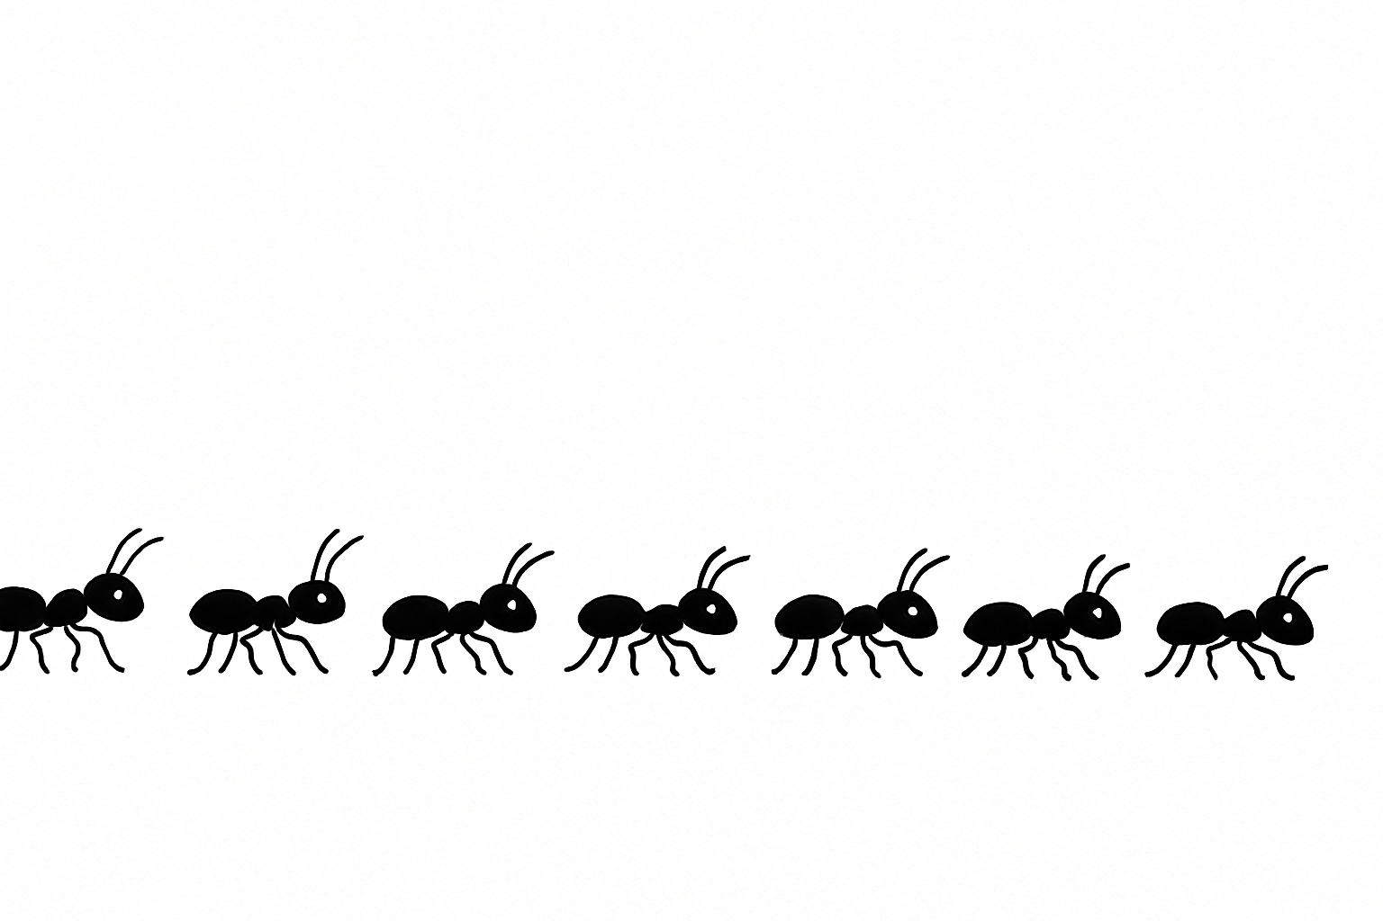



Musical Library
Introduction Research Gap Research Questions uCue
uCue
Introduction Research Gap Research Questions uCue Results Future Work
Ants Go Marching
Wheels on the Bus
Twinkle Twinkle
Row Row Row Your Boat
Notes:
Through an informal survey we conducted with Autism Delaware, children and families indicated they wanted to hear and play with the above songs

Slide 14
Musical Layers
Introduction Research Gap Research Questions uCue
uCue
Introduction Research Gap Research Questions uCue Results Future Work
*Over 2000 possible different combinations of sounds
Melody | Additional Melody | Harmony | Bass Line | Percussion | Bass Drum | Ambient Sounds
D1
M1 | M2 | M3
H1 | H2
P1
A1 | A2 | A3
B1 | B2
S1 | S2 | S3

Slide 15
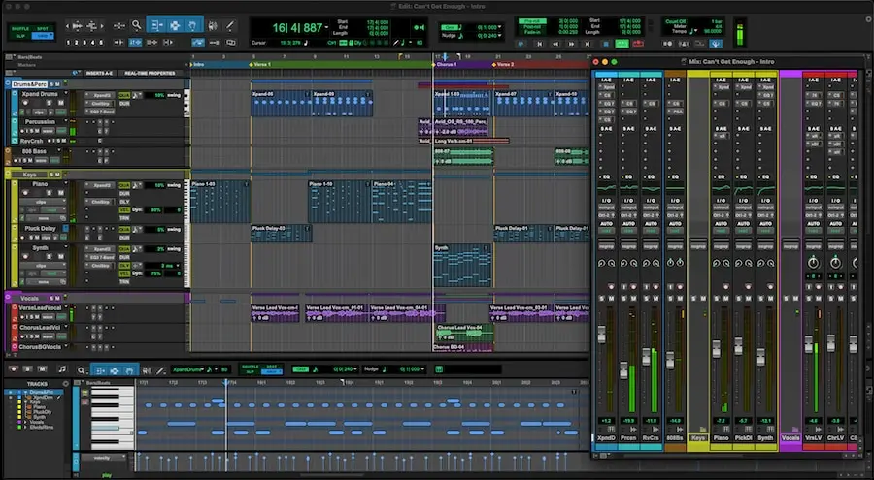
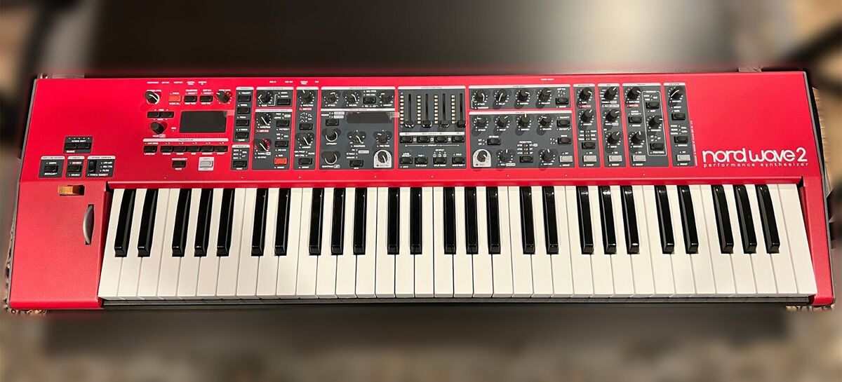
Musical Composition Tools
Introduction Research Gap Research Questions uCue
uCue
Introduction Research Gap Research Questions uCue Results Future Work
Nord Wave 2 Synthesizer
Elektron Digitakt
Arturia Polybrute
Notions & Composing
MuseScore
Sibelius
Midi Manipulation & Mixing
ProTools
*Standard tools for music composition and production

Slide 16
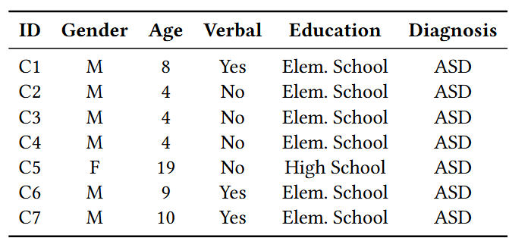
Recruitment
Introduction Research Gap Research Questions uCue
uCue
Introduction Research Gap Research Questions uCue Results Future Work

Slide 17
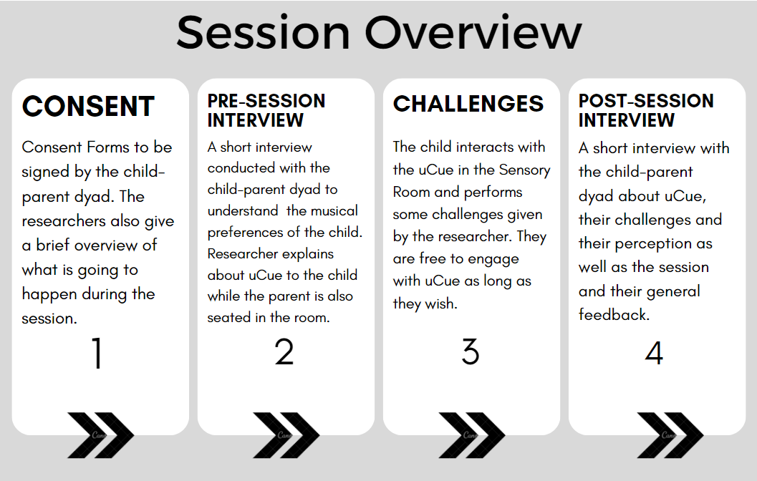
Procedure
Introduction Research Gap Research Questions uCue
uCue
Introduction Research Gap Research Questions uCue Results Future Work

Slide 18
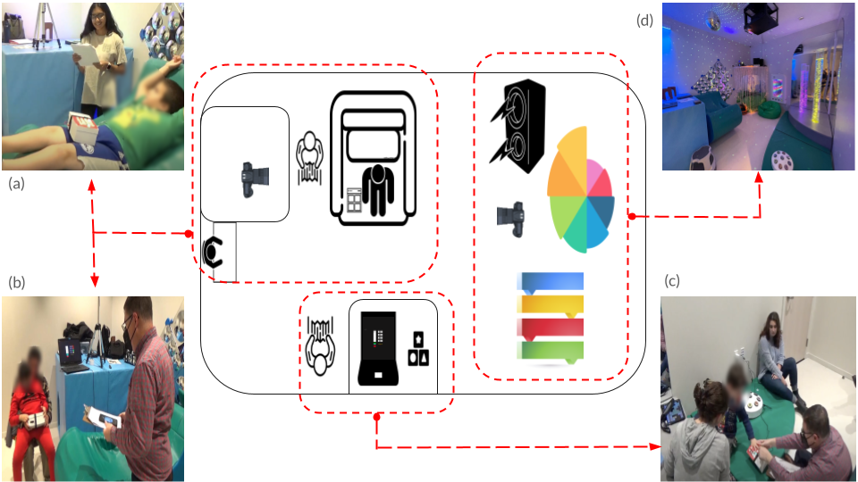
Sensory Room and Session Images
Introduction Research Gap Research Questions uCue
uCue
Introduction Research Gap Research Questions uCue Results Future Work

Slide 19
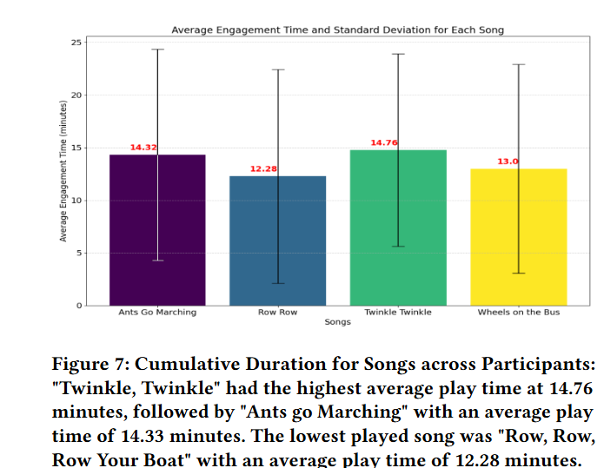
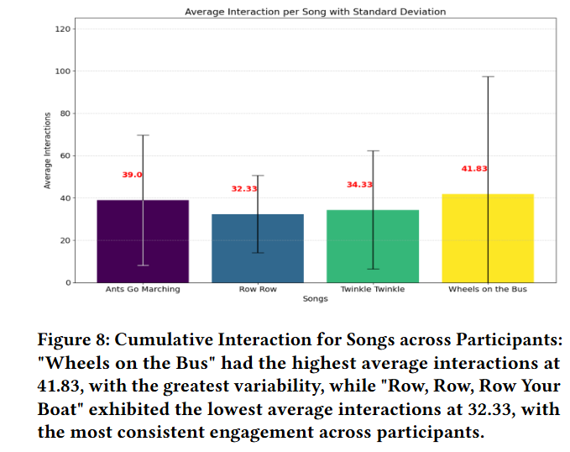
Results: Participant Interaction
Introduction Research Gap Research Questions uCue Results
uCue
Introduction Research Gap Research Questions uCue Results Future Work

Slide 20
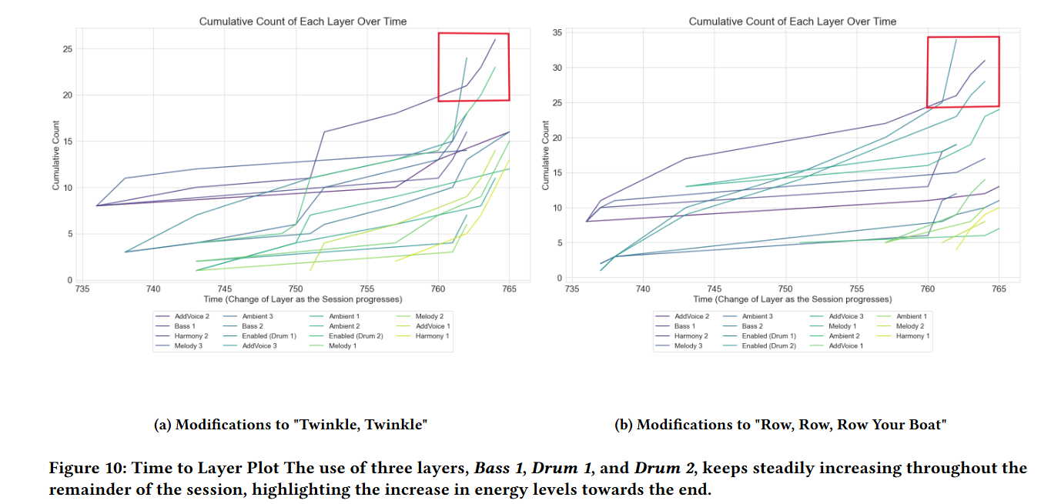
Results: Responses to the Prompts
Introduction Research Gap Research Questions uCue Results
uCue
Introduction Research Gap Research Questions uCue Results Future Work

Slide 21
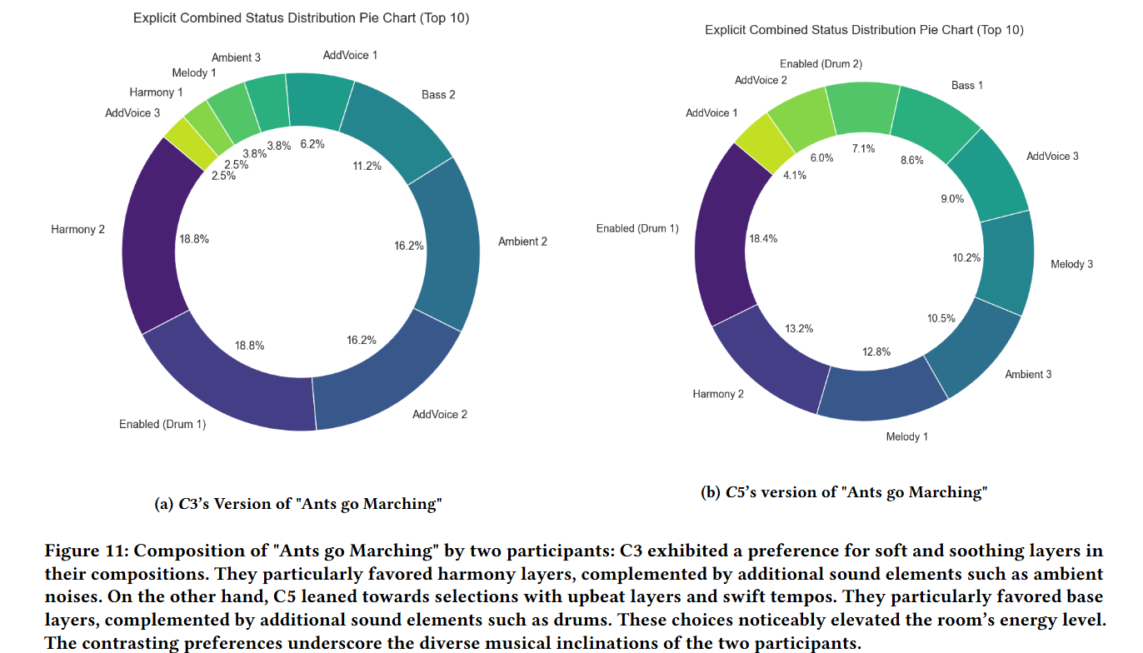
Results: Individual Preferences
Introduction Research Gap Research Questions uCue Results
uCue
Introduction Research Gap Research Questions uCue Results Future Work

Slide 22
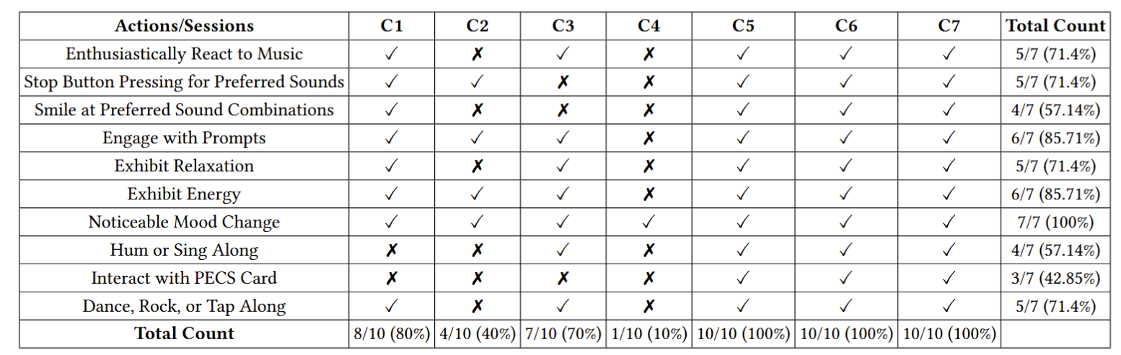
Results: Reactions and Engagement
Introduction Research Gap Research Questions uCue Results
uCue
Introduction Research Gap Research Questions uCue Results Future Work
Notes:
Through coding the session videos using a structured rubric, we reached these results

Slide 23


Results: Parents Perception
Introduction Research Gap Research Questions uCue Results
uCue
Introduction Research Gap Research Questions uCue Results Future Work
My child was excited to explore the device and try different sounds, they smiled and laughed while using the device but also got frustrated when a song stopped abruptly
...liked changing colors and playing with the buttons. It showed they were genuinely engaged and curious. The rhythmic beats seemed to stimulate their movements and energy levels
These moments of decision-making provided insights into how children could exercise autonomy within the uCue framework.

Slide 24
Contributions
Introduction Research Gap Research Questions uCue
uCue
Introduction Research Gap Research Questions uCue Results Future Work
Empirical evidence suggesting uCue's potential to supports children with ASD in accessing formative music experiences
uCue's logs were able to gather valuable interaction data and provide insights about global musical preferences.
The design of a modular music template and prototype music library

Slide 25
Future Work
Future Work
Introduction Research Gap Research Questions uCue Results Future Work
Expand Access: Develop web-based interfaces to reach children beyond local communities.
Composer-Guided Insights: Leverage interaction data to help composers identify effective musical patterns and structure more engaging, personalized compositions.
Refine Activities: Broaden uCue-supported tasks for diverse learning goals in music therapy.

Slide 26




Acknowledgements
Autism Delaware:
Heidi Mizell, Family Resource Coordinator
Rt. 9 Library & Innovation Center New Castle, Delaware
UD Honors Music Students:
Catherine Gilroy, Alondra Gonzalez, Kurt Hammen, Jason Lambros, William Metten, Noah Mummert, Abby Von Ohlen, Ray Pragman, Robert Strauss
Connor Fone and Justin Ike Eichenberg
UD Computer & Information Sciences Students and Faculty:
Maxwell Wang, Chris Bennett and Connor Penhale
Bryan Youse
With Generous Support from:
Maggie E. Neumann Fund College of Health Sciences University of Delaware
Institute of Engineering Driven Health University of Delaware

Slide 27


Thank You! Questions?
Abhishek Karwankar
karwabhi@udel.edu
abhiishek11.github.io
Elise Ruggiero
emrugg@udel.edu
www.linkedin.com/in/eliseruggiero

