Slide 1



“You Figure It Out By Yourself”: Women’s Transitions from Computer Science Education to the Workforce
ACM RESPECT, June 2026
Presented by: Jessica Manchak
Aishwarya Chandrasekaran, Matthew Louis Mauriello
Notes:
Introduction
“You Figure It Out by Yourself”: Women’s Transitions from Computer Science Education to the Workforce
Department of computer and information sciences at the university of delaware
___
Good afternoon.
My name is Jessica Manchak, and today I'll be presenting our research titled 'You Figure It Out by Yourself': Women's Transitions from Computer Science Education to the Workforce.
This work was completed through the Department of Computer and Information Sciences at the University of Delaware.

Slide 2
Contents
Background & Motivation
Research Questions & Goals
Methodology
Key Findings
Insights, Limitations, Future Work
University of Delaware
Sensify Lab
RESPECT 2026
Notes:
First I'll briefly discuss the motivation and research gap, then the research questions and methodology, before focusing on the key findings and implications.

Slide 3
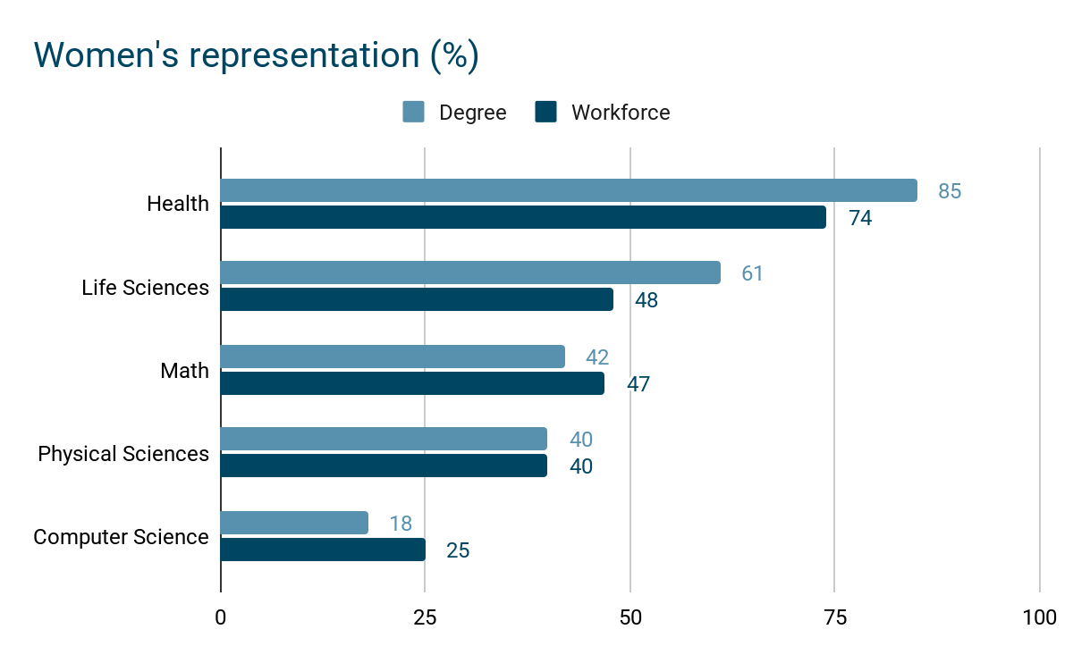
Motivation
Women remain underrepresented in computer science, yet existing research often examines education and workforce experiences separately rather than across the transition between them.
Adapted from Pew Research Center, (Fry et al., 2021)
University of Delaware
Sensify Lab
RESPECT 2026
Notes:
Women remain significantly underrepresented in both CS education and the computing workforce, even while representation has improved in many other STEM disciplines.
As of 2021, women earned roughly one-fifth of CS bachelor’s degrees and represented about one-quarter of the computing workforce.
This is especially notable because fields like health sciences and life sciences have seen much higher levels of women’s participation.
So CS remains somewhat of an outlier within STEM.
Existing research often focuses either on getting women into CS or retaining them once they enter the workforce.
But fewer studies examine how experiences carry across the transition between education and professional practice.
That transition became the central focus of this study.
CS did not see the same growth as other STEM disciplines
Just say: growth in other stem disciplines
___
***Current/recent statistics
Women remain underrepresented in both computer science education and the computing workforce.
As shown in the graph, representation has improved across many STEM disciplines, but CS has not experienced the same growth.
While prior research often examines education or workforce experiences separately, less attention has been given to what happens during the transition between them. That transition became the focus of this study.

Slide 4

Historical Context
Women’s underrepresentation in CS is historically and socially constructed, shaped by cultural narratives, unequal early access, and assumptions about belonging.
(Misa, 2015; Hill et. al., 2010; Master et. al., 2021)
University of Delaware
Sensify Lab
RESPECT 2026
Notes:
Women were not always as underrepresented in computing as they are today.
Participation peaked mid-1980s ~37% degree earnings
Even earlier (non-traditional/non-CS degrees) women played major roles in programming and systems work before computing became heavily masculinized
Rise of home computing + masculine stereotypes shifted participation
This history is important because it shows that underrepresentation is not about innate ability or lack of interest.
Instead, participation has been shaped by social expectations, cultural narratives, and unequal access over time.
___
It's also important to recognize that this underrepresentation is historically constructed.
Women played major roles in early computing, and participation actually peaked in the 1980s before declining.
This suggests that current disparities are shaped less by ability and more by social and cultural factors.

Slide 5
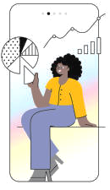
Background
Women’s underrepresentation in CS reflects the cumulative effects of stereotypes, bias, and cultural barriers rather than differences in technical ability.
(Lunn, 2021; Misa, 2021)
Notes:
Stereotypes and gendered expectations discourage women’s participation
Structural constraints rather than disinterest
Research also shows that women often face barriers related to belonging, evaluation, and recognition in both academic and workplace settings.
Disproportionate emotional labor, unequal recognition, undervalued soft skills
Together, these experiences affect persistence over time, even when technical ability is not the issue.
___
Research consistently shows that barriers to participation are tied to stereotypes, bias, and questions of belonging rather than technical ability.
Women often face challenges related to recognition, credibility, and inclusion across both educational and professional settings.

Slide 6


Existing Support Efforts
Educational level
Contextualized curriculum
Inclusive pedagogy
Mentorship programs
Organizational level
Diversity initiative
Bias training
Work-life balance policies
University of Delaware
Sensify Lab
RESPECT 2026
Notes:
Current efforts; prior work has proposed a range of interventions aimed at improving participation and retention.
(e.g., social impact, collaboration, interdisciplinary application)
Educational level: promising results in improving women’s engagement/sense of belonging & retention
employee resource groups, mentorship programs, and inclusive policies (e.g., workplace flexibility, diversity initiatives)
Professional level: aim to improve inclusion/effectiveness & support career persistence, varies by institution
While these interventions can improve inclusion, their effectiveness often varies across institutions.
More importantly, many of these efforts are implemented separately within either educational or workplace contexts.
This creates a gap in understanding how support systems, or lack of thereof, shape experiences across the transition between them.
Credibility: needing to prove themselves more; external validation often shapes confident
Belonging: finding/missing sense of belonging/fitting in & being supported
Invisible labor: women often take on extra work that goes unrecognized
Make intro simpler!!!! Needs to be smoothed out
___
In response, researchers and organizations have proposed a variety of interventions, including mentorship programs, inclusive teaching practices, diversity initiatives, and workplace support structures.
However, these efforts are often studied separately within either education or industry.

Slide 7
Resources for slide 6
Master et al., 2021
Avolio et al., 2020
University of Delaware
Sensify Lab
RESPECT 2026
Notes:
Current efforts; prior work has proposed a range of interventions aimed at improving participation and retention.
(e.g., social impact, collaboration, interdisciplinary application)
Educational level: promising results in improving women’s engagement/sense of belonging & retention
employee resource groups, mentorship programs, and inclusive policies (e.g., workplace flexibility, diversity initiatives)
Professional level: aim to improve inclusion/effectiveness & support career persistence, varies by institution
While these interventions can improve inclusion, their effectiveness often varies across institutions.
More importantly, many of these efforts are implemented separately within either educational or workplace contexts.
This creates a gap in understanding how support systems, or lack of thereof, shape experiences across the transition between them.
Credibility: needing to prove themselves more; external validation often shapes confident
Belonging: finding/missing sense of belonging/fitting in & being supported
Invisible labor: women often take on extra work that goes unrecognized

Slide 8
Research Gap
Existing work focuses on recruitment into education or retention within these settings.
Education
Transition
Workforce
Learn technical skills
Earn credentials
Build confidence & interest
Face bias & stereotypes
?
Apply skills
Grow in career
Contribute to teams & projects
Encounter workplace culture & dynamics
University of Delaware
Sensify Lab
RESPECT 2026
Notes:
longterm involvement/participation
how diff support systems can influence
Existing literature often treats education and workforce experiences as separate stages.
Recruitment research typically focuses on early exposure and increasing participation in CS pathways.
Workforce research often focuses on retention, workplace culture, or advancement.
However, these approaches rarely examine how experiences accumulate across the pipeline over time.
Early experiences can shape confidence, expectations, and vulnerability to bias during later transitions.
Support systems may also become less visible or less accessible during transitions into internships or professional roles.
This study addresses that gap by examining women’s experiences across both educational and workplace contexts within a single study.
Rather than focusing only on entry or retention, the goal is to better understand long-term participation and persistence in CS.
Fail to account for how early experiences shape expectations, confidence & vulnerability to bias
Define earlier what the “pipeline” is
When talking about the transition, keep message simple here as well
___
To fill this gap, we focus on what is often referred to as the academic-to-career pipeline, which emphasizes the movement from education into professional computing roles.
Existing research tends to focus either on recruitment into CS or retention in the workforce.
What we know much less about is how experiences and support systems carry across the transition itself.

Slide 9

Goal: Understand how women enter CS and how early experiences shaped participation
Research Question 1: “How do gendered norms, stereotypes, and institutional practices shape women’s pathways into CS and their experiences in CS education?”
University of Delaware
Sensify Lab
RESPECT 2026
Notes:
The first research question focused on women’s entry into CS and their early educational experiences.
exposure, stereotypes, and institutional practices shaped participants’ pathways into the field.
Prior work suggests that participation is influenced not only by ability, but also by social validation, belonging, and access to opportunities.
explored how participants first encountered CS, what encouraged or discouraged participation, and how early experiences shaped confidence and legitimacy within technical spaces.
___
To address this gap, my first research question examined how women entered CS and how early experiences shaped participation.

Slide 10

Goal: Examine continuity in experiences of belonging, evaluation, and credibility
Research Question 2: “How do these gendered dynamics persist or shift as women transition from CS education into professional settings, and how do they shape persistence?”
University of Delaware
Sensify Lab
RESPECT 2026
Notes:
examined the transition from education into professional settings.
whether experiences related to evaluation, credibility, and belonging changed or persisted across contexts.
Prior research often examines classroom or workplace experiences independently.
This question instead focused on continuity across the transition itself.
how participants described confidence, professional legitimacy, peer interactions, and workplace expectations during internships or early career experiences.
___
The second question focused on whether experiences related to belonging, evaluation, and credibility changed or persisted during the transition into professional settings.

Slide 11

Goal: Explore how mentorship, peer support, and workplace structures influenced long-term participation
Research Question 3: “How do women describe the role of institutional support across the academic-to-career pipeline, and how do these experiences inform more equitable and approachable CS environments?”
University of Delaware
Sensify Lab
RESPECT 2026
Notes:
focused on support systems across the pipeline.
mentorship, peer networks, women-centered organizations, and workplace structures shaped persistence over time.
interested in how participants described support as necessary for navigating transitions and reducing uncertainty.
also explored what participants believed institutions could do differently to create more equitable and approachable CS environments.
__
And the third question examined how support systems such as mentorship, peer networks, and workplace structures influenced persistence across the pipeline.
To answer these questions, we conducted a qualitative interview study.

Slide 12

Methodology
Qualitative interview study
Semi-structured
N = 9
Students + professionals (current or former)
~1 hour virtual interviews
University of Delaware
Sensify Lab
RESPECT 2026
Notes:
We conducted semi-structured interviews with nine women at different stages of the education-to-workforce pipeline.
Interviews lasted approximately one hour and explored educational experiences, workplace experiences, and transitions between them.

Slide 13
Recruitment
University of Delaware
Sensify Lab
RESPECT 2026
Notes:
Qualtrics intake survey
Emailing, linkedin, limited snowballing
Qualified participants would be sent follow up email to sign up for an interview time slot via Calendy, which would be hosted over Zoom
___
Participants were recruited through online outreach, professional networks, and limited snowball sampling.
Eligible participants completed an intake survey and then participated in a Zoom interview.

Slide 14




Participant Overview
Age
Status
18-24
35-34
35-44
45+
Educational Background
Years of Experience
1-3
4-6
7+
University of Delaware
Sensify Lab
RESPECT 2026
Notes:
Participants represented multiple stages of the education-to-workforce pipeline
Interviewed 2 undergraduate students
6 currently employed
1 previously employed
Educational background
7 CS related, 2 non-CS related pathway (academically)
Non
Bachelor's, English/Classics; Master's, Library Science
Bachelor's, Wildlife Conservation
Age groups ranged from: 18-24 to 45+
5 age 18-24
1 age 25-34
2 age 35-44
1 age 45+
Experience ranged from: 1-3yrs to 7+yrs
3 exp. 1-3yrs
3 exp. 4-6yrs
3 exp. 7+yrs
___
The sample included both students and professionals (as well as 1 former professional)
, representing a range of ages from groups of 18-24 to 45+,
A small variety of educational backgrounds with 7 participants following a traditional CS pathway, and 2 following a non-traditional pathway (where bachelor’s degrees were earned in alternative programs)
and levels of industry experience, ranging from 1-3yrs to 7+yrs.

Slide 15
Thematic Analysis
Braun and Clarke, 2006
Iterative coding process
IRR improved from κ = 28 → κ = 75
Codes clustered into higher-level themes
Key Theme Areas:
Prior Exposure
Undergraduate Experience
Employee/Internship Experience
University of Delaware
Sensify Lab
RESPECT 2026
Notes:
finalized codebook included codes related to early CS exposure, educational experiences, workplace dynamics, transitions, support systems, and factors influencing persistence
initial IRR score (0.28) prompted refinement of code definitions and clarification of overlaps
After revision, the codebook achieved acceptable reliability (0.75) and was then applied consistently across all transcripts
Describe the # of codes & code that then became the key themes…. Important bit to say based on this slide is that these are some of the high-level themes
___
To answer these research questions, I conducted a thematic analysis following Braun and Clarke's approach.
The coding process was iterative. An initial round of coding produced a preliminary codebook, and inter-rater reliability improved from Cohen's Kappa κ .28 to .75 after refinement.
The final codes were then grouped into broader themes. The themes shown here are some of the higher-level categories that ultimately guided the analysis and findings.

Slide 16
Key Findings
1.
2.
3.
Entry into CS was uneven and often shaped by stereotypes
Gendered evaluation persisted across transitions
Support systems enabled persistence
University of Delaware
Sensify Lab
RESPECT 2026
Notes:
The findings centered on three themes:
First, entry into CS was shaped by exposure and stereotypes.
Second, gendered evaluation persisted across educational and workplace settings.
And third, support systems played a critical role in persistence.

Slide 17
Findings: Entry into CS Was Shaped by Exposure and Legitimacy
Many participants entered CS indirectly
Early exposure opportunities were uneven
“And one more thing I would like tell other people is, like, just because you don't seem like the the stereotypical computer scientist doesn't mean you can't be one, because that was something because that was something I kind of struggled with.” (P1)
University of Delaware
Sensify Lab
RESPECT 2026
Notes:
Most participants did not initially plan to pursue CS.
Many first encountered computing through required coursework, peer suggestion, or indirect exposure rather than long-term technical identity.
Early exposure functioned less as a pipeline advantage and more as a legitimizing experience that helped participants see themselves as capable of belonging in CS.
However, access to these experiences was uneven.
Participants without prior exposure often described uncertainty about whether they were “technical enough” to succeed.
Change this & subsequent findings to “Findings: <Thing>” instead of “Finding #”
Also working/reread the quotes on the slides “For example, participant X said…”
___
Many participants did not initially plan to pursue computer science.
Instead, they entered through coursework, peer influence, or other indirect pathways.
Exposure often served as a legitimizing experience that helped participants see themselves as capable of belonging in CS.
For example, Participant 1 explained that not fitting the stereotype of a computer scientist initially made them question whether they belonged, reflecting “Just because you don't seem like the stereotypical computer scientist doesn't mean you can't be one”

Slide 18
Findings: Entry into CS Was Shaped by Exposure and Legitimacy
Masculinized stereotypes created hesitation
Social encouragement legitimized participation
“I remember my friends even saying, like, oh, well, you're a girl, so you obviously aren't going to do computer science, even that recently. But I always played lots of video games, and was like, into a lot of sort of nerdy culture kind of stuff. And so I was, like, close. I liked computers a lot. I was very interested in them, even though I wasn't, I didn't study it.” (P2)
University of Delaware
Sensify Lab
RESPECT 2026
Notes:
Participants frequently described stereotypes portraying computer scientists as male, socially isolated, or naturally gifted.
These stereotypes created hesitation and self-doubt even among highly capable participants.
At the same time, encouragement from peers, faculty, or mentors often played a legitimizing role.
Social validation helped participants reframe CS as a space where they could belong.
This suggests that entry into CS was shaped not only by interest or ability, but also by cultural perceptions and external affirmation.
___
Participants also described stereotypes portraying computer scientists as male or naturally gifted.
These stereotypes created hesitation and self-doubt.
At the same time, encouragement from peers, faculty, or mentors often helped validate participation.
For example, Participant 2 recalled being told:
'Well, you're a girl, so you obviously aren't going to do computer science.'
Experiences like this highlight how entry into CS was shaped not only by interest, but also by cultural expectations and social validation.

Slide 19
Findings: Gendered Evaluation Persisted Across Transitions
Underrepresentation shaped visibility and participation
Peer interactions reinforced credibility differences
“I think computer science and girls, like a lot of girls, fall out of computer science because they don't think they can do it, and they're not, like, no one's there, like, cheerleading for them.” (P6)
University of Delaware
Sensify Lab
RESPECT 2026
Notes:
Participants consistently described navigating male-dominated environments across both education and workplace settings.
Underrepresentation increased visibility and often created representational pressure.
Many participants described being one of the only women in classrooms, teams, or meetings.
Peer interactions also reinforced unequal participation and credibility.
Women described being interrupted, overlooked, or needing to repeatedly prove competence.
These experiences were rarely described as overt discrimination, but rather as subtle and cumulative patterns that shaped confidence and belonging over time.
___
Participants described similar challenges in both educational and workplace settings.
Many were frequently one of the only women in classrooms, teams, or meetings.
They also described needing to continually prove their competence.
As Participant 6 noted:
'A lot of girls fall out of computer science because they don't think they can do it, and no one's there cheerleading for them.'
These experiences often accumulated over time and influenced confidence and belonging.

Slide 20
Findings: Gendered Evaluation Persisted Across Transitions
Women described being spoken over or being assigned non-technical work
Credibility often required additional validation
“I must have tried to say it very diplomatically... Eventually I gave up and messaged one of the senior devs... and the guy immediately changed it.” (P8)
University of Delaware
Sensify Lab
RESPECT 2026
Notes:
Gendered expectations also shaped task allocation and evaluation.
Participants frequently described being pushed toward coordination, communication, or organizational work while male peers claimed technical responsibilities.
In workplace settings, women often described needing external validation before their technical contributions were taken seriously.
These experiences reflected broader patterns of invisible labor and uneven recognition.
Importantly, participants linked persistence less to technical ability and more to whether their contributions were acknowledged and valued
___
Participants also described credibility challenges that extended into professional settings.
Women were often assigned organizational or communication-focused work while technical contributions received less recognition.
For example, Participant 8 described repeatedly suggesting a solution that was ignored until a senior male developer reinforced the same idea.
This illustrates how credibility often required additional validation before women's technical expertise was taken seriously.

Slide 21
Findings: Support Systems Enabled Persistence
Persistence depended on support continuity within and across transitions
Mentorship reduced isolation and uncertainty
Women-centered organizations normalized struggle and belonging
“Seeing that other people were having the same sort of struggles... one girl helped me a lot with my resume... that was really a turning point for me.” (P6)
University of Delaware
Sensify Lab
RESPECT 2026
Notes:
Participants consistently described support systems as critical mechanisms of persistence.
Mentorship, peer support, and women-centered organizations helped reduce intimidation and normalize uncertainty.
These environments also helped participants recognize that many struggles were shared rather than personal failures.
Support systems created identity-safe spaces where participants could ask questions, build confidence, and access career guidance.
Main point, make sure to nail this part & slide 22
___
Participants consistently described support systems as critical mechanisms of persistence.
Mentors, peer networks, and women-centered organizations helped reduce isolation and normalize challenges.
For example, Participant 6 described connecting with other women who were experiencing similar struggles and receiving career guidance that became, in her words, a turning point.
These supports did more than provide resources. They helped participants feel that they belonged in the field and could succeed within it.

Slide 22
Findings: Support Systems Enabled Persistence
Persistence depended on support continuity within and across transitions
Workplace support systems varied
Transitions became harder when support lessened or was absent
“Yeah, they should definitely do that with computer science, like, give, like, a little externship with a company. So, yeah, like, students are able to know the difference with the transitions between work and then school. Because it's definitely like, it's like, you just, you're thrown in, because everything you do in school is not like, the same as we do in work, which that was, like, a thing that would, they would teach us beforehand.” (P7)
University of Delaware
Sensify Lab
RESPECT 2026
Notes:
Participants described the education-to-workforce transition as especially difficult when institutional support became inconsistent.
In academic settings, expectations and evaluation structures were often clearer and more scaffolded.
Professional environments introduced greater ambiguity and less structured guidance.
Some organizations provided mentorship, onboarding, or inclusive team cultures that supported adjustment.
Others relied heavily on individuals to independently seek support and navigate uncertainty.
These findings suggest that persistence is not solely individual resilience, it is institutionally enabled.
___
Support became especially important during the transition into professional settings.
Several participants described feeling that support structures became less visible after leaving school.
Participant 7 explained:
'It's like you're just thrown in.'
When mentorship, onboarding, and guidance were available, transitions were easier.
When they were absent, participants often felt responsible for figuring everything out on their own."

Slide 23
Implication: Persistence Is Institutionally Shaped
Support mattered more than ability alone
Barriers accumulated across contexts
Transitions are critical inflection points
University of Delaware
Sensify Lab
RESPECT 2026
Notes:
Participants did not describe technical inability as the primary barrier.
Instead, persistence depended on whether institutions provided consistent support across contexts.
The transition into professional environments often intensified existing confidence disruptions when support systems became less visible or less accessible.
This suggests that persistence should be understood as institutionally shaped rather than individually determined.
Feels more like findings, trim this part down or move it to earlier
___
One implication of these findings is that persistence should be understood as institutionally shaped rather than purely individual.
Participants rarely described technical ability as the primary challenge.
Instead, persistence depended on whether support systems remained available across educational and professional contexts, particularly during transitions.

Slide 24
Implication: Recognition and Evaluation Matter
Invisible labor constrained technical growth
Credibility was unevenly granted
Evaluation and recognition systems reinforced inequities
University of Delaware
Sensify Lab
RESPECT 2026
Notes:
Participants frequently described needing to establish credibility repeatedly across both educational and workplace settings.
Women were also disproportionately pushed toward relational or organizational labor that sustained teams but was undervalued.
These patterns shaped opportunities for technical development, advancement, and recognition.
Improving participation therefore requires structural changes in how contributions are evaluated and rewarded.
___
A second implication concerns how technical contributions are evaluated.
Participants described needing to establish credibility repeatedly while also taking on forms of labor that were important but often undervalued.
Improving participation therefore requires attention not only to representation, but also to how work is recognized and rewarded.

Slide 25
Implication: Support Must Be Expansive
Recruitment alone is insufficient
Mentorship and identity-safe spaces supported persistence
Transition-focused support structures may reduce attrition
University of Delaware
Sensify Lab
RESPECT 2026
Notes:
Early exposure and recruitment initiatives remain important, but they are not sufficient on their own.
Participants emphasized the importance of sustained mentorship, peer support, and accessible institutional guidance across transitions.
Structured onboarding, mentorship continuity, and transparent expectations may help reduce confidence disruptions during early professional stages.
These findings suggest that long-term participation depends on continuity of support rather than isolated interventions.
___
Finally, these findings suggest that recruitment efforts alone are not enough.
Participants emphasized the importance of mentorship, community, and structured guidance throughout the transition into professional roles.
Long-term participation depends on continuity of support, not simply entry into the field.

Slide 26

Limitations and Future Work
Small US-based qualitative sample
Limited intersectional analysis
Current trends (i.e. AI, remote work)
University of Delaware
Sensify Lab
RESPECT 2026
Notes:
There are limitations of this work which include…..
“As far as Limitations & Future Work….”
__
As far as limitations and future work, this study draws on a small qualitative sample of nine participants within the United States, so the findings are not intended to be broadly generalizable.
Additionally, intersectional factors such as race, socioeconomic background, and first-generation status were outside the primary scope of this study.
Future research could examine larger and more diverse populations, as well as how emerging trends such as remote work and AI-assisted development may influence the education-to-workforce transition.

Slide 27


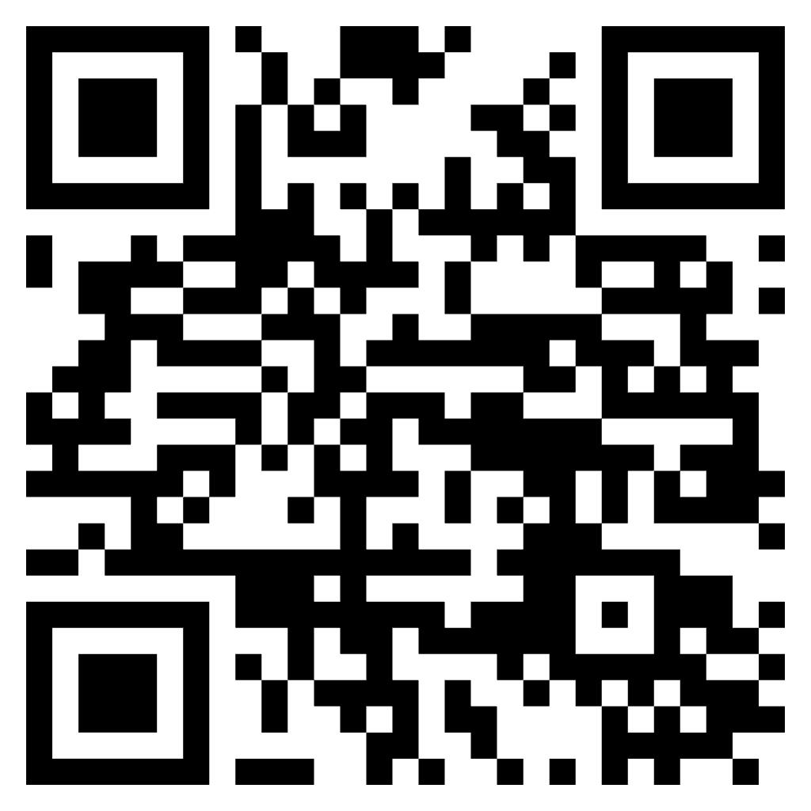

Thank you!
Jessica
Manchak
Questions? Let’s chat!
Contact me at: jmanchak@udel.edu
QR code to paper
Aishwarya
Chandrasekaran
Matthew Louis
Mauriello
University of Delaware
Sensify Lab
RESPECT 2026
Notes:
Women’s persistence is CS shaped not only by technical ability but by how institutions structure belonging, evaluation, and support across transitions
___
To conclude, this study suggests that women's persistence in computer science is shaped not only by technical ability, but by how institutions structure belonging, evaluation, and support across the transition from education to the workforce.
By better understanding that transition, we can move beyond simply recruiting women into computer science and toward creating environments that better support long-term participation.
Thank you, and I'm happy to take any questions.

