Slide 1


When to Check In? Identifying Early Signs of Student Struggle at Various Cut-Points in CS1 Course Data
Presented by Abigail Liu

Slide 2
Motivation
According to the 2024 CRA Taulbee Survey, introductory computer science (CS1) courses have received
  Large amounts of enrollment (Petersen 2016)
  Sizable dropout rates (Petersen 2016, Tims 2023)

Slide 3
Motivation
According to the 2024 CRA Taulbee Survey, introductory computer science (CS1) courses have received
  Large amounts of enrollment (Petersen 2016)
  Sizable dropout rates (Petersen 2016, Tims 2023)
Students do not always ask for help on their own
  (Hao 2017, Smith IV 2020, Kazerouni 2021)

Slide 4
Motivation
According to the 2024 CRA Taulbee Survey, introductory computer science (CS1) courses have received
  Large amounts of enrollment (Petersen 2016)
  Sizable dropout rates (Petersen 2016, Tims 2023)
Students do not always ask for help on their own
  (Hao 2017, Smith IV 2020, Kazerouni 2021)
Both factors make it difficult for CS1 instructors to provide interventions that are timely and personalized to students

Slide 5
Our work aims to design technologies to help CS1 instructors, using learning analytics (LA) to predict student struggle and performance

Slide 6

Research
Questions

Slide 7
RQ1: Can we predict student performance using common behavioral data features from LA literature?
RQ2: Which data features are most predictive at different times in the semester?
Research
Questions

Slide 8
RQ1: Can we predict student performance using common behavioral data features from LA literature?
RQ2: Which data features are most predictive at different times in the semester?
Research
Questions

Slide 9
Related Work
Educational data mining uses action log data to predict student performance
  Logs are a series of actions
  often in version control systems (VCS) or learning management systems (LMS)

Slide 10
Related Work
Educational data mining uses action log data to predict student performance
  Logs are a series of actions
  often in version control systems (VCS) or learning management systems (LMS)
Arakawa et al. (2022)
  Data from 312 students using GitHub
  Logged each time a student pushed a version of code to their repository

Slide 11
Related Work
Educational data mining uses action log data to predict student performance
  Logs are a series of actions
  often in version control systems (VCS) or learning management systems (LMS)
Arakawa et al. (2022)
  Data from 312 students using GitHub
  Logged each time a student pushed a version of code to their repository
Pinto et al. (2021)
  Data from 733 students using PrairieLearn
  Logged progress on programming homework, weekly quizzes, and cumulative exams

Slide 12
Current Datasets
Current Features and Predictive Methods
Small student samples
Hard to verify claims
Varying sets of data features
Hard to compare works

Slide 13
We examine how predictive data features are different cut-points across the semester
So how are we different from prior work?

Slide 14
Current Datasets
Our Dataset
Current Features and Predictive Methods
Our Features and Predictive Methods
Small student samples
Hard to verify claims
Large student sample from 30 course sections
Granular data collection allows for adaptable analyses
Varying sets of data features
Hard to compare works
Compare 16 features on a single dataset
Using a commonly used regression model

Slide 15
We examine how predictive LA data features are at different cut-points across the semester

Slide 16
Data Aggregation Methodology
Start of
semester
End of
week 2
End of
week 4
End of
week 6
End of
week 8
After 2 weeks
Aggregation
“After X weeks”
After 4 weeks
After 6 weeks
After 8 weeks

Slide 17

Bakery Evidence of Learning (EOL) Dataset
30 course sections between the Fall 2022 and Spring 2024 semesters
  21 sections for non-CS majors
  9 sections for CS majors

Slide 18
Bakery Evidence of Learning (EOL) Dataset
30 course sections between the Fall 2022 and Spring 2024 semesters
  21 sections for non-CS majors
  9 sections for CS majors
Logged every time a student compiles code for an assignment
  ~1,200 student samples
  ~2.2 million student compiles/ assignment submissions
  ~15 million unique code states

Slide 19
Dataset Analysis
Focus on 14 coding assignments from Python Bakery Curriculum, which cover fundamental concepts like
  Functions
  If statements
  Data structures

Slide 20
Dataset Analysis
Focus on 14 coding assignments from Python Bakery Curriculum, which cover fundamental concepts like
  Functions
  If statements
  Data structures
Pedal is an autograding framework for analyzing student code
  Gave feedback about unit tests, syntax errors, and other kinds of structural checks

Slide 21
Data Analysis
We focus on coding assignments because they occur regularly throughout the semester

Slide 22
Data Analysis
We focus on coding assignments because they occur regularly throughout the semester
Captures more nuance in student course progression

Slide 23
Data Analysis
We focus on coding assignments because they occur regularly throughout the semester
Captures more nuance in student course progression
May also reveal signs of struggle much earlier than exams or projects.

Slide 24
Model
Generalized linear mixed models (GLMMs), used in prior research
  Focused on logistic regression coefficients and p-values to assess the relationships between data features and course outcomes

Slide 25
Model
Generalized linear mixed models (GLMMs), used in prior research
  Focused on logistic regression coefficients and p-values to assess the relationships between data features and course outcomes
Focus on deviance scores to assess how well our models fit the data
  Lower values indicate a betterfit.

Slide 26
Model
Generalized linear mixed models (GLMMs), used in prior research
  Focused on logistic regression coefficients and p-values to assess the relationships between data features and course outcomes
Focus on deviance scores to assess how well our models fit the data
  Lower values indicate a betterfit.
Total of 8 separate regressions
  GLMM for 2, 4, 6, and 8 weeks of the semester for each of our two outcomes: final exam grades and final course grades

Slide 27
Model
Generalized linear mixed models (GLMMs), used in prior research
  Focused on logistic regression coefficients and p-values to assess the relationships between data features and outcomes
Focus on deviance scores to assess how well our models fit the data
  Lower values indicate a betterfit.
Total of 8 separate regressions
  GLMM for 2, 4, 6, and 8 weeks of the semester for each of our two outcomes: final exam grades and final course grades
Benjamini-Hochberg procedure to account for the false discovery rate

Slide 28
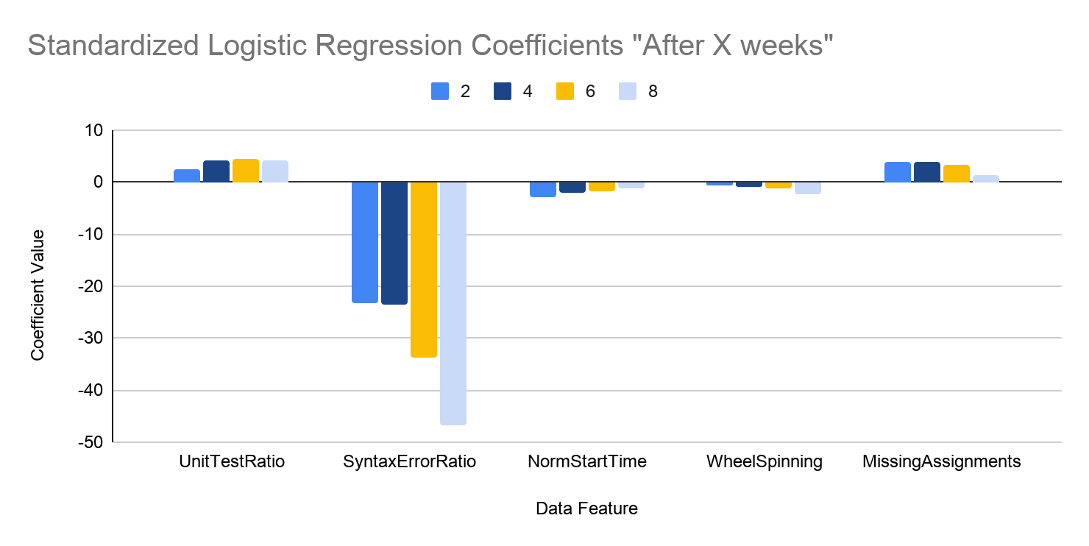
Results: Predicting Final Exam Grades
Statistically significant across all cut-points
  Accuracy in unit test problems
  Amount of syntax errors
Statistically significant at a subset of cut-points
  How early a student starts an assignment
    (after 2, 4, and 6 weeks)
  Whether a student experiences wheel-spinning
    (after weeks 6 and 8)
  How many missing assignments
    (after 2 and 4 weeks)
Decreasing deviance scores →
  Model fits better with more semester data
*
*
*
*
*
*
*
*
*
*
*
*
*
*
*

Slide 29
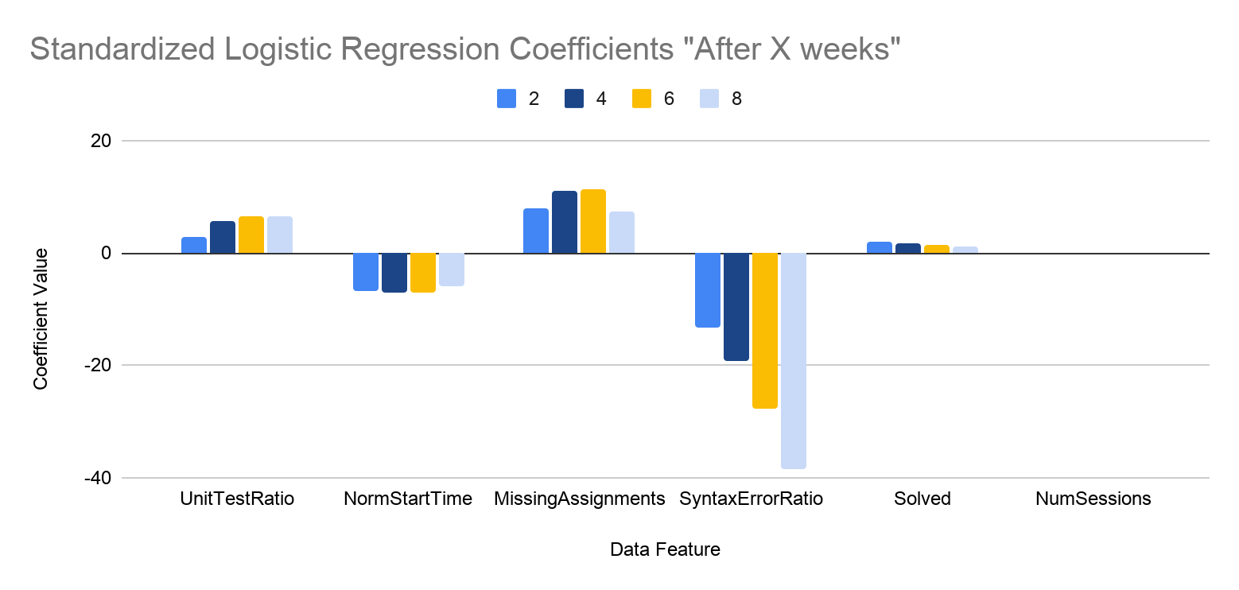
Results: Predicting Final Course Grades
Statistically significant across all cut-points
  Accuracy in unit test problems
  How early a student starts an assignment
  How many missing assignments
Statistically significant at a subset of cut-points
  Amount of syntax errors
    (after weeks 4, 6, and 8)
  Whether a student got 100% on an assignment
    (after weeks 2 and 4)
  Number of coding sessions
    (after weeks 2 and 4)
Decreasing deviance scores →
  Model fits better with more semester data
  Model fits better with final course grade
*
*
*
*
*
*
*
*
*
*
*
*
*
*
*
*
*
*
*

Slide 30
Discussion + Future Work
During the semester, the complexity of course materials increases
  Students’ coding behaviors may also change across the semester
  These changes are reflected in the statistical significance for some data features

Slide 31
Discussion + Future Work
During the semester, the complexity of course materials increases
  Students’ coding behaviors may also change across the semester
  These changes are reflected in the statistical significance for some data features
Students may attempt fewer assignments later in the semester
  Due to several factors, like balancing effort between other courses or losing motivation
  This decrease in attempts affects effort-based data features

Slide 32
Discussion + Future Work
During the semester, the complexity of course materials increases
  Students’ coding behaviors may also change across the semester
  These changes are reflected in the statistical significance for some data features
Students may attempt fewer assignments later in the semester
  Due to several factors, like balancing effort between other courses or losing motivation
  This decrease in attempts affects effort-based data features
Our chosen data features do not require any special calculations
  Could be implemented into a dashboard for instructors
  Could be used to identify patterns and early warning signs within student behavior, allowing instructors to intervene in a timely manner

Slide 33
Limitations
Analysis did not include other course materials like
  Midterm exams
  Projects
  More advanced assignments (in 2nd half of semester)

Slide 34
Limitations
Analysis did not include other course materials like
  Midterm exams
  Projects
  More advanced assignments (in 2nd half of semester)
We only test at cut-points at 2-week intervals

Slide 35
Limitations
Analysis did not include other course materials like
  Midterm exams
  Projects
  More advanced assignments (in 2nd half of semester)
We only test at cut-points at 2-week intervals
Our dataset is from one institution and only 2 CS1 courses

Slide 36
Conclusion
Compared 16 common behavioral data features from LA literature to predict student struggle and performance

Slide 37
Conclusion
Compared 16 common behavioral data features from LA literature to predict student struggle and performance
For the final exam and course grade, student accuracy on unit test problems was a statistically significant predictor across all cut-points
  Statistical significance of other features changed as the semester progressed

Slide 38
Conclusion
Compared 16 common behavioral data features from LA literature to predict student struggle and performance
For the final exam and course grade, student accuracy on unit test problems was a statistically significant predictor across all cut-points
  Statistical significance of other features changed as the semester progressed
These data features can be implemented into a dashboard tool to help CS1 instructors provide timely student interventions, powered by temporally contextual analysis

Slide 39








Special thanks to my collaborators!
Contact Info:
apliu@udel.edu
www.linkedin.com
/in/abigailpliu/
Abigail Liu
Sammy Alashoush
Austin Cory Bart
Teomara Rutherford
Check out our paper!
Nazim Karaca
John Aromando Jr.
Matthew Mauriello

Slide 40
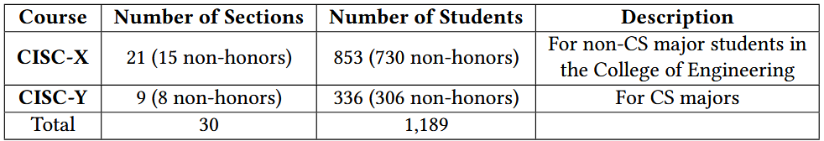
EOL Dataset Information

Slide 41
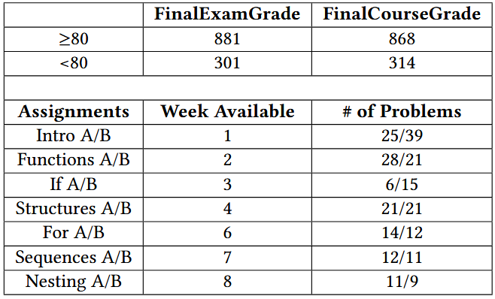
EOL Data Information

Slide 42
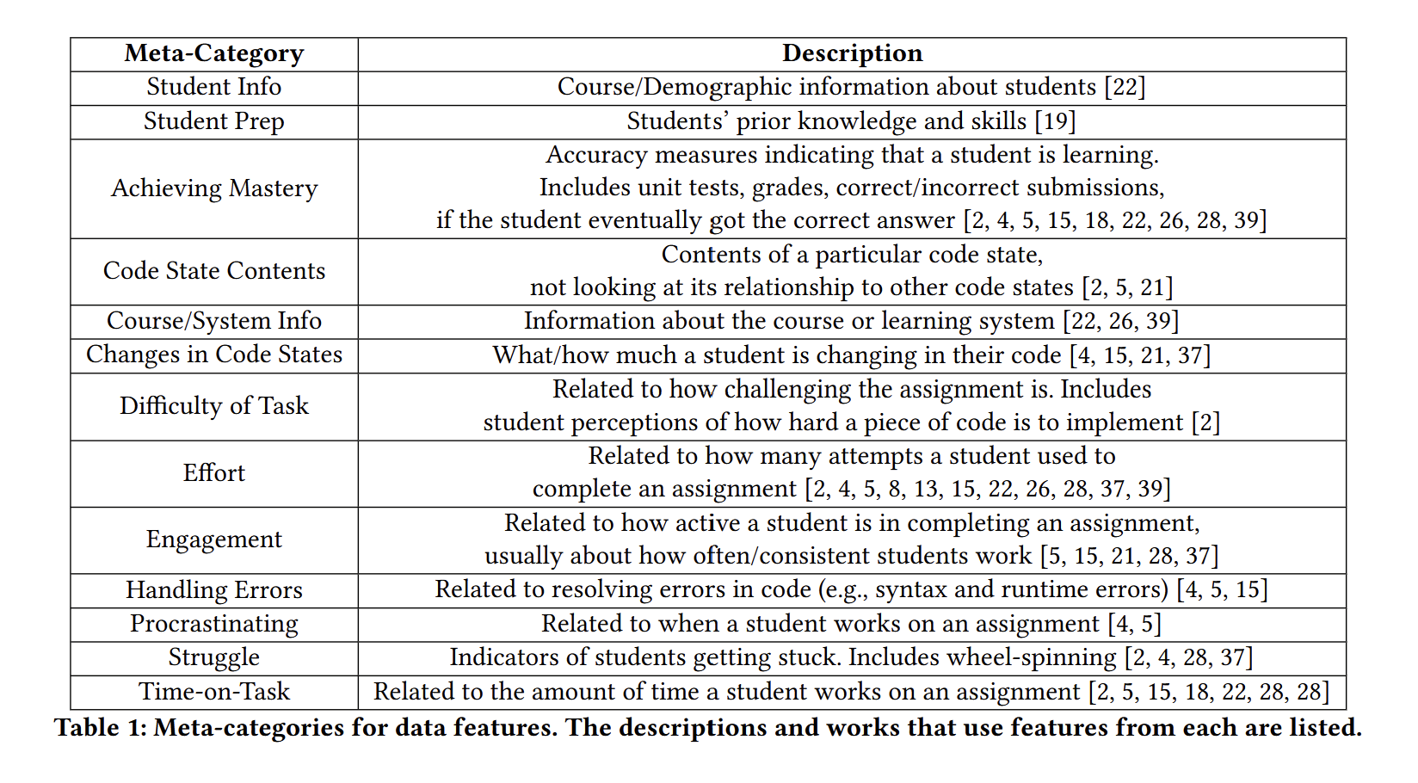
Data Features Literature Review

Slide 43
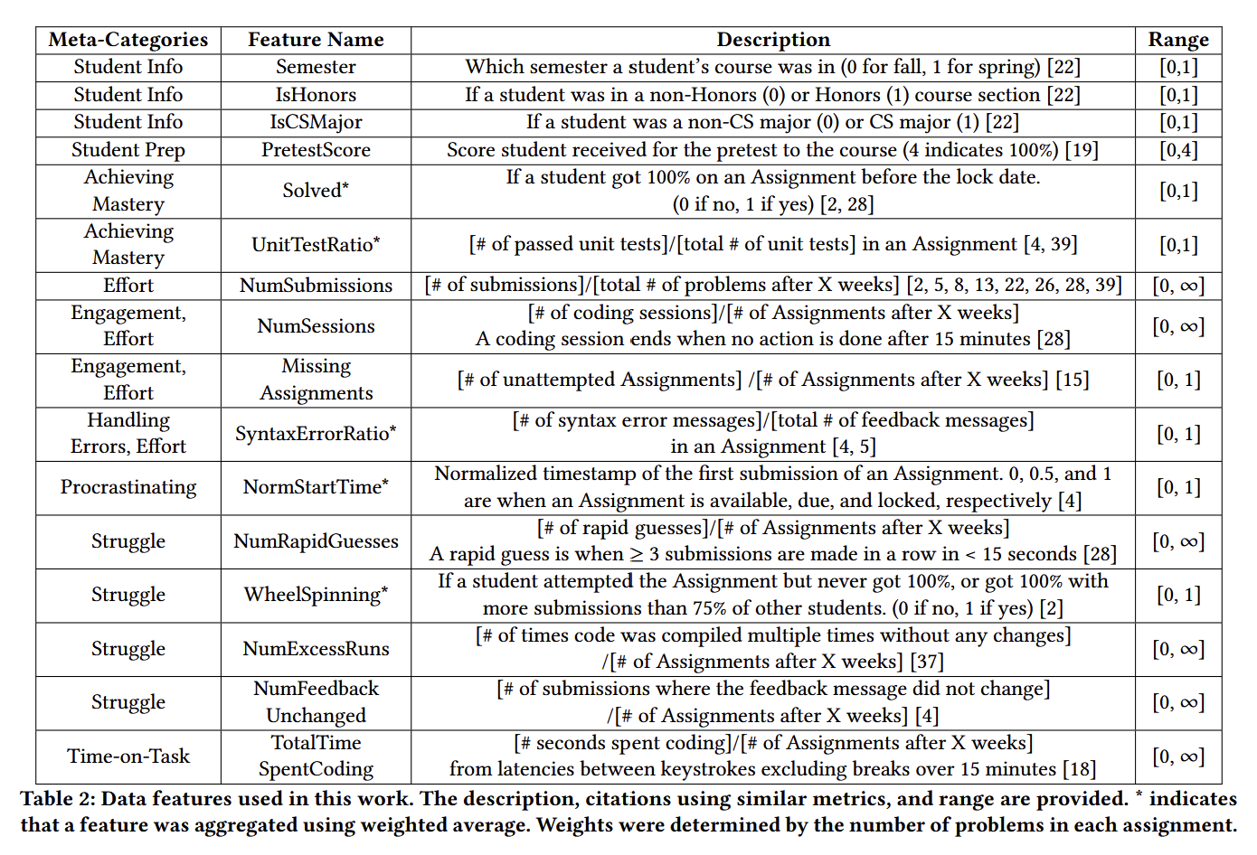
Features used in this work

Slide 44
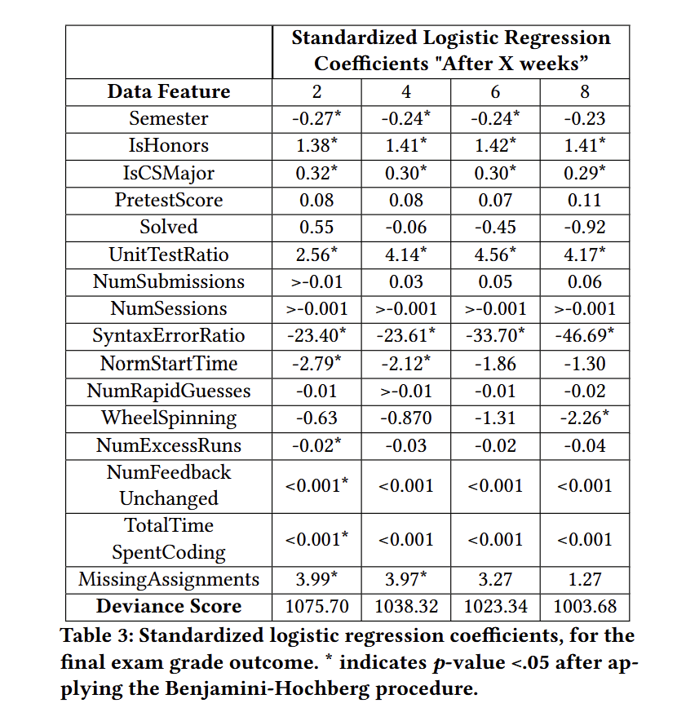
Results: Predicting Final Exam Grades
Statistically significant across all cut-points
  Accuracy in unit test problems
  Amount of syntax errors
Statistically significant at a subset of cut-points
  How early a student starts an assignment
    (after 2, 4, and 6 weeks)
  Whether a student experiences wheel-spinning
    (after weeks 6 and 8)
  How many missing assignments
    (after 2 and 4 weeks)
Decreasing deviance scores →
  Model fits better with more semester data

Slide 45
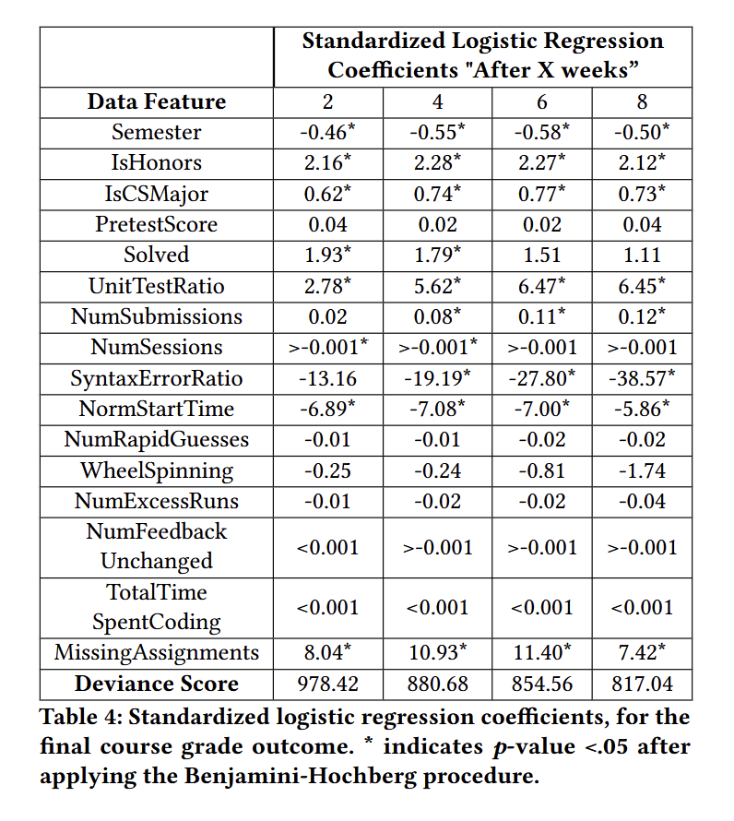
Results: Predicting Final Course Grades
Statistically significant across all cut-points
  Accuracy in unit test problems
  How early a student starts an assignment
  How many missing assignments
Statistically significant at a subset of cut-points
  Amount of syntax errors
    (after weeks 4, 6, and 8)
  Whether a student got 100% on an assignment
    (after weeks 2 and 4)
  Number of coding sessions
    (after weeks 2 and 4)
Decreasing deviance scores →
  Model fits better with more semester data
  Model fits better with final course grade

Slide 46
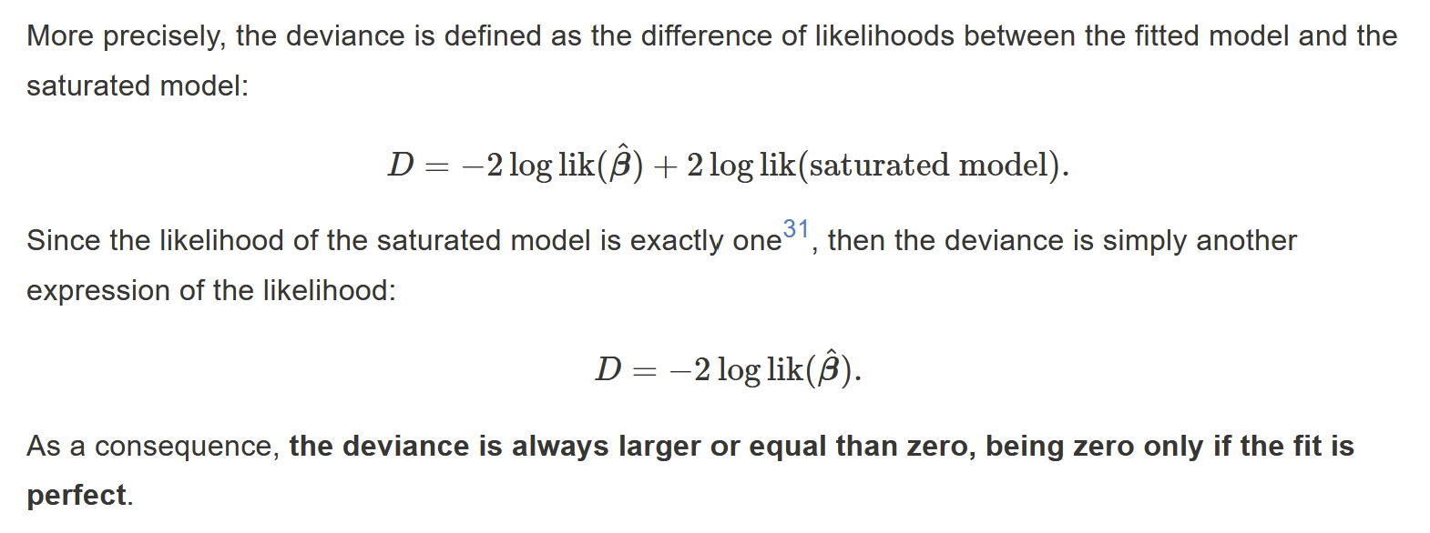
Deviance

Slide 47
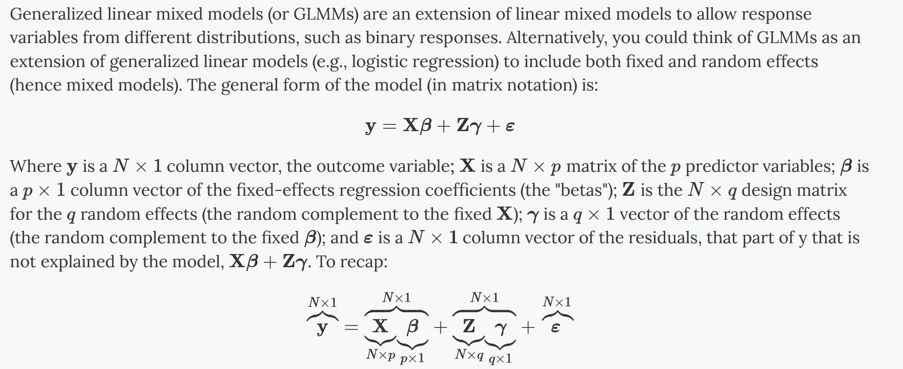
GLMM

Slide 48
When to Check In?
Identifying Early Signs of Student Struggle at
Various Cut-Points in CS1 Course Data
Thank you!
Presented by Abigail Liu
ITiCSE 2026
Abigail Liu, Sammy Alashoush, Austin Cory Bart, Teomara Rutherford, Nazim Karaca, John Aromando Jr., and Matthew Louis Mauriello. 2026. When to Check In?: Identifying Early Signs of Student Struggle at Various Cut-Points in CS1 Course Data. In Proceedings of the 31st ACM Conference on Innovation and Technology in Computer Science Education V. 1 (ITiCSE 2026), July 10–15, 2026, Madrid, Spain. ACM, New York, NY, USA, 7 pages.https://doi.org/10.1145/3803400.3809327

Slide 49
References
Kai Arakawa, Qiang Hao, Wesley Deneke, Indie Cowan, Steven Wolfman, and Abigayle Peterson. 2022. Early identification of student struggles at the topic level using context-agnostic features. In Proceedings of the 53rd ACM Technical Symposium on Computer Science Education-Volume 1. 147–153.
Augie Doebling and Ayaan M Kazerouni. 2021. Patterns of academic help-seeking in undergraduate computing students. In Proceedings of the 21st Koli Calling International Conference on Computing Education Research. 1–10.
Qiang Hao, Brad Barnes, Robert Maribe Branch, and Ewan Wright. 2017. Predicting computer science students’ online help-seeking tendencies. Knowledge Management & E-Learning: An International Journal 9, 1 (2017), 19.
Andrew Petersen, Michelle Craig, Jennifer Campbell, and Anya Tafliovich. 2016. Revisiting why students drop CS1. In Proceedings of the 16th Koli Calling International Conference on Computing Education Research. 71–80.
Juan D Pinto, Yingbin Zhang, Luc Paquette, and Aysa Xuemo Fan. 2021. Investigating elements of student persistence in an introductory computer science course. In 5th Educational Data Mining in Computer Science Education (CSEDM) Workshop.
Katie Siek and Jasmine Batten. 2024. Taulbee Survey 2024: Annual Report. Computing Research Association (2024).
David H Smith IV, Qiang Hao, Vanessa Dennen, Michail Tsikerdekis, Bradly Barnes, Lilu Martin, and Nathan Tresham. 2020. Towards Understanding Online Question & Answer Interactions and their effects on student performance in large-scale STEM classes. International Journal of Educational Technology in Higher Education 17 (2020), 1–15.
Jodi L Tims, Cindy Tucker, Mark A Weiss, and Stuart Zweben. 2023. Computing Enrollment and Retention: Results from the 2021–22 Undergraduate Enrollment Cohort. ACM Inroads 14, 4 (2023), 24–43.

